Slide 1
European Open Science Cloud and e-Infrastructures work-programme 2016-2017 DI4R – Krakov - 28th September 2016
Augusto BURGUEÑO ARJONA
Head of Unit e-Infrastructure and Science Cloud
DG CNECT - European Commission

Slide 2
The European Cloud Initiative
European Open Science Cloud (EOSC)
Integration and consolidation of e-infrastructures
Federation of existing research infrastructures and scientific clouds
Development of cloud-based services for Open Science
Connection of ESFRIs to the EOSC
European Data Infrastructure (EDI)
Development and deployment of large-scale European HPC, data and network infrastructure
Widening access
SMEs, Industry at large, Government

Slide 3
EOSC & EDI: Static View on Year 2020 (over-simplification)
Industry
Scientific Users
Public Sector
European Open Science Cloud
European Data Infrastructure

Slide 4
EOSC & EDI: Dynamic View from 2016 to 2020 (over-simplification)
ESFRIs, RIs and scientific clouds
European Open Science Cloud
European Data Infrastructure
e-Infrastructures
2016
2020

Slide 5
Widening access (1/2): e-Infrastructures as service providers
Public Sector
Scientific Users
Industry
EOSC
e-Infrastructures

Slide 6
Widening access (2/2): e-Infras as aggregators of demand
Scientific Users
€
EOSC
EU H2020
funding
e-Infrastructures
Grants
€
Procurement
Commercial services

Slide 7
The European Open Science Cloud will encompass data, computing and networking services for the benefit of the whole scientific community and beyond … and Horizon 2020 is accelerating the implementation of the European Open Science Cloud and widening policy by supporting European e-Infrastructure platforms and projects to become European Open Science Cloud service providers and demand aggregators
In short …

Slide 8
e-infrastructures are the foundation of the European Open Science Cloud
https://ec.europa.eu/futurium/en/content/e-infrastructures-making-europe-best-place-research-and-innovation

Slide 9
Contribution of e-Infrastructure (H2020 Excellence in Science)
Theme 1:
Integration and consolidation of e-infrastructures
services
Theme 2:
Prototyping of innovative e-infrastructure services

Slide 10
Interplay between Theme 1 and Theme 2: a dynamic view
E-infrastructure Operational services
European Open Science Cloud
Theme 1: Integration and consolidation
Theme 2: Innovation
Prototypes of new e-infrastructure services
New service
prototypes
WP 16/17 (220M€)
WP 18/20 (440M€)
2020 and beyond

Slide 11
Concrete steps
Theme 1 – EINFRA-12-2017 – Data and distributed computing e-infrastructures for Open Science (€40 M€)
Integration and consolidation of e-infrastructure services
Theme 2 – EINFRA-21-2017 – Platform-driven e-infrastruct. innovation (€20 M€)
Service development
INFRASUPP-02-2017(3) – Support to the Research Data Alliance (RDA) (€3.5M€)
Closing date: 29/3/2017

Slide 12
EINFRA-12-2017(a) Secure and agile data and distributed computing e-infrastructures
Integration of resources exposing them through a dynamic registry and catalogue of services
Engagement with user communities
Promoting interoperability with similar infrastructures and exploiting economies of scale
Interoperability of pan-European thematic e-Infrastructures
Expected EU contribution: EUR 10 to 15 million
Maximum: EUR 30 million

Slide 13
EINFRA-12-2017(b) Access and preservation platforms for scientific information
Support of publishing platforms and services for scientific information linking institutional and thematic repositories across Europe
Collection of bibliometric data on publications, citations etc. on all Horizon 2020 scientific output. Delivery of standard and on-demand statistics.
Expected EU contribution: EUR 8 to 10 million
Maximum: EUR 10 million

Slide 14
Evaluation criteria for EINFRA-12-2017
Excellence
TRL8 required before the start of the project
Quality of the catalogue of services
Key Performance Indicators (measurements and baseline)
Impact
Potential to enhance capacity for innovation and production of new knowledge

Slide 15
Implementation mechanism for EINFRA-12-2017
All proposals responding to this call will be evaluated by the same expert evaluators
Additional experts (external board) will help the Commission to identify potential synergies, overlaps and gaps in the overall service offering of retained proposals (amendment in WP)
Successful proposals will conclude complementary grants with the Commission, which requires them to sign collaboration agreements among themselves
The Commission will encourage projects to take into consideration the findings on synergies, overlaps and gaps when concluding their collaboration agreements
After six months of grant agreement signature, the Commission will convene the external board to assess the collaboration agreements
Reviews for these projects will be run jointly

Slide 16
EINFRA-21-2017(b.1) e-Infrastructure prototypes for universal discoverability of data objects and provenance
Service prototype for the uptake of a Digital Identifier for digital objects across disciplines and geographical areas
Promote federation of locally operated systems to ensure interoperability
Address requirements from all relevant stakeholder groups
Expected EU contribution: EUR 4 to 5 million

Slide 17
EINFRA-21-2017(b.2) Computing e-infrastructure prototypes with extreme large datasets
Service prototyping for dealing with very large data resources
Support by robust mathematical methods and tools following an open source approach and aiming at common interfaces
New model approaches to HPC and data management are encouraged
Expected EU contribution: EUR 2.5 to 3 million

Slide 18
Evaluation criteria for EINFRA-21-2017
Excellence
TRL 6 (min.) required before the start of the project and achieving at least TRL 8 by the end
The extent to which the proposed activities will improve, in quality and/or quantity, the services provided by state of the art e-infrastructures
Impact
Potential to enhance capacity for innovation and production of new knowledge

Slide 19
INFRASUPP-02-2017(3): European support to RDA
Support the emergence of a data infrastructure fostering interoperability
Support the RDA secretariat for
Logistics
Open access to RDA documents
Dissemination activities
Financial support for European stakeholders to engage in RDA processes
In particular, support to ESFRI infras and other communities
Expected EU contribution: EUR 3 to 3.5 million
Maximum: EUR 3.5 million

Slide 20
Future: WP18-20
More European Open Science Cloud
More European Data Infrastructure
More widening
More service provision and development
More agregation of demand
More integration
More consolidation

Slide 21
Thanks!

Slide 22
Back-up

Slide 23
Digital Single Market Technologies and Public Service Modernisation Package
Digitising European Industry
SWD on Advancing the Internet of Things
European Cloud Initiative
SWD on High-Performance Computing
SWD on Quantum Technologies
Priorities for ICT Standardisation
E-Government Action Plan
Adopted on 19 April 2016

Slide 24
Why Europe is not yet fully tapping into the potential of data?
Data coming from publicly funded research is not always open due to lack of clear incentives
Lack of general framework for the reuse of data
Lack of data interoperability
Fragmentation of data infrastructures (geographic, thematic, technological, governance)
Offer does not match demand in world-class High Performance Computing (HPC) infrastructures

Slide 26
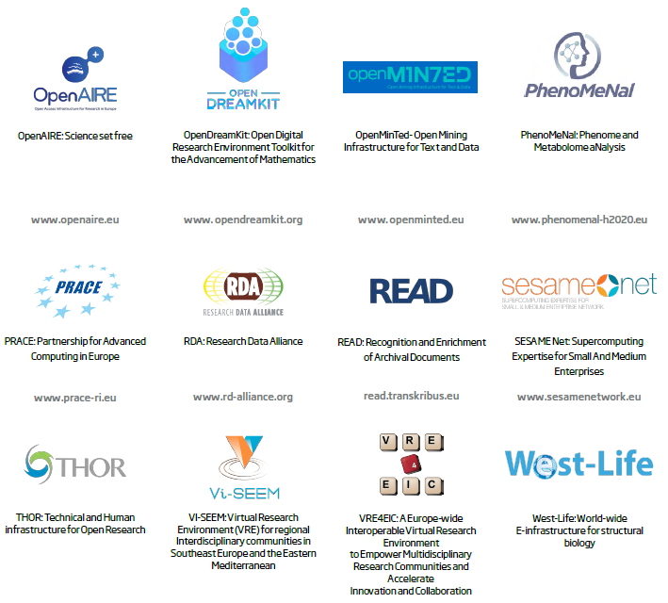

Slide 27
Successful governance and funding mechanisms are already in place …

Slide 28
Pan-European e-infrastructures with specific governance and funding models

Slide 30
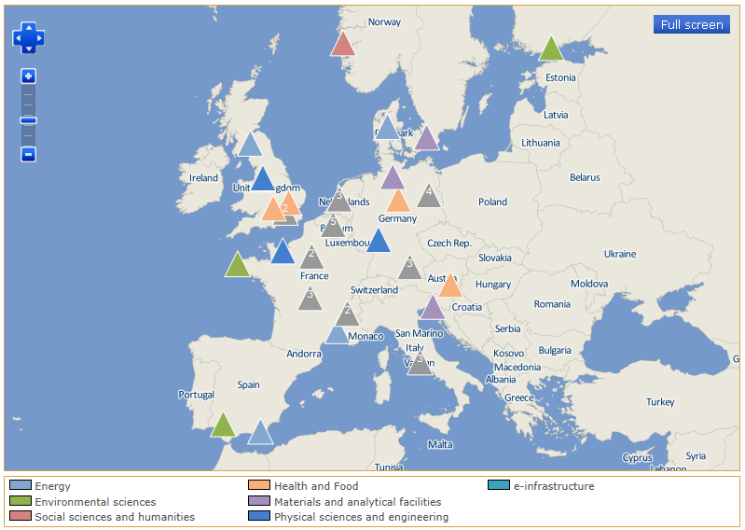
Pan-European Research Infrastructures

Slide 31
And to complete the picture consider also international, national, regional, local, institutional, commercial and other research infrastructures and e-infrastructures

Slide 32
So, with all that in mind, how should the current governance and funding mechanisms be adapted to support the:
Integration and consolidation of e-infrastructures
Federation of existing research infrastructures and scientific clouds
Development of cloud-based services for Open Science
Connection of ESFRIs to the European Open Science Cloud

Slide 33
Introducing the new C1 team ☺
Head of Unit Augusto Burgueño Arjona
Deputy Head of Unit Cristina Martinez
Research Data Policy Sector Celina Ramjoué
Administrative Support Gaëlle Velge
Patricia Heindryckx
Amel Ayatellah
Financial Officers Rudi Gschnitzer
David Belle
Communication Officer Stéphanie Matt
Project Officers Jean-Luc Dorel
Enrique Gomez Martinez
Martin Majek
Pilar Ocon-Garces
Georgeta Serafim

Slide 34
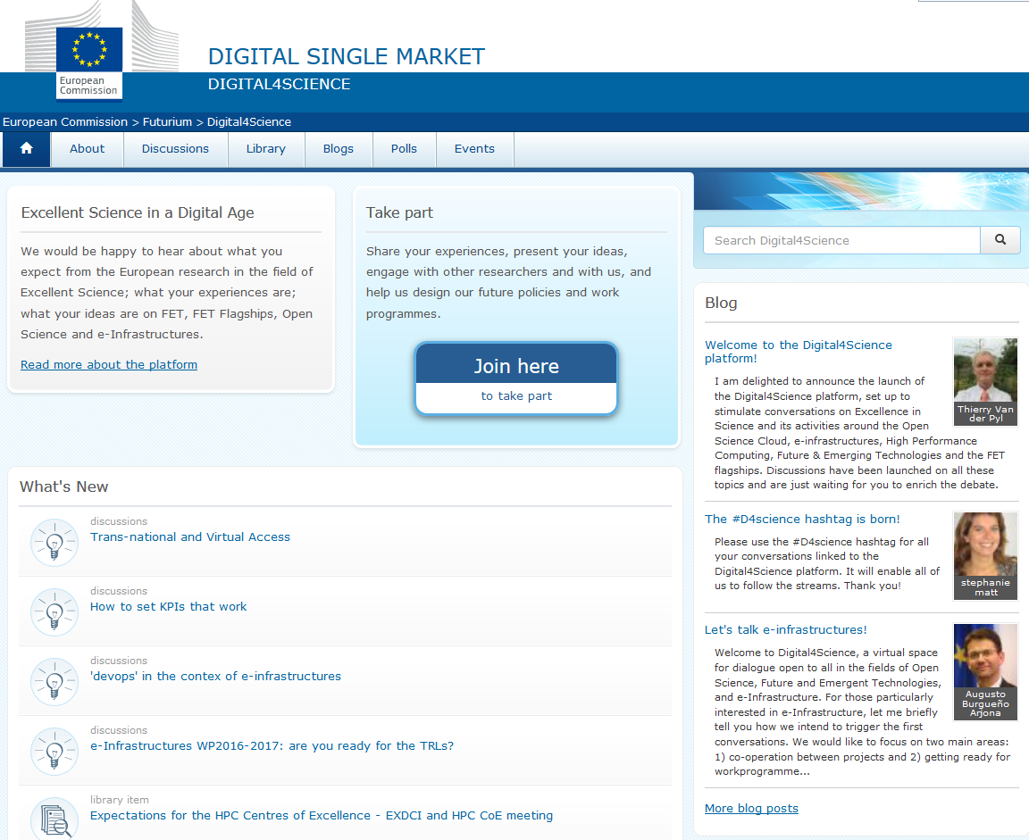
The Digital4Science platform
www.ec.europa.eu/d4science
#D4Science
@ICTscienceEU @FET_EU @FETflagships @eInfraEU

