Slide 1
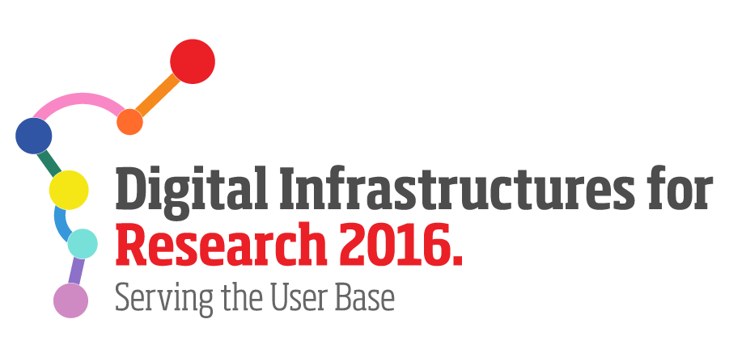
CESSDA (1)
Consortium of European Social Science Data Archives www.cessda.net
Mission: “To provide a full scale sustainable research infrastructure that enables the research community to conduct high-quality research in the social sciences which can contribute inter alia to effective solutions to the major challenges facing society today.”
Use of eInfrastructures:
Knowledge sharing and technical know-how
Sharing Requirements/Use cases
Best practices

Slide 2
CESSDA (2)
Better coordinate service delivery across RIs?
Central hub, expert groups, etc.
To increase participation of RI representatives in eInfrastructures:
Partnership agreements (different levels) & Yearly fee;
Definition of interoperability levels (complying with requirements and standards);
Definition of Road-map, Work plans, Outcomes;
Regular technical meetings (for knowledge-sharing and etc.)
….

