Slide 1
Challenges for researchers in the Digital Humanities Custom development vs. sustainable research infrastructures
Roxanne Wyns
Roxanne.Wyns@kuleuven.be

Slide 2
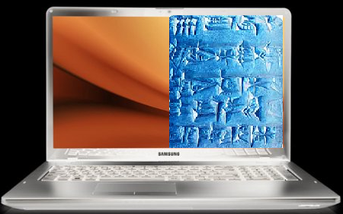
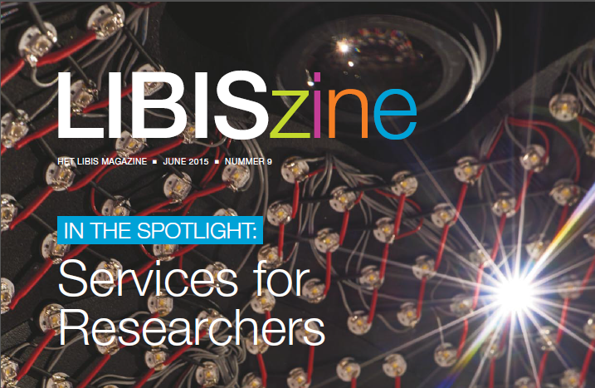
Digital Humanities @ KU Leuven
Digital Humanities (DH)
@ KU Leuven
& LIBIS
Cross-section between IT & Humanities
Emerging and hot
Services for researchers
Usage of digital tools and IT techniques to enhance research (text mining, data visualization …)
DH summer school
Master in DH
Partner in DARIAH-VL
Steadily growing number of projects
Division of LRD
Part of University Library
Information solutions and services for GLAM and digitally supported research

Slide 3
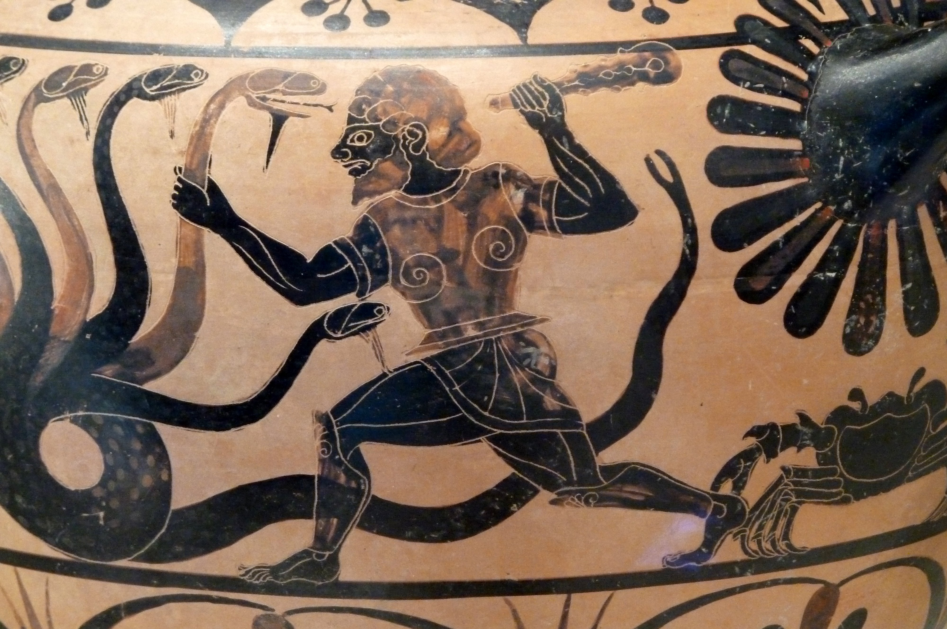
From GLAM to research tools
European projects (FP7)
Focus on digital cultural heritage tools & infrastructures
Evolution towards research tools & infrastructures since 2013
Hercules infrastructure call
Flemish investment fund (now FWO)
For the purchase / development of infrastructures to support research
Call opens every 2 years
Budget divided among main universities
Some context
Hercules fighting Hydra
Source: commons.wikimedia.org

Slide 4
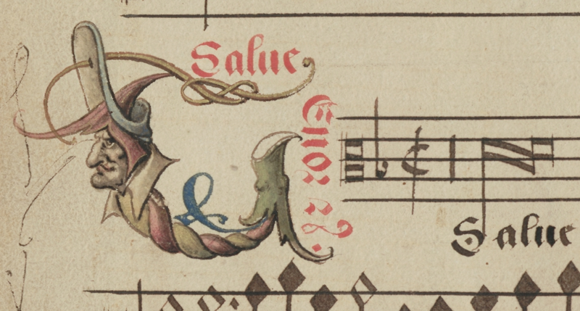
From GLAM to research tools
Alamire Foundation
International Centre for the Study of Music in the Low Countries
Digitize medieval music manuscripts at high resolution for research
Proposal writing
Collaborative approach between researchers and technical partners (LIBIS, ESAT)
Revision phase
Funded, but budget was heavily reduced
IDEM project – Hercules call 2013
Manuscript illumination.
Probably created by the workshop of Petrus Alamire for the Illustrious Brotherhood of Our Lady in 's-Hertogenbosch (around 1530’s).
Source: idemdatabase.org

Slide 5
From GLAM to research tools
Project budget:
Main budget preserved for storage & long term preservation
Limited resources for database, website, and viewer
No budget for post-project maintenance and support
IDEM project – Hercules call 2013
Budget cut on post-project maintenance influenced the selection of tools

Slide 6
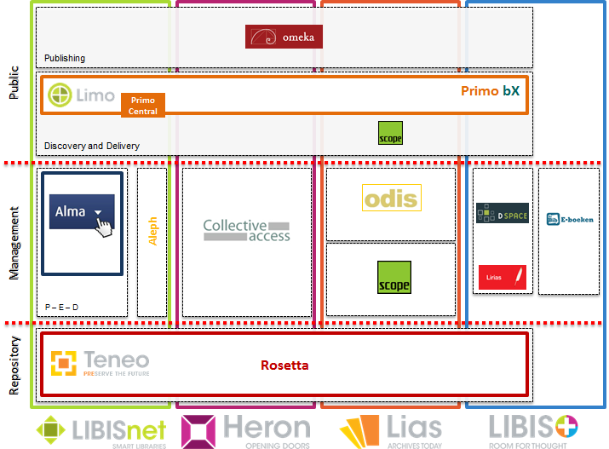
From GLAM to research tools
Decision to:
Reuse a combination of existing tools in a flexible way
Use open source where possible to limit the license costs
Share the development costs with projects with similar interests
IDEM project (2014 – 2015)
Clear communication on pros & cons of offered tools and total cost of ownership

Slide 7
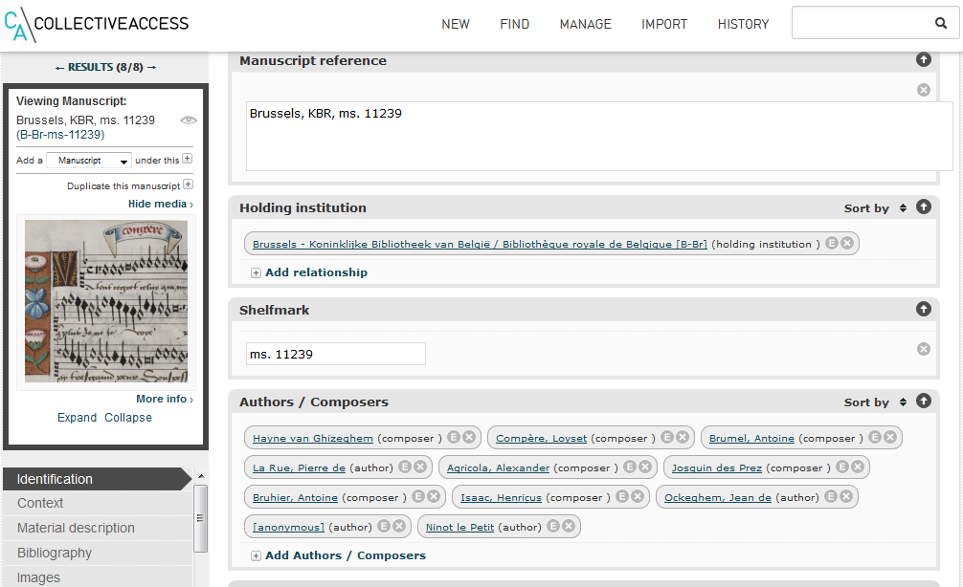
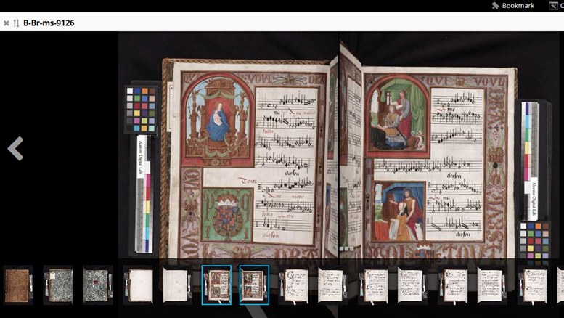
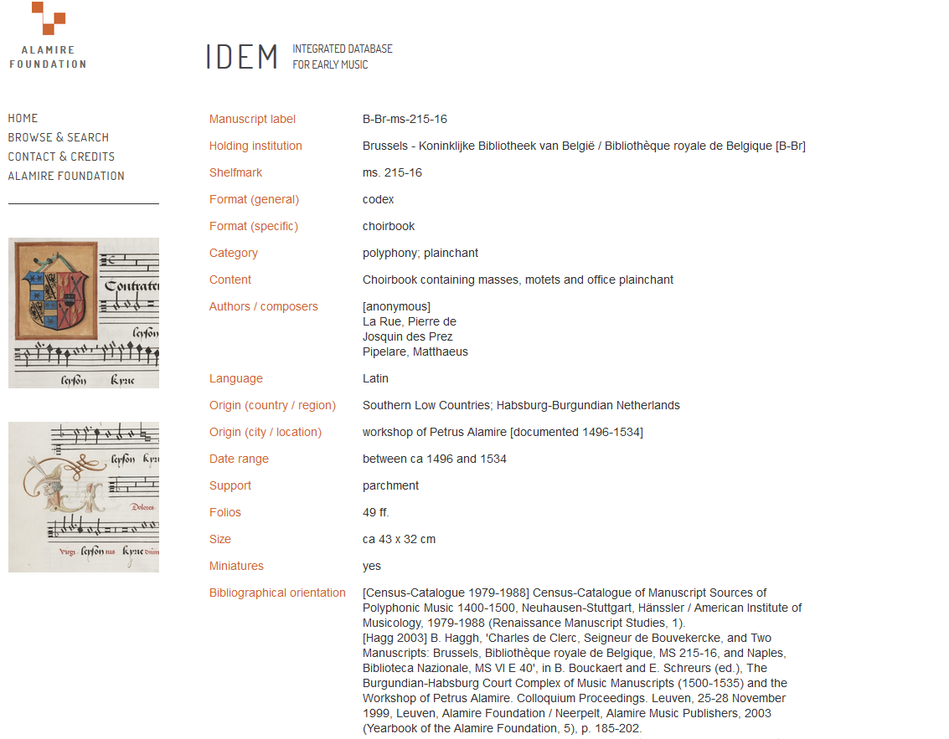
IDEM project - tools & infrastructure
CollectiveAccess
Rosetta & IIIF Mirador
Omeka
Collaborative research database
Preservation & visualisation of the research objects
Online publication and access to the research data
Web application
Flexible data modeling
Suitable for collaboration
Open source
Long term preservation
Persistent identification
Access to high resolution images in a novel way
Propriety and open source
Flexible web publishing for GLAM & scholarly collections
Lot’s of plug-ins, strong community
Open source

Slide 8
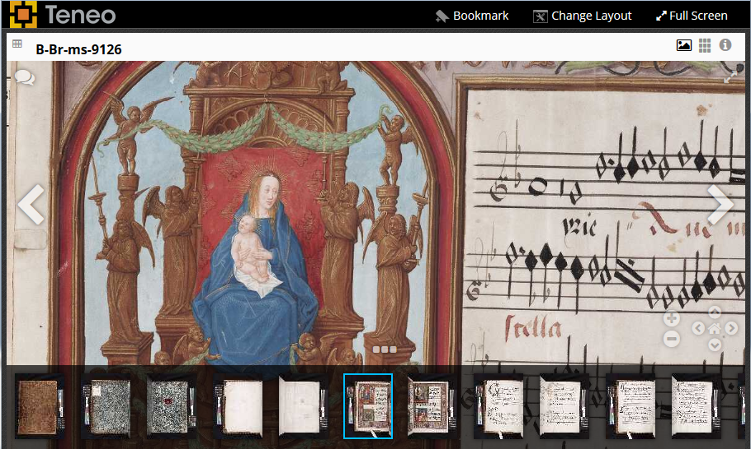
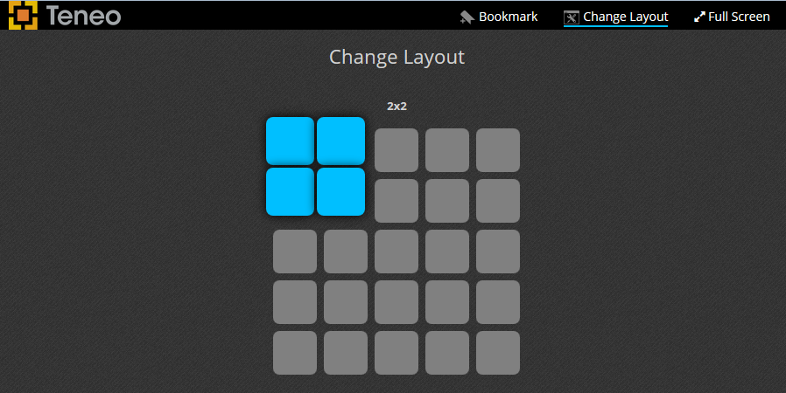
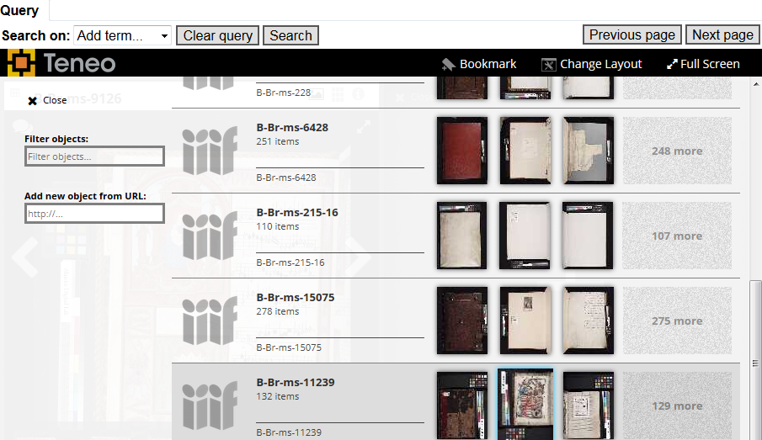
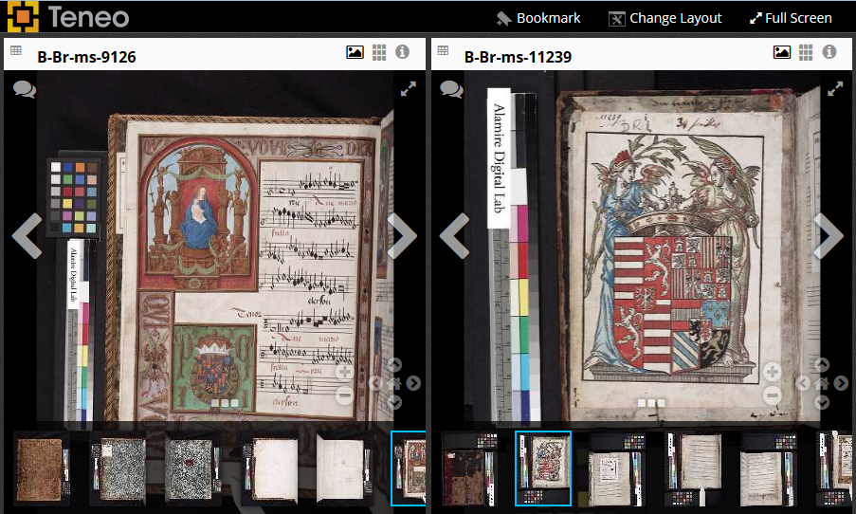
Growing number of partnerships through investments and diversification of services

Slide 9
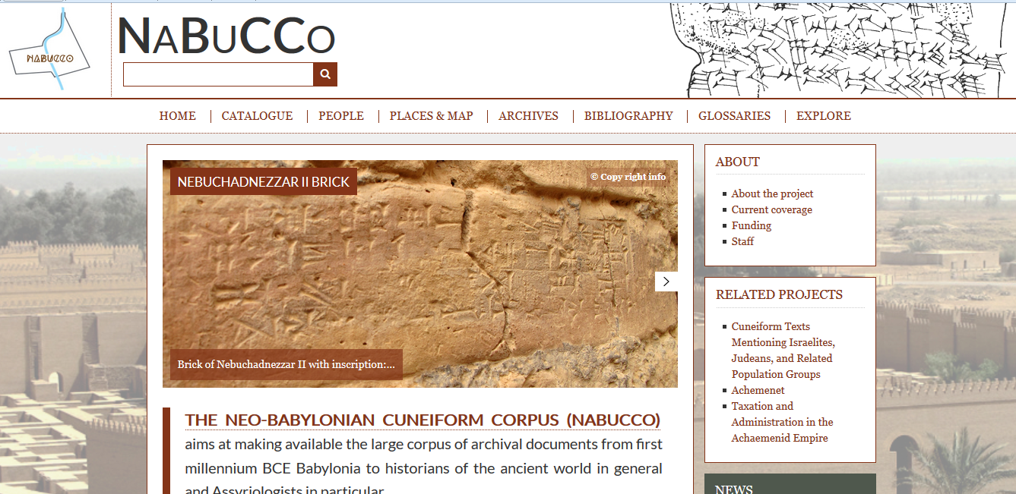
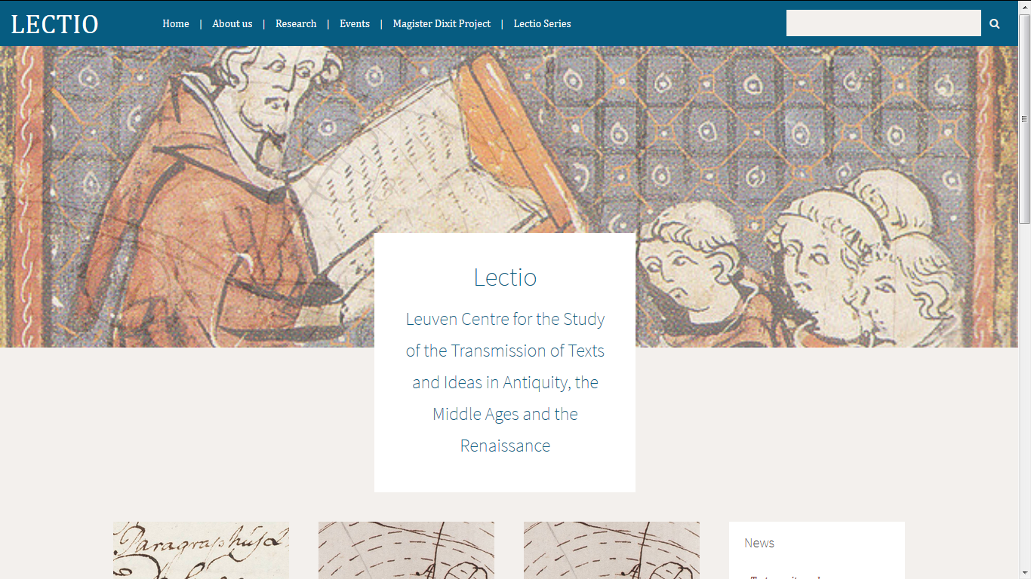
Development partner in Digital Humanities projects
NaBuCCo
Magister Dixit
Near Eastern Studies
Lectio research group
Text oriented database and website of Babylonian sources
Metadata model focused on research of texts content
Web access for researchers, also attractive for wider audiences
Post-project sustainability through faculty support
Research on the collection of handwritten lecture notes of the ancient University of Louvain (1425-1797)
Digitally restored and online accessible
Post-project sustainability by the research group, but …
Data keeps growing

Slide 10
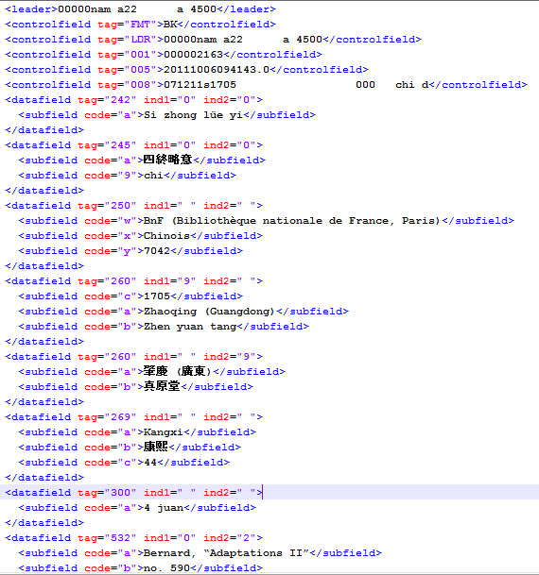
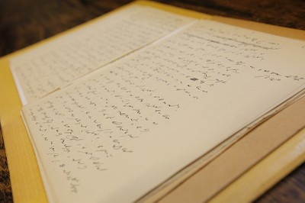
Development partner in Digital Humanities projects
CCT
DigitalHusserl
Sinology research unit
Centre for Phenomenology & Continental Philosophy
Chinese Christian Texts Database
Research on primary and secondary sources concerning the cultural contacts between China and Europe
Chinese (+ pinyin), western languages
Migration from MARC standard to relational data structure
A standardised version could be suitable for other humanities researchers
Funding by the Hercules foundation
Collaborative research environment with tools to create virtual editions, collaboratively annotate and transcribe Husserl's work (stenographs)
Extra attention for sustainability

Slide 11
Challenges
Source: http://www.kazyoung.com/

Slide 12
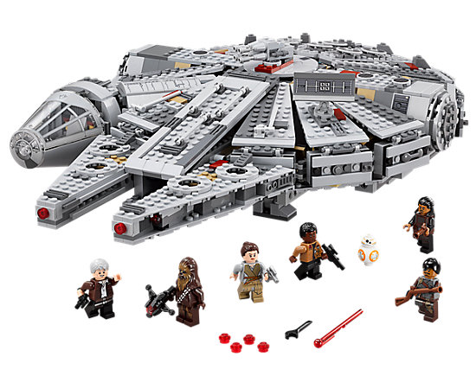
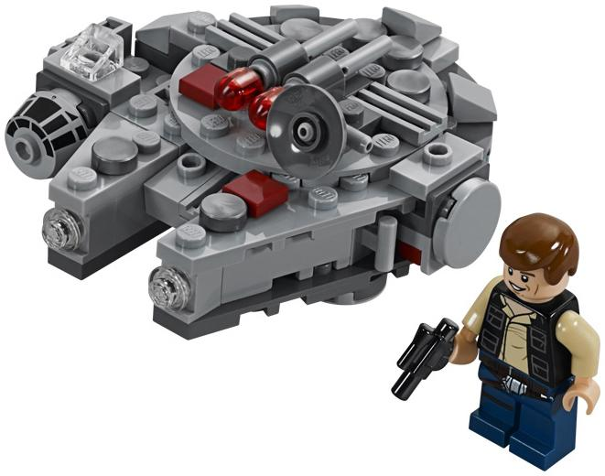
Challenges
Budget vs. Requirements
Budget for IT usually underestimated by humanities researchers

Slide 13
Challenges
Technical knowhow
Things can be challenging, but awareness and IT knowledge are growing

Slide 14
Challenges
Sustainability
Costs for maintenance, storage and support remains the biggest challenge for humanities research groups
TB

Slide 15
Opportunities
Source: http://www.kazyoung.com/

Slide 16
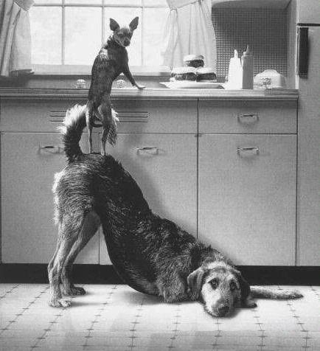
Opportunity
Collaboration
Clear communication on the limitations and what to expect (TCO)
Working together to achieve our goals
Willingness to collaborate and share developments is growing
Alternative financing mechanisms for post-project sustainability
Source: https://www.pinterest.com/pin/132926626478982555/

Slide 17
Benefits for DH researchers
Technical research support services at the University
Have access to both financial and personnel resources to execute technology projects
Can interpret and translate the research needs into technical requirements
Can serve as a bridge between DH researchers and research infrastructures
Can provide qualitative, scalable, affordable and reusable services
Can link up with other service providers and vendors to achieve technical innovation
Are the best guarantee for technical and financial sustainability

