Slide 1
PRACE and the Services for the Users
G. Erbacci, (CINECA and PRACE)
Introduction to European einfrastructures
DI4R, Krakow 28-30 September 2016

Slide 2
Partnership for Advanced Computing in Europe
PRACE is an international not-for-profit association under Belgian law, with its seat in Brussels.
PRACE counts 25 members and 2 observers.
The PRACE Hosting Members are France, Germany, Italy and Spain.
PRACE is governed by the PRACE Council in which each member has a seat. The daily management of the association is delegated to the Board of Directors.
PRACE is funded by its members as well as through a series of implementation projects supported by the European Commission.

Slide 3
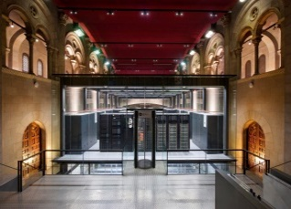
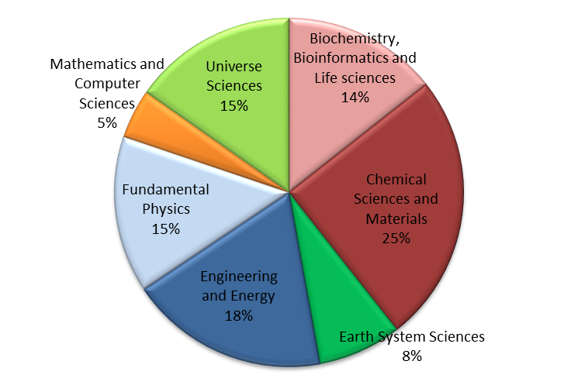
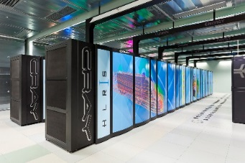
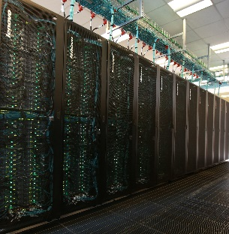
4 Hosting Members offering core hours on 6 world-class machines
JUQUEEN: IBM BlueGene/Q
GAUSS/FZJ
Jülich, Germany
SuperMUC: IBM
GAUSS/LRZ Garching, Germany
MareNostrum: IBM BSC, Barcelona, Spain
Hazel Hen: Cray
GAUSS/HLRS,
Stuttgart, Germany
CURIE: Bull Bullx GENCI/CEA
Bruyères-le-Châtel, France
MARCONI: Lenovo
CINECA
Bologna, Italy

Slide 4
465 scientific projects enabled
12.2 thousand million core hours awarded since 2010 with peer review, main criterion is scientific excellence. Open R&D access for industrial users with >50 companies supported
>7 350 people trained by 6 PRACE Advanced Training Centers and others events
21 Pflop/s of peak performance on 6 world-class systems
530 M€ of funding for 2010-2015, access free at the point of usage
25 members, including 4 Hosting Members (France, Germany, Italy, Spain)

Slide 5
Access through PRACE Peer Review
Criterion: Scientific Excellence
Free-of-charge required to publish results at the end of the award period
Open to international projects
Project Access (every 6 months) award period 1 to 3 years
Individual researchers and groups
No restriction on nationality for both researcher and centre
Required to demonstrate technical feasibility of project
Preparatory Access (cut-off date every 3 months)
Optional support from PRACE experts
Prepare proposals for Project Access

Slide 6
Project Access
Open Call
for
Proposals
Technical
Review
Scientific
Peer Review
Right to reply
Priorisation
+
Resource
Allocation
Project
+
Final
Report
~ 2 Months
~ 3 Months
Up to 3 years
Technical experts in PRACE systems and software
Researchers with expertise in scientific
field of proposal
Access Committee
Researcher
www.prace-ri.eu/call-announcements/
Notes:
6

Slide 7
Preparatory Access Types
Type of Prep Access | Code Already Scales to Tier-0 Minimum ? | System | Duration | Apps enabling work needed for efficient running? | Expected outcome
Type A | Yes, this is a pre-requisite | Tier-0 only | 3 months | No, scaling testing only | Application for Project Access for production runs
Type B | Yes, this is a pre-requisite | Tier-0 only | 6 months | Yes, work will be done by researchers themselves | Application for Project Access for production runs
Type C | Yes, this is a pre-requisite | Tier-0 only | 6 months | Yes, staffing resources from project requested | Application for Project Access for production runs
Type D | Possibly, but not necessarily. Potential must be demonstrated. | Tier-1 and Tier-0 | 12 months | Yes, staffing resources from project requested | Application to Prep Access A, B or C to prepare code for Tier-0 access, application for Project Access, SHAPE or DECI for production runs

Slide 8
SME HPC Adoption Programme in Europe
Programme to raise awareness and assist SMEs in taking advantage of HPC
Enable development of new products; reduce time-to-market and R&D costs; increase quality
Aims to enable SMEs to overcome barriers to HPC adoption
Such as cost, lack of expertise, access to resources, …
Successful applicants get effort from a PRACE HPC expert and machine time at a PRACE centre

Slide 9
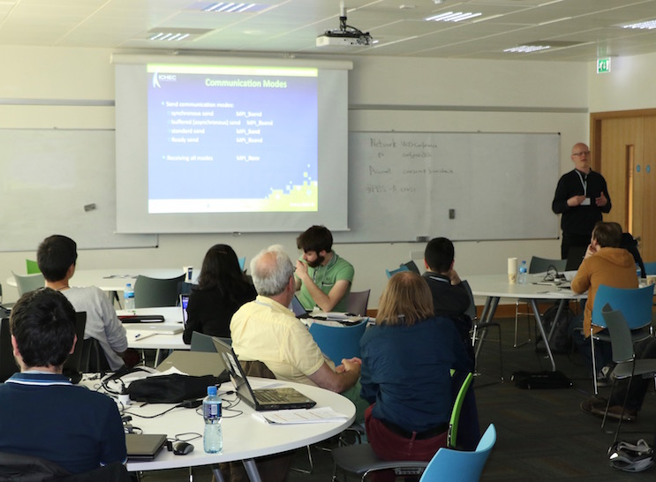
Seasonal Schools
Have been running since 2008
Offering top-quality face-to-face training events
Organised around / all over Europe
Topics range from generic intermediate to advanced
From programming techniques to more specialised topical schools
Upcomming Seasonal Schools
27 - 30 September 2016
PRACE Autumn School 2016, Austria - Modern HPC Development for Scientists and Engineers
10 – 12 April 2017
PRACE Spring School 2017, Sweden - HPC in the Life Sciences

Slide 10
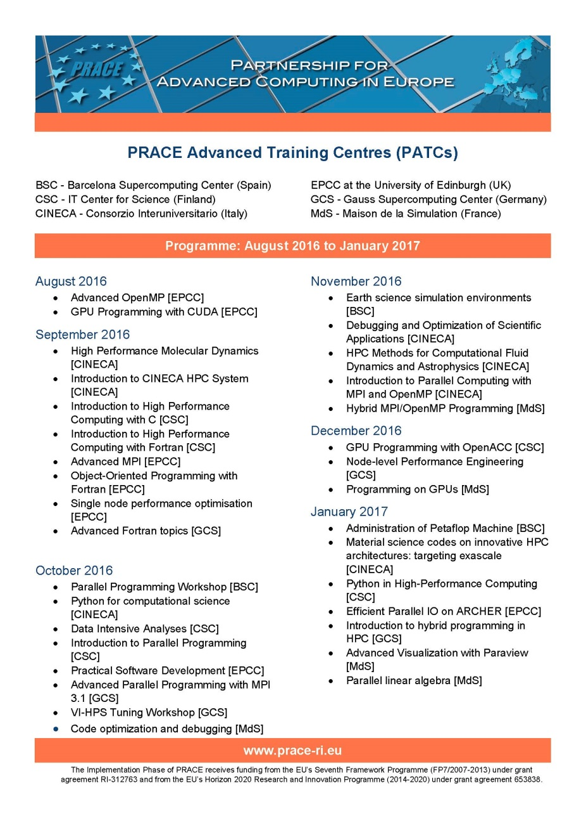
PATC Programme 2016-2017
79 courses, 215 training days
New courses on forward-looking topics
New hardware and programming paradigms
Data science
Collaboration with CoEs on several courses

Slide 11
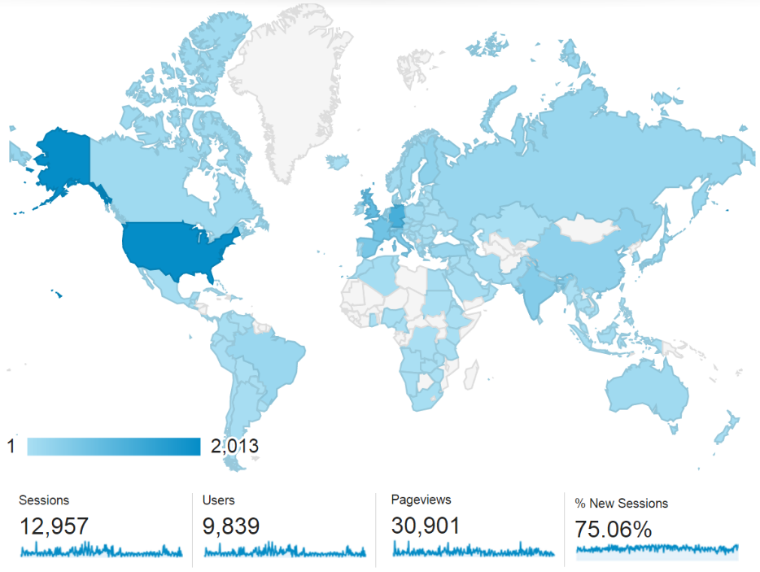
Training and Events Portal
www.training.prace-ri.eu
Single hub for the PRACE training events, training material and tutorials
Number of page views increased by 25% and number of users by 45% since 2014

Slide 12
CodeVault and More
Repository of Open Source code samples
https://gitlab.com/PRACE-4IP/CodeVault
Examples and model solutions of common HPC programming tasks
Possible to utilise in training and as building blocks of real-world applications
Anonymous read access
Best Practice Guides
http://www.prace-ri.eu/best-practice-guides/
White Papers
http://www.prace-ri.eu/white-papers/

Slide 13
Future Training Activities
On-demand events addressing the needs of the CoEs
Needs for basic, intermediate, and advanced training
Launch of Massive Open Online Courses (MOOCs)
Introduction to HPC, coordinated by EPCC
Management of massive data, coordinated by Univ. Ljubljana
PRACE Training Centres (PTCs)
Cover basic and advanced needs across Europe

Slide 14
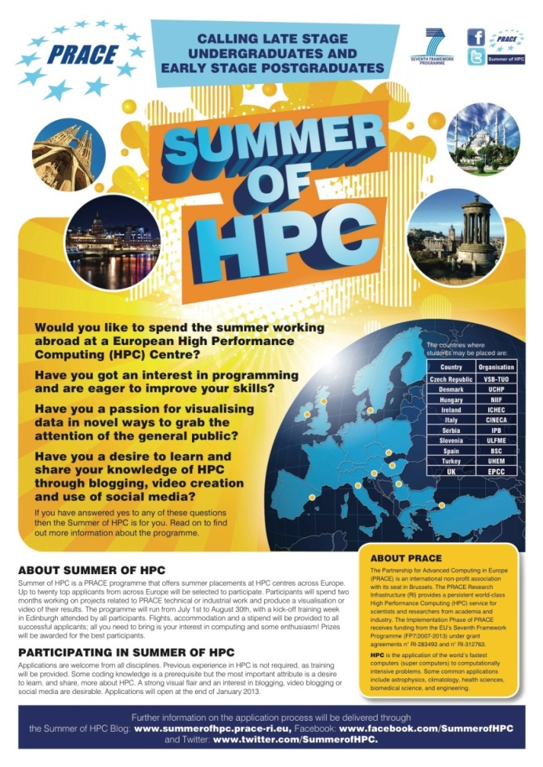
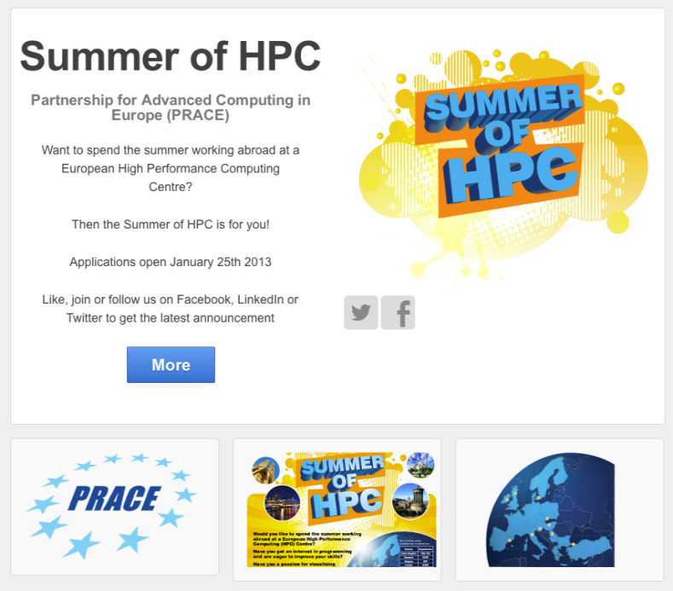
PRACE Summer of HPC (SoHPC)
Goal: To inspire the next generation of software engineering, system administrators, and general users of HPC
Notes:
PRACE embarked on an ambitious outreach programme to inspire and encourage the next generation of software engineers, system administrators, and general users of HPC systems. This programme, the Summer of HPC (SoHPC) will take place in the summer of 2013 and offer undergraduate and junior postgraduate university students the opportunity to spend two months of the summer at a HPC centre in a PRACE partner country.
Outreach is at the core of the programme, both in terms of objectives and outputs. Students will undertake a visualisation project based on the outcomes from PRACE technical work, or other work using PRACE resources, and this end product will be available to PRACE for use in further outreach and dissemination activities.
Social media is an integral part of the programme from beginning to end and is one of the primary methods of communication used to address this new target demographic for PRACE.
It will also be used by the students themselves to reach out to a broader audience of their peers, friends and families. Students will engage in outreach efforts of their own by maintaining and updating a blog outlining their experiences during the SoHPC with the goal of increasing familiarity of the general public with PRACE and HPC. Social media is also a potential channel for the dissemination of the final products the students will produce.

Slide 16
Climate
Astrophysics
Energy
Chemistry
Seismology
Life Science
144 million core hrs on Hermit (DE) for UK - UB
million core hrs:
98 on CURIE (FR) + 49 on SuperMUC (DE) for Germany
30 million core hrs on SuperMUC (DE)
for Finland
59,8 million core
hrs on JUQUEEN (DE)
for Switzerland
53.4 million core hrs on SuperMUC (DE) for Italy
40 million core hrs on JUQUEEN (DE)
for Germany
PRACE will give to UK Met a 3 years advance in the development of their models (high resolution global weather & climate models).
This PRACE grant is one of the biggest worldwide allocation in this domain. Without this huge computational resources this project would not have been carried out in a decent time.
PRACE resources enable the first European direct comparison of first-principles simulations to multi-scale experimental data for fusion energy (Link ITER).
Simplified models would not give reliable or meaningful results: Only PRACE systems are large enough to allow these computational models to be calculated.
The massive allocation of computing resources awarded via PRACE can be used to explore the non-linearity involved in the dependence of local ground shaking on geological structure.
A single standard PC would need 5.000 years to do what JUGENE did in 100 days (40 million core hours)
Only a PRACE system can offer enough resources to accomplish such a computationally intensive project.
Notes:
Credits: Prof. Pier Luigi Vidale, Univ. Reading, U.K.
Cray XE6 System Hermit in GCS@HLRS also in NATURE Climate Change July 2012

