Slide 1
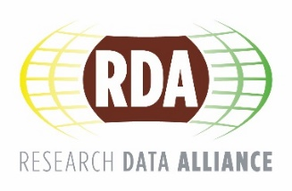
The Research Data Alliance
- And RDA Europe’s role in it -
Raphael Ritz, MPCDF
Raphael.ritz@mpcdf.mpg.de
@resdatall @rda_Europe @RDA_US
https://rd-alliance.org/

Slide 2
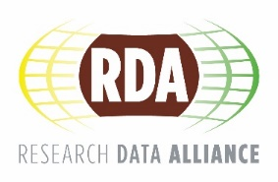
What is RDA?
RDA is an international organization focused on the development of infrastructure and community activities that reduce barriers to data sharing and exchange, and the acceleration of data driven innovation worldwide. With more than 4,300 members globally representing more than 110 countries, RDA includes data science professionals from multiple disciplines, including but not limited to academia, library sciences, earth science, astronomy and meteorology.
RDA is building the social and technical bridges that enable open sharing of data to achieve its vision of researchers and innovators openly sharing data across technologies, disciplines, and countries to address the grand challenges of society.
www.rd-alliance.org/about-rda

Slide 3
What does RDA do?
Members come together through self-formed, volunteer, focussed Working Groups, exploratory Interest Groups to exchange knowledge, share discoveries, discuss barriers and potential solutions, explore and define policies and test as well as harmonise standards to enhance and facilitate global data sharing.
RDA members collaborate together regionally and with the global RDA community to tackle numerous infrastructure challenges related to:
Reproducibility
Data preservation
Best practices for domain repositories
Curriculum development
Data citation
Data type registries
Metadata
and so many more!
www.rd-alliance.org/about-rda

Slide 4
Who Can Join RDA?
Any individual or organization, regardless of profession or discipline, with an interest in reducing the barriers to data sharing and exchange and who agrees to RDA’s guiding principles of:
Openness
Consensus
Balance
Harmonization
Community-driven
Non-profit and technology-neutral
Membership is free @ http://www.rd-alliance.org/user/register
www.rd-alliance.org/about-rda

Slide 5
Getting involved
Individuals
Observers
Contributors
Drivers
Organisations
Insight
Adopt
Drive
National level
Coordination & Knowledge Exchange, Strategy & / or Implementation
Members
WGs-IGs-BoFs
Requests for Comments
Plenaries
Member
WGs-IGs-BoFs
RfCs
H2020 projects
Adoption / Uptake
Papers & Events
Meetings & Fora
Training & Workshops
Uptake pilots
www.rd-alliance.org/get-involved.html

Slide 6
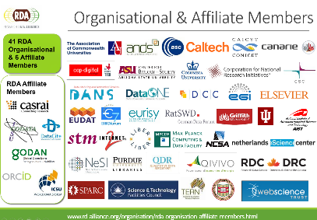
Why Join RDA?
Individual RDA Member Benefits
Contribute to acceleration of data infrastructure development
Work and share experiences with collaborators throughout the world
Access to extraordinary network of colleagues with various levels of experience, perspectives and practices
Gain greater expertise in data science regardless of whether one is a student, early or seasoned career professional
Enhance the quality and effectiveness of personal work and activities
Improve one’s competitive advantage professionally and positioning oneself for leadership within the broader research community
Organizational RDA Member Benefits
Provide an organizational perspective on the work of RDA and ability to influence RDA’s direction
Assist in implementation of RDA Outputs
Participate in all RDA Organizational Forums
Receive regular updates on the work of the RDA
Attend Organizational Assembly meetings and vote on proposed policies for consideration by the RDA Council and for members of the Organizational Advisory Board
Provide advice to the Council through the Organizational Advisory Board
Be recognized on the RDA Website and at RDA Meetings as a supporter of data interoperability
www.rd-alliance.org/get-involved.html

Slide 7
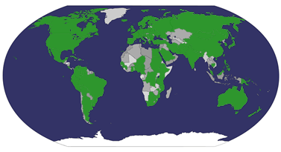
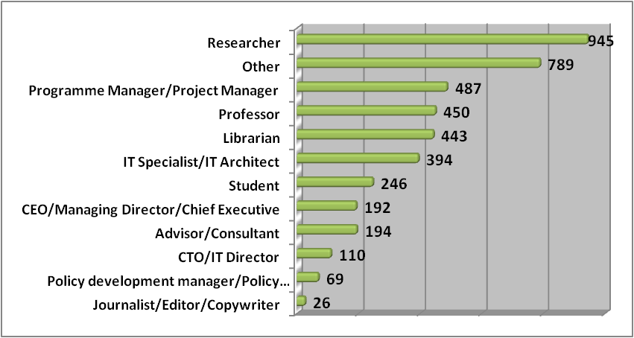
Type | Members (Sept. 2016)
Press & Media | 27
Policy/Funding Agency | 64
Large Enterprise | 99
IT Consultancy/Development | 143
Small and Medium Enterprise | 249
Other | 235
Government/Public Services | 671
Academia/Research | 2857
TOTAL | 4345
Who is RDA?
from 111 countries
Total RDA Community Members: 4345
www.rd-alliance.org/about-rda

Slide 8
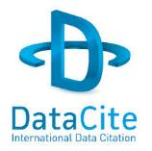
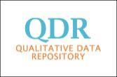
Organisational & Affiliate Members
44 RDA Organisational Members
6 RDA Affiliate Members
https://rd-alliance.org/organisation/rda-organisation-affiliate-members.html
Notes:
Guiding Principles:
Openness
Consensus
Balance
Harmonization
Community-driven
Non-profit and technology-neutral

Slide 9
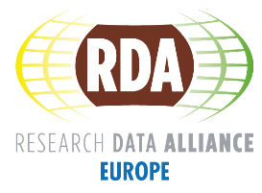
RDA & RDA Europe .. What’s the connection?
THE
MACHINE
THE
SUPPORT
RDA Global
WG/IG/BoF
funding
RDA Europe
Project
funding
EC
owning
Data
Practitioners
commenting
Co-funding
funding
creating
testing
adopting
Workshops/Sessions
Training
Helping
Knowledge Base
Leading Scientists WS
Policy Activities
Dissemination & Awareness Raising
RDA
Results
Pan European
&
National

Slide 10
RDA Europe Collaboration Projects / Adoption Cases
Dynamic Data Citation & the Argo data set
Adopting: Dynamic Data Citation
Creation of a Query interface for phenotyping data
Adopting: Wheat Data Interoperability (WDI)
Integration of the RDA Metadata Standards Directory into DMPonline
Adopting: Metadata Standards Directory
Analysis of the OpenPhilology/Perseus and the CLARIN data repositories
Adopting: Data Foundation and Terminology
Implementation of a Query Store for the VAMDC infrastructure
Adopting: Data Citation
Integration of the DLI Service into the OpenAire infrastructure
Adopting: Publishing Data services
Introduction of PIDs to the Armenian Life Sciences
Adopting: PID Information Types
Objective: to support communities that want to test/adopt RDA outputs.
1st call: Sept – Dec 2015
Outcome: 25 submitted & 7 selected.
Start: Mid 2016

Slide 11
RDA Europe Collaboration Projects / Adoption Cases - 2nd Call
Co-organization of domain workshops or training courses on barriers, solutions, RDA results and adoption possibilities.
Adoption of a specific RDA output and integration into the infrastructure software stack.
Adaptation of some existing software stack to be compliant with RDA guidelines.
Writing guidelines on RDA output tuned to domain specialties.
In the case of RDA Result Uptake & Test projects collaborations should be short and focused activities with concrete results produced within a 6 month time frame and should be in the order of 15.000€.
Call for Collaboration Launch: mid May 2016
Deadline of Submission: end September 2016
More information http://europe.rd-alliance.org/rda-europe-call-collaboration-projects

Slide 12
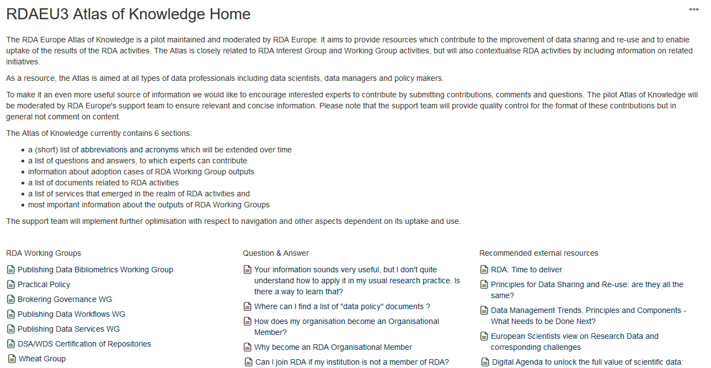
RDA Europe Atlas of Knowledge Pilot
moderated wiki focusing on issues raised by RDA Working Groups and Interest Groups
will also incorporate topics with a much broader focus
advice about research data issues and to also carry out analysis work to clarify open questions.
executed in collaboration with research communities & experts from different fields & initiatives with deep experience & knowledge to give the most comprehensive answers
https://confluence.csc.fi/display/RDAEUKB/RDAEU3+Atlas+of+Knowledge+Home

Slide 13
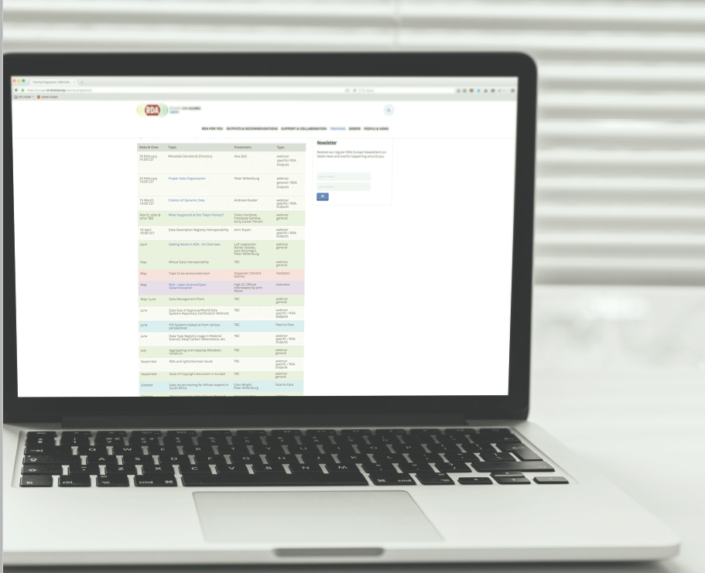
Training & Webinars
training webinars, face-to-face workshops, hackathons/datathons partly organized as “summer schools” and special meetings on request.
Delivered in different formats by International Experts:
RDA recommendations and outputs – e.g. Data Description Registry Interoperability
General topics – e.g Data Management Plans, State of EU Copyright discussion
Interviews – e.g. Open Science/Open Data/Innovation
information sessions – e.g. What happened at the Tokyo Plenary?
Scheduled (Feb-Dec 2016) so far …
Face-to-Face | 3
Hackathon | 2
General | 9
specific / RDA Outputs | 9
interviews | 2
webinar | 18
http://europe.rd-alliance.org/training-programme

Slide 14
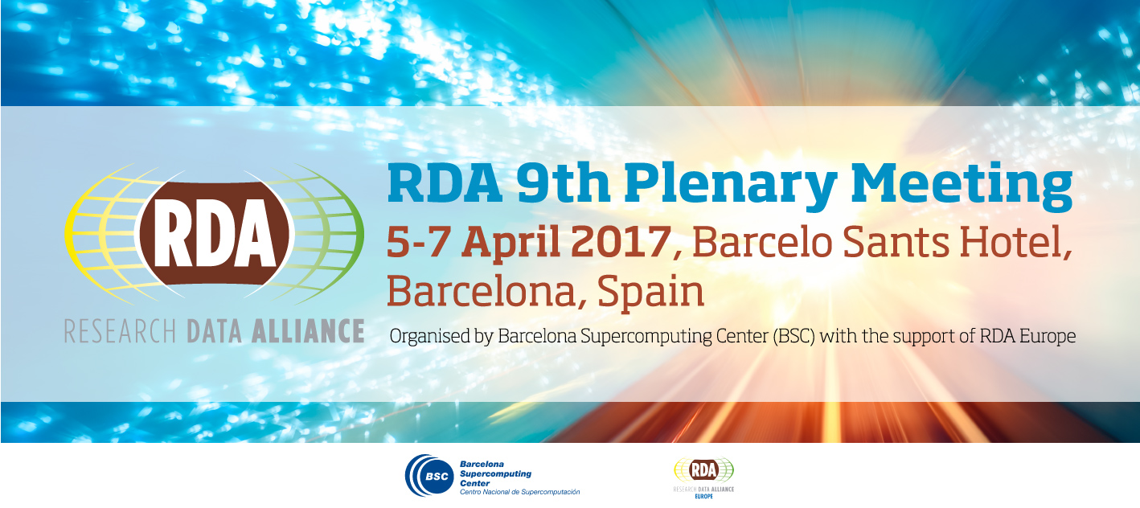
https://rd-alliance.org/plenary-meetings/rda-ninth-plenary-meeting.html

Slide 15
@resdatall @RDA_US @rda_europe
RDA Global
Email - enquiries@rd-alliance.org
Web - www.rd-alliance.org
Twitter - @resdatall
LinkedIn - www.linkedin.com/in/ResearchDataAlliance
Slideshare - http://www.slideshare.net/ResearchDataAlliance
Facebook - https://www.facebook.com/pages/Research-Data-Alliance/459608890798924
RDA Europe
Email - info@europe.rd-alliance.org
Web - europe.rd-alliance.org
Twitter - @RDA_Europe
RDA US
Twitter - @RDA_US

Slide 16
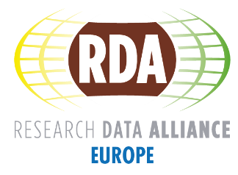
The RDA Europe Early Career Support Programme
introduce European early career researchers & scientists to RDA;
highlight what data scientists / practitioners are doing;
leverage on Early Career Researchers & Scientists knowledge to support Plenary activities;
support the Working & Interest group activities.
RDA Plenary 8 - Call for applications is OPEN!
APPLY to join the International Data Week in Denver September 2016!
https://rd-alliance.org/plenaries/rda-eighth-plenary-meeting-denver-co/rda-eu-early-career-support-programme

Slide 17
RDA Interest (IG) & Working Groups (WG) by Focus (1)
Domain Science - focused
Agrisemantics WG
BioSharing Registry: connecting data policies, standards & databases in life sciences WG
Rice Data Interoperability WG
Wheat Data Interoperability WG
Agriculture Data IG (IGAD)
Biodiversity Data Integration IG
Chemistry Research Data IG
Digital Practices in History and Ethnography IG
Geospatial IG
Global Water Information IG
Health Data IG
Marine Data Harmonization IG
Metabolomics Data Interoperability IG
Quality of Urban Life IG
RDA/CODATA Materials Data, Infrastructure & Interoperability
Research data needs of the Photon and Neutron Science community IG
Structural Biology IG
Community Needs - focused
RDA/CODATA Summer Schools in Data Science and Cloud Computing in the Developing World WG
Archives & Records Professionals for Research Data IG
Data for Development IG
Development of Cloud Computing Capacity and Education in Developing World Research IG
Education and Training on handling of research data IG
Engagement IG
Ethics and Social Aspects of Data IG
Total 73 groups: 27 Working Groups & 45 Interest Groups
https://rd-alliance.org/groups

Slide 18
RDA Interest (IG) & Working Groups (WG) by Focus (2)
Reference and Sharing - focused
Data Citation WG
Data Description Registry Interoperability WG
Data Security and Trust WG
Empirical Humanities Metadata WG
RDA / WDS Publishing Data Bibliometrics WG
Research Data Collections WG
QoS-DataLC Definitions WG
International Materials Resource Registries WG
National Data Services IG
RDA/CODATA Legal Interoperability IG
Reproducibility IG
Partnership Groups
RDA / TDWG Metadata Standards for attribution of physical and digital collections stewardship
RDA/NISO Privacy Implications of Research Data Sets WG
Repository Audit and Certification DSA–WDS Partnership WG
RDA/WDS Publishing Data IG
ELIXIR Bridging Force IG
Total 73 groups: 27 Working Groups & 45 Interest Groups
https://rd-alliance.org/groups

Slide 19
RDA Interest (IG) & Working Groups (WG) by Focus (3)
Data Stewardship and Services – focused
Brokering Framework WG
Brokering Governance WG
RDA / WDS Publishing Data Services WG
RDA / WDS Publishing Data Workflows WG
Active Data Management Plans IG
Data in Context IG
Data Rescue IG
Domain Repositories IG
Libraries for Research Data IG
Long tail of research data IG
Preservation e-Infrastructure IG
RDA/WDS Certification of Digital Repositories IG
RDA/WDS Publishing Data Cost Recovery for Data Centres IG
Repository Platforms for Research Data IG
Research Data Provenance IG
Virtual Research Environments IG
Base Infrastructure – focused
Array Database WG
Data Foundation and Terminology WG
Data Type Registries WG
Metadata Standards Catalog WG
Metadata Standards Directory WG
PID Information Types WG
Practical Policy WG
Data Fabric IG
Data Foundations and Terminology IG
Data in Context IG
Big Data IG
Brokering IG
Federated Identity Management IG
Metadata IG
PID IG
Service Management IG
Vocabulary Services IG
Total 73 groups: 27 Working Groups & 45 Interest Groups
https://rd-alliance.org/groups

Slide 20
RDA Outcomes: Recommendations & Outputs
THE RDA OUTCOMES LEGEND
Recommendations: are as currently defined and should be presented as the flagship outputs of RDA. We should specifically use the word RECOMMENDATION. They are RDA’s equivalent of the “specifications” or “standards” that other organisations create and endorse. The process for creating and endorsing these is already defined.
Supporting Outputs: are the outputs of RDA WGs and IGs that are fruit of RDA work, but are not necessarily adoptable bridges. “Upon request”, these sort of outputs go through a community comment period and if no major objections or gaps are identified they get the RDA Brand.
Other Outputs: include workshop reports, published articles, survey results, etc. Anything a WG or IG wants to register and report. Upon request, these are published and discoverable on the RDA website but have no level of endorsement.
https://rd-alliance.org/rda-outputs.html

Slide 21
Recommendations & Outputs
Data Foundation & Terminology: a model for data in the registered domain.
PID Information Types: a common protocol for providers and users of persistent ID services worldwide.
Data Type Registries: allowing humans and machines to act on unknown, but registered, data types.
Practical Policy: defining best practices of how to deal with data automatically and in a documented way with computer actionable policy.
https://rd-alliance.org/rda-outputs.html

Slide 22
Recommendations & Outputs
Metadata standards directory: Community curated standards catalogue for metadata interoperability
Data Citation: defining mechanisms to reliably cite dynamic data
Data Description Registry Interoperability solutions enabling cross platform discovery based on existing open protocols and standards
Wheat Data Interoperability impacting the discoverability, reusability and interoperability of wheat data by building a common framework for describing, representing linking and publishing wheat data
https://rd-alliance.org/rda-outputs.html

Slide 23
Recommendations & Outputs
Repository Audit and Certification DSA–WDS: A convergent DSA-WDS certification standard to help eliminate duplication of effort, increase certification procedure coherence and compatibility thus benefitting researchers, data managers, librarians and scientific communities.
RDA/WDS Publishing Data Bibliometrics: improved research data metrics and corresponding services, with the final goal of increasing the overall availability and quality of citations and research data itself.
RDA/WDS Publishing Data Services: A universal interlinking service between data and the scientific literature.
RDA/WDS Publishing Data Workflows: enhance the possibilities for greater discoverability and a more efficient and reliable reuse of research data benefitting other stakeholders like publishers, libraries and data centres.
https://rd-alliance.org/rda-outputs.html

