Slide 1
EGI Applications Database
Marios Chatziangelou, et al. <mhaggel@iasa.gr>
Institute of Accelerating Systems and Applications (IASA)

Slide 2
Capabilities
A community driven, central service that stores and provides:
software solutions (in the form of native software and/or virtual appliances), originated from almost every scientific area/discipline
reference of scientific datasets (pilot - under development)
the programmers and scientists responsible for them
the publications derived from the registered items (SW, VA & datasets)

Slide 3
General features (1/2)
information retrieval
advanced searching mechanism (rated search results)
'faceted search' mechanism for refinements
quality of information
content tagging, ratting, commenting
per registered item contact expertise information
problem and comment abuse report
centrally managed quality control
taxonomy
technical classification
scientific classification
tagging
dissemination of information
custom RSS/Atom news feeds
news e-mail subscription lists
user focused communication (messaging, requests, etc)
special dissemination tool for sending ad-hoc messages to scientists
'follow' button for receiving all the activity related to a registered item
dissemination features customizable through user preferences
sharing content with social networks

Slide 4
General features (2/2)
AuthN/AuthZ and security
advanced AuthN/AuthZ mechanisms (simpleSAML)
integrated with EGISSO, EGI AAI, eduGAIN
support for multiple accounts for accessing user’s personal profile
internally managed AuthZ, based on allowed actions, roles and permissions
everything is under https channel
relations…
… between all the entities listed below, are possible:
software
virtual appliances
datasets
persons
virtual organizations
sites / resource providers
organizations
projects
integration with AppDB
RESTfull API, supports operations following a CRUD convention.
flexible API stateless authentication mechanism using Personal Access Tokens (no need for X509)
API documentation in good shape
or even, by adapting the AppDB Gadget
(easy – copy & paste, one line of code – no technical skills required, you may get it here)
AppDB already integrated with EGI services and beyond…
EGI GOCDB
for the list of sites and their end-points
Top-BDII
fetching sites dynamic information
EGI AAI
for auth and high level authorization attributes
Perun and EGI Operations Portal
for VO related details + Authorization attributes
OpenAIRE: retrieving FP7 and H2020 projects and linked Organizations, persons and in the near future… publications

Slide 5
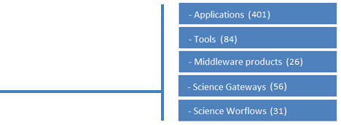
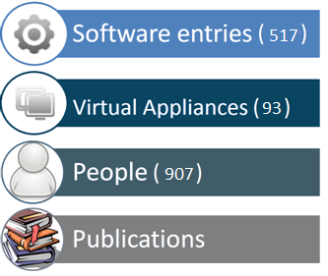
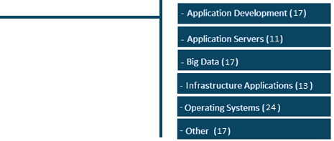
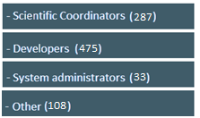
Indicative Statistics

Slide 6
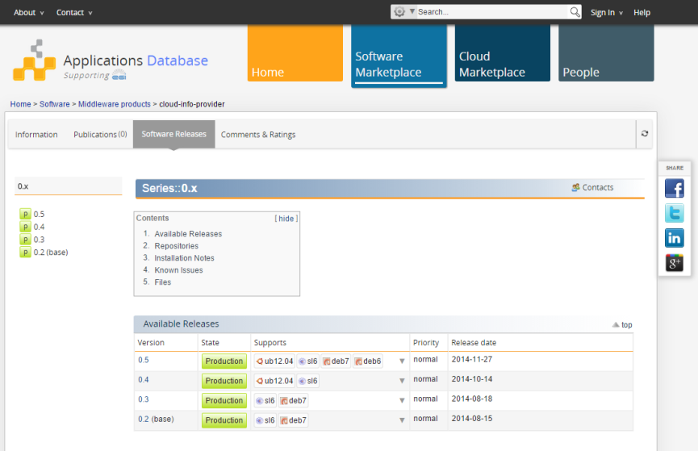
Software Marketplace
Registry for Software items:
Applications, tools, Workflow frameworks and instances, Science Gateways, Middleware products, …)
Offers release management capabilities
- unlimited series of releases
- light-weight & collaborative, release
management process
Acts as a repository for binary artifacts
unlimited number of repositories per register software
generic tarballs, RPM & DEB (32bit/64bit) binaries
multiple flavor / operating system combinations
simplified, web-based, process for uploading the binary artifacts
YUM & APT repositories for automatic distribution
artifacts populated through the UMD Community Repository

Slide 7
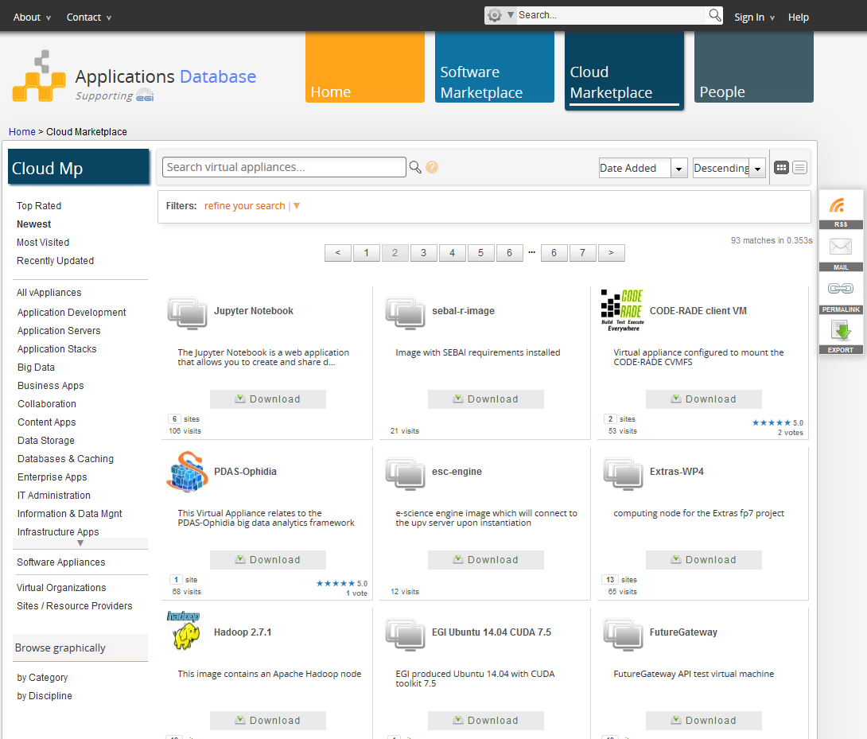
Cloud Marketplace (1/3)
Registry for virtual appliances (VA)
a logical container of versioned image file & metadata bundles
Registry for software appliances (SA)
a logical container of VA versions & contextualization scripts bundles
VA distribution medium
distributing endorsed VAs to the resource providers/sites
Resource providers catalogue
list of the VAs which are available by each site/resource provider
Virtual Organizations (VO) catalogue
list of the VAs which are available for each VO member

Slide 8
Cloud Marketplace (2/3)
Users may….
Visitors: Search, download for personal/local use, get all the technical information on how a VA can be used under the EGI FedCloud Infrastructure, where (site) is available, to which VO the user should be member for using the VA,….
Virtual Appliance Providers/Submitters
Register Virtual Appliance
Create/Update Virtual Appliance versions and link a VM image to them
Provide a contextualization script for each VM image
Project & VO Managers
Select which of the registered Virtual Appliances, should be pushed to the cloud infrastructure (sites).
The AppDB system takes the responsibility for distributing the “chosen” ones to the respective Resource providers/sites.
AppDB gets feedback from the sites that the Virtual Appliances are indeed available ready to be used by the users
Every user
Create a Software Appliance from an existing VA version and a contextualization script he/she provides

Slide 9
Cloud Marketplace (3/3)
Remote Sites
Search for vAppliances
Information System
(Top-BDII for
FedCloud sites)
Get availability & usage details
cloud m/w
Start/Stop/…. an image
local info system
push info
about the VA
availability
and usage
perform VM operations
using rocci command line tool
Next logical step:
perform VM operations through
the AppDB
vmcatcher
user::visitor
subscribe and/or get any update
AppDB Image List Store
AppDB
Cloud Marketplace
AppDB portal
generate
image_list
(Re)publish VO or Project’s accepted list of Virtual Appliances
Publish new vAppliance version
Select/update/exclude vAppliances
Insert/update/remove image(s)
Create a new vAppliance version
Register a vAppliance
VO or Project Manager
AppDB portal
AppDB portal
user::submitter
Notes:
Make notes for interaction
Submitter
- Through the AppDB portal (=graphical interface) is able to register a vApp
The vApp is versioned. Each vApp version contains VM images, The submitter can create a vApp version either using the AppDB portal (graphically) or even through a command line tool (mainly for automation i.e. upload updates of images without human intervention)
Can create vApp version and at the end publish it and therefore meke it publicly available
VO or Project Manager
Selects the vApps (or their updates) that considere as suitable to be offered by his/her sites of responsibility
And publishes the chosen ones in to the AppDB Image List Store
Sites / Resource prividers
Subscribe and download the vApps or their respective updates
And inform back the AppDB that indeed the sites are downloaded and are accepted by the sites (EGI is using the TopBDII for this but this part of the chain can be replaced by other information systems or technilogies)
The site does not only inform AppDB about the vApp availability but also gives back usage ditails (= all details the user needs in order to make use of the vApp in question. In EGI. usage details = occi_id, template_id site occi endpoint)
The end user
Through the AppDB portal can search for a vApp and perhaps download it for use it into his own PC (i.e. VirtualBox)
Gets the info about which vApp is available in wich site and how he//she can use it (again, In EGI that means => occi_id, template_id site occi endpoint).
Having the usage details he/she can perform brokering actions (start/stop/…) to the remote site by using the OCCI command line tool
Next in the raw: to give the ability to the end user to perform brokering action through the AppDB portal in a graphicall way. Hiding all the technicalities (occi_id, template_id site occi endpoint) .from his eyes

Slide 10
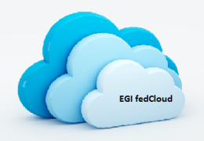
AppDB VM Operations
The objective (EGI-Engage) : “The EGI Applications Database (AppDB) will evolve from its current role as catalogue of applications and virtual machines (VM) to include a graphical user interface allowing authorized users to perform basic VM management operations”
AppDB
Portal
VM operations dashboard

Slide 11
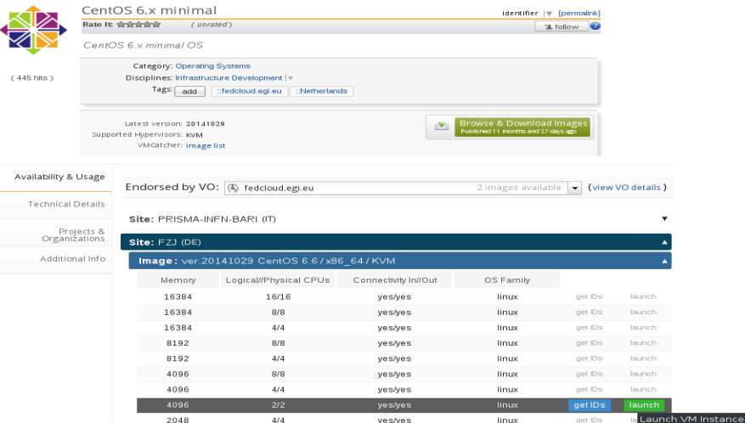
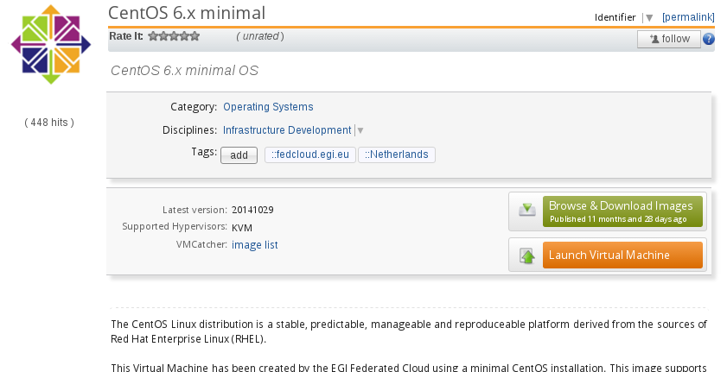
The AppDB portal
Portal
Select VMI (=VA version )
or, select VMI (VA version), & VO & site/endpoint & template
…. and be redirected to the VM ops dashboard for further adjustments
and execution

Slide 12
The VMops dashboard (1/3)
Highlighted features for the end-user
User identification
Based of the aforementioned identification, provide a personalized list of the VMs that are available for him (based on his VO membership and his role within the VO, ex. vm_operator@fedcloud.egi.eu)
Create a new topology with one or more instances of a single VM – VM addition is on going
Attach additional storage to the VM instances
Deploy/Un-deploy a topology
Start/Stop a topology (=start/stop all the VM instances of a topology)
Start/Stop a single VM instance
Provide personalized views of Topologies and/or VM instances

Slide 13
The VMops dashboard (2/3)
Highlighted technical features
TOSCA compatible
Infrastructure Manager [1] as the OCCI communication layer
Rest API for integration with other services
Single-Sign-On with the portal and the rest of the AppDB sub-services
Scalable architecture (one front-end many back-ends for load balancing)
[1]. https://appdb.egi.eu/store/software/infrastructure.manager.im

Slide 14
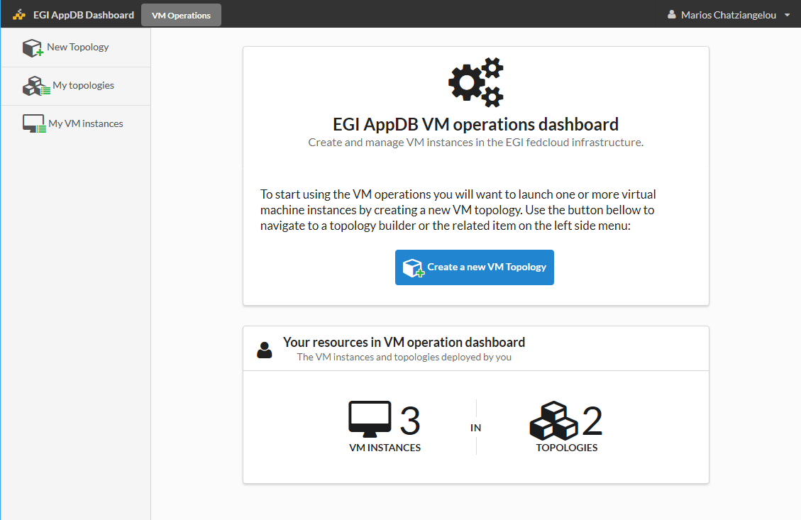
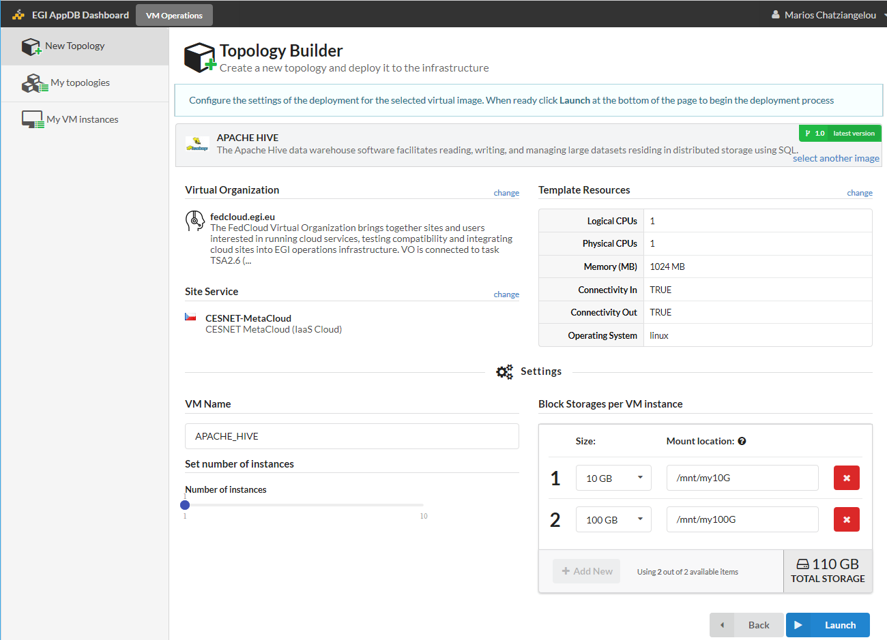
The VMops dashboard (3/3)
…lets see in action: https://dashboard.appdb.egi.eu

Slide 15
Status & Open Items
In a pre-release state – VMOps its being tested by a group of experts
First release is expected in the next month
Contextualization script builder
VM Monitoring component
Quite a few issues have been identified and should be internally discussed and preferably addressed before the first production-grade release:
Policy related:
Common policy for public IPs assignment/availability
Common policy for block storage i.e. storage size, need for device id or not, etc.
Security based policies i.e. who should be able to revoke suspicious instances, user should provide his own key or let the AppDB to create (and keep!) one for him
Infrastructure related:
Information mismatch between Information system and OCCI
Image update issue on sites and/or issues on Information system
Incompatible image files

Slide 16
Summary
Users may ….
AppDB
vAppliance
Publish or pick one
Publish or
pick one
Software
VM image
EGI fedCloud
infrastructure
Cont. scripts
Datasets
Publish or pick one
Block storage(s)

