Slide 1
FutureGateway (WP6)
Riccardo Bruno (INFN)
RIA-653549
DI4R. 29 September 2016. Krakow, Poland

Slide 2
Outline
Design and architecture of the current FG implementation
Design, components overview and implementation
Installation
AuthN/Z
baseline and INDIGO AAI (PTV)
Training
SciGaia/INDIGO-dc/COST ENeL co-sponsored Summer HackFest event
2

Slide 3
FutureGateway (FG)
A framework to build Science Gateways:
"A Science Gateway is a community-developed set of tools, applications, and data that is integrated via a portal or a suite of applications, usually in a graphical user interface, that is further customized to meet the needs of a specific community." TeraGrid-XSEDE
Serves Community
Tools applications and data integration
Provides GUI (Web, desktop and mobile applications)
FutureGateway is the evolution of another product named: Catania Science Gateway Framework (CSGF)
FG improves CSGF from well identified weakness especially those things addressing the learning curve
It consists of two components:
A web portal (optional)
The API Server: Front-end and queue daemon
3

Slide 4
FG – Design principles
Ease the installation and the maintenance
It provides installation and maintenance scripts
All sources available on GitHub
Easily customizable for different community needs
Flexible and uniform access to distributed computing services
The physical access to the distributed infrastructures comes through the JSAGA library (Grid&Cloud Engine, SimpleTosca->ToscaIDC)
FG executor interfaces (customizable)
Back-end portal independency
The FG can operate with any existing portal technology or even linked to mobile and desktop applications
Ease SG application development
It provides a set of RESTful APIs so that the FG can be easily piloted by any programming language and/or web framework
4

Slide 5
FG - Concepts
Tasks
Any activity targeting a DCIs is a task; this ranges from simple batch executions to more sophisticated actions like a PaaS creation and exploitation.
Applications
It describes the activity to perform against the DCI. Tasks are applications instances.
Infrastructures
Describe the environment where the application can run. Normally is a resource description necessary to JSAGA adaptors and/or Executor Interfaces to physically access DCIs.

Slide 6
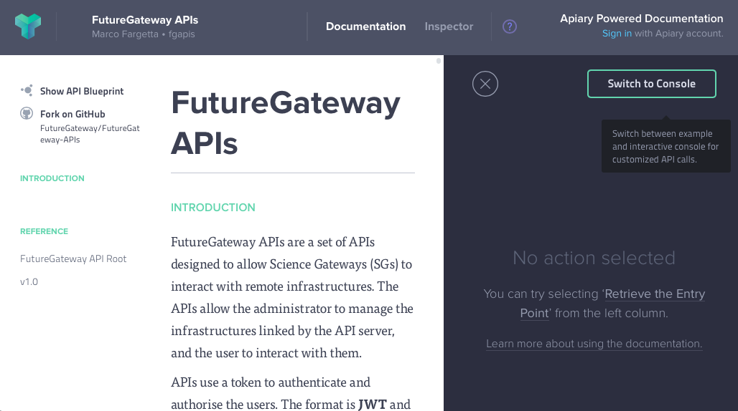
API Server Front-End
It is in charge to implement APIs specification as in: http://docs.fgapis.apiary.io/#
Two actions
Verify user credentials (accept or not the requested API action)
Fills a queue table identifying the action to perform on the DCI
Manages a MySQL database with information about: tasks, applications, DCIs
More than one front-end can fill the queue

Slide 7
API Server
Queue Daemons and Executor Interfaces
Action on DCI
Queue
Command
EI (Action)
Action
EI name
APIServerDaemon/Other daemons
Commands (Tasks=Command(Action,EI)) are extracted from the fgAPIServer queue
Each ‘command’ contains the ‘Target Executor’ field which specifies the Executor Interface name
Executor interfaces are dynamically instantiated by the APIServerDaemon by its name, applying the specified action on DCI
Other queue daemons may extract commands from the queue having their own EIs implemented.
New EIs can be easily developed just implementing an abstract class (APIServerDaemon)
Current available EIs (APIServerDaemon):
GridEngine (A core component of the CSGF using JSAGA and targeting: ssh, rOCCI and wms)
SimpleTosca -> ToscaIDC (Indigo orchestrator)
7

Slide 8
API Server - Current implementation
Graphic User Interfaces (Web, Mobile and Desktop applications)
APIServer DB (fgapiserver)
APIServer frontend
(fgAPIServer)
REST APIs – APIServer specs. V1.0
Python 2.7 + Flask microframework
Queue table
(as_queue)
APIServer
(APIServerDaemon)
Tomcat Java WebApp
Executor Interfaces
Grid and Cloud Engine
(GridEngine)
TOSCA 1st EI
(SimpleTosca)
TOSCA 2nd EI
(ToscaIDC)
Other Interfaces …
(…)
DB Interface
JSAGA
Mid Layer Components
JSAGA Adaptors
SSH
EMI/gLite
rOCCI
TOSCA
ganymed-ssh-2
EMI/gLite APIs
rOCCI CLI
TOSCA
Orchestrator
Distributed Computing Infrastructures

Slide 9
FG – Actual components
API Server Front-End (fgAPIServer)
Python code on top of Flask microframework
Very easy to develop/manage/configure
Uses a MySQL DB to configure:
Applications
Application parameters
Application I/O files
Application Infrastructures and their parameters
Tasks (Submitted applications) with params, args, etc.
Task queue (used to communicate with the APIServerDaemon)
Users/Groups/Roles (No API yet defined for this)
APIServerDaemon
Java servlet running as a daemon on top of Tomcat application server
It timely polls over the task queue table and executes requested tasks
It instructs the right ‘executor interface’ to perform the requested task
Actually only the Grid&Cloud Engine and TOSCA interfaces are available:
Grid&Cloud Engine: exploits JSAGA standard to execute on distributed infrastructures: gLite/EMI wms, ssh, occi (rOCCI), (Others: Globus, Unicore, ...)
SimpleTosca->ToscaIDC: Simplified version of TOSCA based resource management: It accepts only one kind of input yaml file (used for demonstrative purposes)->ToscaIDC (More evoluted version)
9

Slide 10
FG - Installation
Available on GIT: https://github.com/indigo-dc/PortalSetup
Two kind of bash installation scripts
Core scripts (setup_*.ssh)
They are ment to cover all possible operating systems: Debian based (Ubuntu), Yum (ELx), MacOSX and potentially Windows platforms (Cygwin)
Hi-level scripts
These scripts are meant for a specific operating system, they take care of mandatory packages and execute the core scripts properly configured
Current supported platforms: Ubuntu 14.04 LTS (Docker Container), EGI FedCloud, CentOS7
Configuration
All configurable environment variables are located in setup_config.sh script
Hi-level scripts generate its own copy of setup_config.sh
Maintenance
APIServer-frontend and APIServerDaemon together with its database schema can be kept updated

Slide 11
FG - Typical usages
Final Users
Mobile&Desktop Apps
Liferay Portal
Community Portal
Portlet
Portlet
Portlet/WebApp/Web+Ajax
APIServer
FrontEnd/Daemon
PTV
Requires (INDIGO) AAI
PrivateNet/Firewall/SSL Protection
APIServer
FrontEnd/Daemon
APIServer
FrontEnd/Daemon
The portal manages user access to portlets. CSGF-like setup
Used for:
INDIGO SG Demonstrator
https://sgw.indigo-datacloud.eu
Used for:
Molecular Dynamics
Climate change
Used for:
New Galaxy portlet
Desktop & Mobile apps
(Coming soon)
11

Slide 12
AuthN/Z
Baseline token management
and
Portal Token Validator (PTV)
12

Slide 13
FutureGateway
Baseline AuthN/Z
Log Token
Token check
Log-In
Username, Password
1
3
APIServer
Front-End
Key
Key
2
Log Token
Session Token
Username
Password
Timestamp
User details
User Group(s)
Group(s) roles
Key
…
4
Session Token identifies the user and provides AuthZ informtaiotn
Token Expiration
1
Log-In
The user log-in providing its own credentials; in the baseline this uses (username and password).
This log-in can be handled also with OAUTH authentication (INDIGO AAI, Facebook, Google, …)
2
LogToken
The baseline Log-In code encrypts username, password and a timestamp in a LogToken string. In OAUTH cases the OAUTH token will be returned after the authentication
3
Token check
Incoming LogTokens are processed by the TokenCheck function which in the baseline authentication just maps decrypted credentials with stored users in APIServer DB
In OAUTH cases the TokenCheck function will use received user info to map the user with users registered into the APIServer DB. A new session token for mapped user is returned
4
Session Token
Session Token will be used to call any further API REST call till token expiration
13
Notes:
http://blog.miguelgrinberg.com/post/oauth-authentication-with-flask

Slide 14
FG AuthN/Z in INDIGO
https://www.indigo-datacloud.eu/documents/software-architecture-and-work-plan-wp6-d61
Portal
1
IAM
AuthN
AuthZ
2
AuthN/Z
APIServer
3
4
Resources
Validity Check (PTV)
1
IAM
The user is redirected to IAM Login page
2
Token
Once authenticated the user receives also AuthZ information, stored inside the Token
3
Portal and APIServer
The portal contacts the ApiServer providing the IAM Token and the APIServer checks the validity of the incoming Token. The Scope and Policies will be applied accordingly to stored AuthZ information
4
Resources
IAM Token will be used to access the Resources
14
Notes:
http://blog.miguelgrinberg.com/post/oauth-authentication-with-flask

Slide 15
Training
15

Slide 16
Summer Hackfest (www.sci-gaia.eu/summer-hackfest)
Overview and objectives
The e-Research Summer Hackfest was held at the Department of Physics and Astronomy of the University of Catania (Italy) in two editions: the first on July, 4-15, 2016 and the second on July, 18-29, 2016
The event was co-sponsored by the Sci-GaIA, INDIGO-DataCloud, and COST ENeL projects
The main objective of the event was to integrate scientific use cases through a pervasive adoption of web technologies and standards and make them available to their end users through Science Gateways
Promoting and fostering open and reproducible research was the ultimate goal of the hackfest
Topics:
Big Data analytics
Distributed computing services
Distributed storage services
Programmatic access to Open Data repositories
Semantic federation of Open Access repositories
User interfaces (web, desktop, mobile, etc.)
Workflows
Tools and technologies:
FutureGateway;
gLibrary
Kepler
Invenio
OAI-PMH
Onedata
Ophidia
Training format:
16
Use case
APIs
Service/Tools
Infrastructure

Slide 17
Summer HackFest Resources for FG
Video lectures & tutorials
Streamed video recordings
Video «moments»
Documentary video
The FutureGateway framework - Overview : Slides - Video part 1 , Video part 2
The FutureGateway framework - APIs: Slides - Video part 1, Video part 2
The FutureGateway framework - Installation: Slides - Video part 1, Video part 2, Video part 3
Official INDIGO-dc documentation on GitBook
https://www.gitbook.com/book/indigo-dc/futuregateway/details

Slide 18
Questions …
?
18

