Slide 1
Unleashing
Earth Observation data
A Research Networking Perspective
Jakob Tendel GÉANT / DFN

Slide 2
Outline
GÉANT
COPERNICUS
  Collaboration with ESA
    Sentinel Data Hubs on GÉANT
  Collaboration with EUMETSAT
    Multicast across network domains
R&E Network Services

Slide 3
GÉANT

Slide 4
Research and Education Networks
Dedicated Internet networks
Serve publicly funded research and academic education organisations
Architected and tuned to best performance for scientific data
Most countries have one designated or de facto national R&E network
Strong international R&E community enabling cross-border services

Slide 5
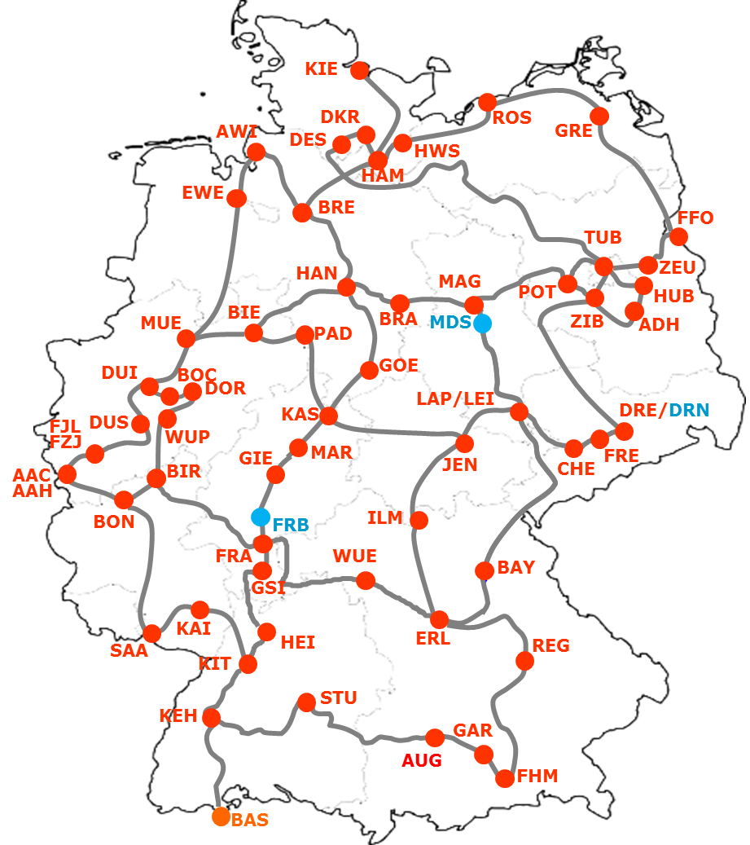
National R&E network

Slide 6
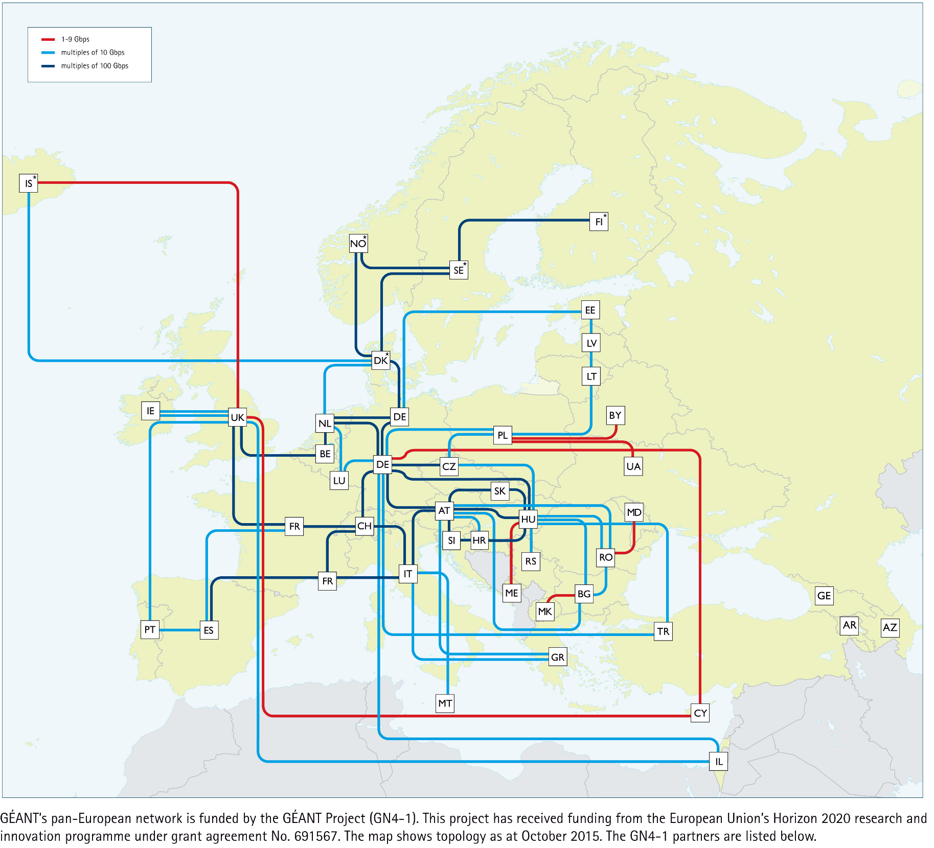
European GÉANT network

Slide 7
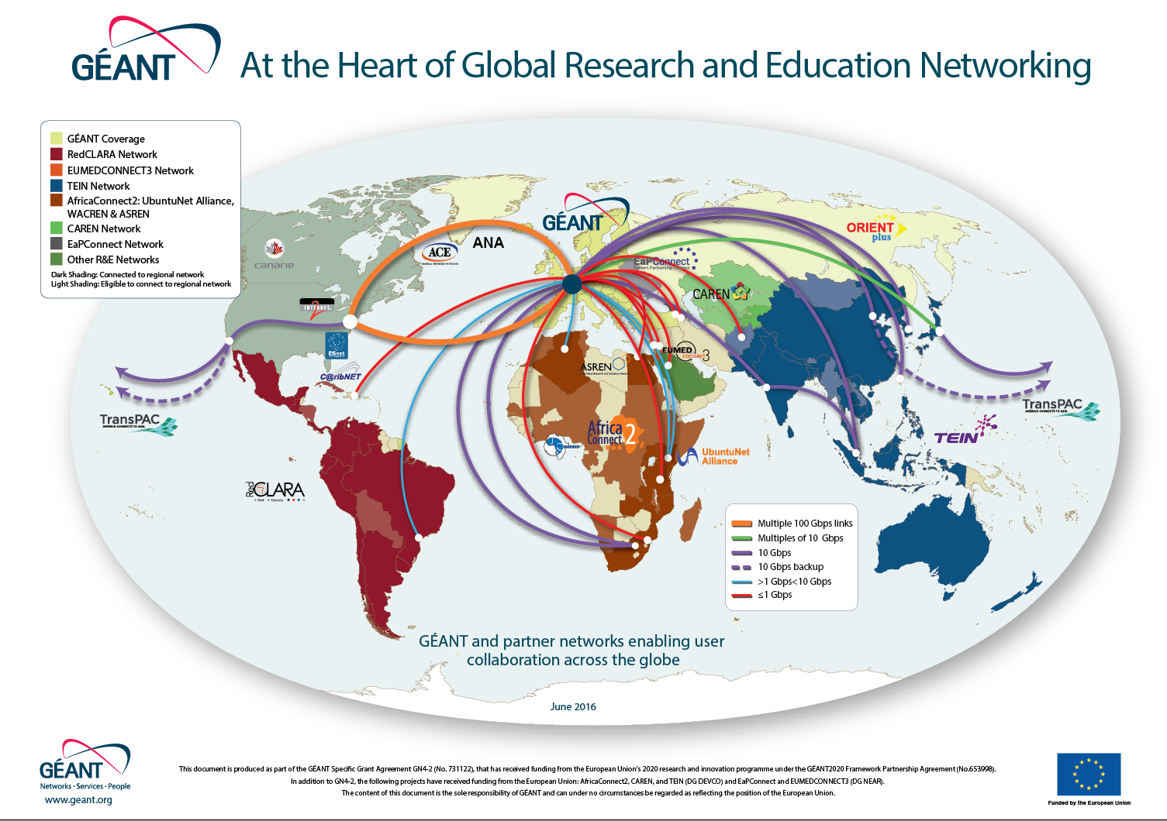
Global connectivity

Slide 8
COPERNICUS
Supporting the Distribution of COPERNICUS Data
over R&E Networks

Slide 9


Slide 10
Original ESA dissemination plan
Data Processing
Product Generation
Archives
Satellite Downlink
Sentinel Hubs
“The Internet”
T
COPERNICUS
WAN
Frankfurt
DFN
REN
GÉANT
REN

Slide 11
Original ESA dissemination plan
Data Processing
Product Generation
Archives
Satellite Downlink
Sentinel Hubs
“The Internet”
T
COPERNICUS
WAN
Frankfurt
DFN
REN
GÉANT
REN

Slide 12
Copernicus – DFN peering with ESA
Data Processing
Product Generation
Archives
Satellite Downlink
Sentinel Hubs
“The Internet”
T
COPERNICUS
WAN
Frankfurt
DFN
REN
GÉANT
REN

Slide 13


Slide 14
What R&E has done for EUMETSAT
EUMETCast data distribution using IP multicast from EUMETSAT HQ in Germany to 31 countries in Europe, using GÉANT and the NRENs networks
A Single point of contact for EUMETSAT
– connecting them with the whole community
In the absence of a formal SLA:
  Implementation of added-value services
  that support an operational-like data provision
  Monitoring, reporting and escalation processes

Slide 15
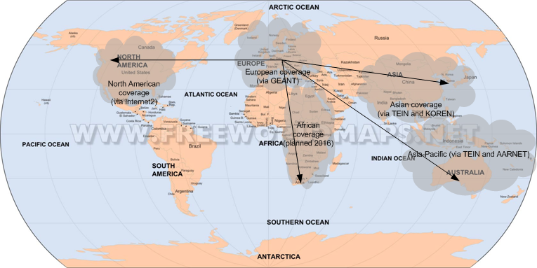

EUMETCast Terrestrial Footprint
EUMETCAST data distribution using IP multicast from EUMETSAT HQ in Germany to 31 countries in Europe, using GÉANT and the NRENs
Outreach to Asia - Korea (KMA) via cooperation between GEANT and our Asian partner networks
Outreach to USA (NOAA) via cooperation - GEANT and Internet2
Outreach to Australia (NCI) via cooperation GEANT-TEIN and Asia-Pacific partner networks
Feasibility of outreach to selected organisations located in Africa planned for 2016

Slide 16
R&E Services
for Researchers and Projects

Slide 17
R&E Services for Researchers
AAI, federated identity
Single-Sign-On
Access to e-infrastructures
Access to cloud service providers
Custom connectivity solutions:
  VPNs
  Light-paths
Transfer performance optimisation
Help with Data Management Plans
Contacts:
  Dr. Jakob Tendel – DFN
  tendel@dfn.de
  GÉANT
  businessdevelopment@geant.org
NREN Resources
geant.org/Services clouds.geant.org enlightenyourresearch.net fasterdata.es.net (USA)

Slide 18
Q
?
?
Q

