Slide 1
eduGAIN: Some people don't get it.
Brook Schofield
eduGAIN Product Manager (or something like that).
DI4R 2016 Conference
Kraków, Poland – 28th September 2016
Notes:
The evolution of identity federations over the past 10 years has culminated in REFEDS and the GÉANT Harmonisation activity developing a suite of best practices and improvements for SAML Identity Providers, Service Providers, VOs and the eInfrastructure projects.
The uptake of these hasn't been universal and the adoption of some developments have been rather disappointing.
While the collective wisdom of the federated community believes these practices are a good idea - how can we enable widespread adoption of these practices and ensure their support is visible to the wider community.
REFEDS created some New Years Resolutions to engage the federation community behind a few simple practices as a first step in this direction.
This presentation will show how eduGAIN has been working to present the adoption of these (and other) best practices, highlight areas for improvement and push e-infrastructures toward their acceptance.
How far are we away from universal interfederation?
Who's succeeding and who is falling behind?

Slide 2
eduGAIN: Meeting the challenge of scaling conflicting requirements
Brook Schofield & Ann Harding
eduGAIN and Trust&Identity Lead for GÉANT
DI4R 2016 Conference
Kraków, Poland – 28th September 2016
Notes:
The evolution of identity federations over the past 10 years has culminated in REFEDS and the GÉANT Harmonisation activity developing a suite of best practices and improvements for SAML Identity Providers, Service Providers, VOs and the eInfrastructure projects.
The uptake of these hasn't been universal and the adoption of some developments have been rather disappointing.
While the collective wisdom of the federated community believes these practices are a good idea - how can we enable widespread adoption of these practices and ensure their support is visible to the wider community.
REFEDS created some New Years Resolutions to engage the federation community behind a few simple practices as a first step in this direction.
This presentation will show how eduGAIN has been working to present the adoption of these (and other) best practices, highlight areas for improvement and push e-infrastructures toward their acceptance.
How far are we away from universal interfederation?
Who's succeeding and who is falling behind?

Slide 3
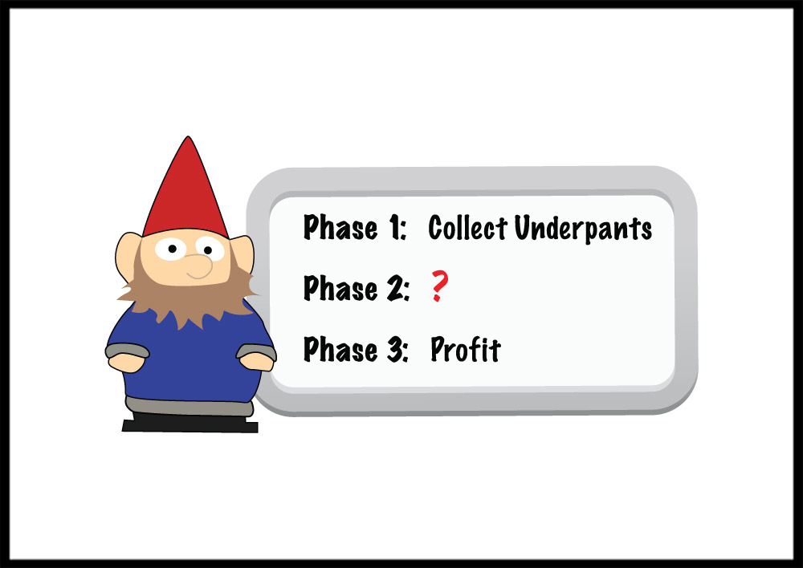
In the beginning: eduGAIN in 3 easy steps
Federations
http://www.tshirtlaundry.com/The-Underpants-Gnome_p_1441.html
Notes:
Image: http://www.tshirtlaundry.com/assets/images/photos/UnderpantsGnome12_2009.jpg
Page: http://www.tshirtlaundry.com/The-Underpants-Gnome_p_1441.html

Slide 4
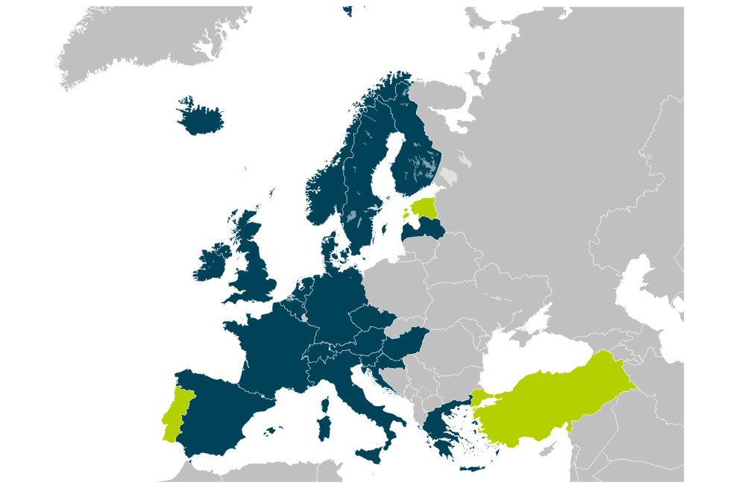
Early days of eduGAIN
eduGAIN Member
Joining eduGAIN
Candidate Federation
Known Federation

Slide 5
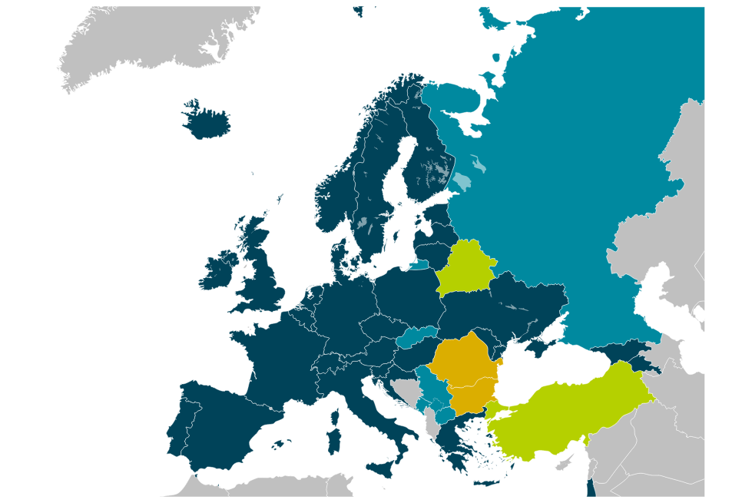
eduGAIN Initial Growth
eduGAIN Member
Joining eduGAIN
Candidate Federation
Known Federation

Slide 6
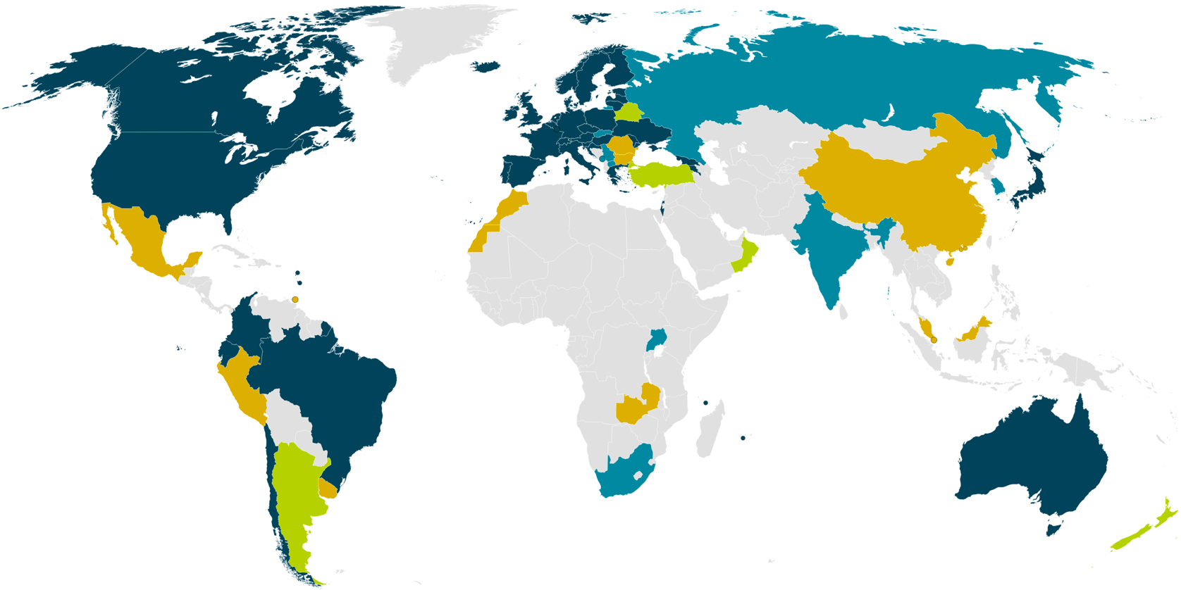
eduGAIN
38 eduGAIN Members
6 Joining eduGAIN
9 Candidate Federations
12 Known Federations
September 2016

Slide 7
Information from met.refeds.org
All IdPs | All SPs
3844 | 9103

Slide 8
Information from met.refeds.org
Information from eduGAIN Technical Status Page
All IdPs | All SPs
3844 | 9103
eduGAIN IdPs | eduGAIN SPs
2199 | 1335

Slide 9
Users define if something is useful…
!eduGAIN IdPs | eduGAIN IdPs | !eduGAIN SPs | eduGAIN SPs
1645 | 2199 | 7768 | 1335

Slide 10
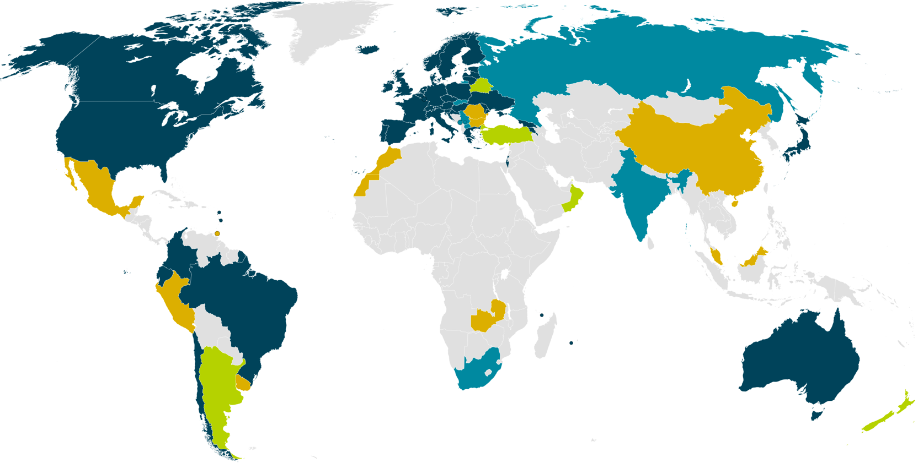
eduGAIN & Federation Status
38 eduGAIN Members
5 Joining eduGAIN
8 Candidate Federations
10 Known Federations
March 2016
Notes:
Big growth in new federations – many have aspirations to join eduGAIN and interfederate.

Slide 11
eduGAIN & Federation Status (% of entities)
15%
29%
78%
0.3%
38 eduGAIN Members
5 Joining eduGAIN
8 Candidate Federations
10 Known Federations
March 2016
Notes:
Australia: 1/252=
Brazil: 127/162=78%
USA: 482/3192 5720=8.4% (check this for eduGAIN content)
UK: 3131

Slide 12
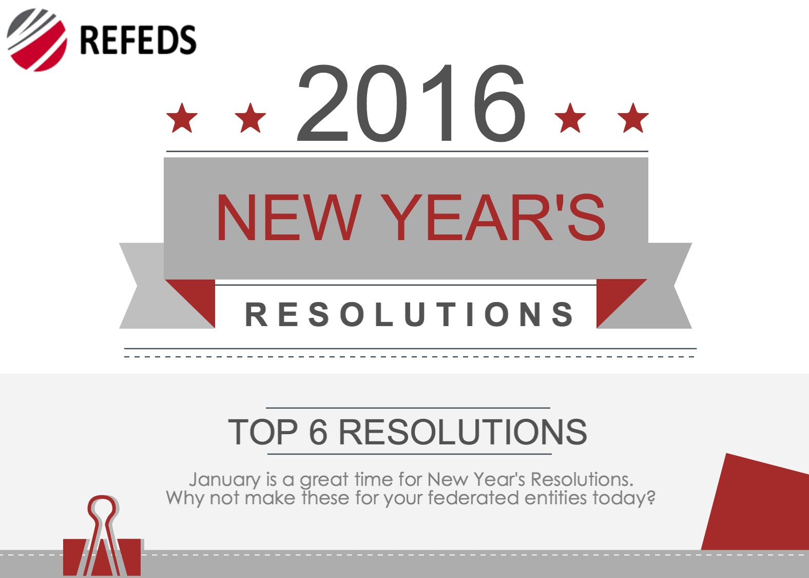
REFEDS New Year’s Resolutions 2016

Slide 13


#1 & #6 relate to Attributes

Slide 14

Getting to 100%
InCommon participation:
  75% of USA LIGO institutions are now in InCommon.
  95% of USA LIGO members are in InCommon institutions.
eduGAIN participation:
  74% of territories who have LIGO participants have eduGAIN
  90% with eduGAIN candidates (India, Korea and Russia).
  93% of LIGO users in nations with participating federations
  99% of LIGO users in nations (if you include candidates)
R&S entity category (InCommon and REFEDs) Support:
  44% of LIGO users from R&S asserting institutions
  78% of US LIGO users from R&S institutions
  21% of UK LIGO users from R&S institutions (all from Cardiff)
  --Warren Anderson, LIGO

Slide 15

SIRTFI
Combination of Security Practices that can be assessed or asserted.
Opportunity wider assessment using tools:
  SSL Labs Security Assessment
  Software Fingerprinting
  Metadata Description of SAML support
  Incident Response Readiness
  …more metrics.

Slide 16
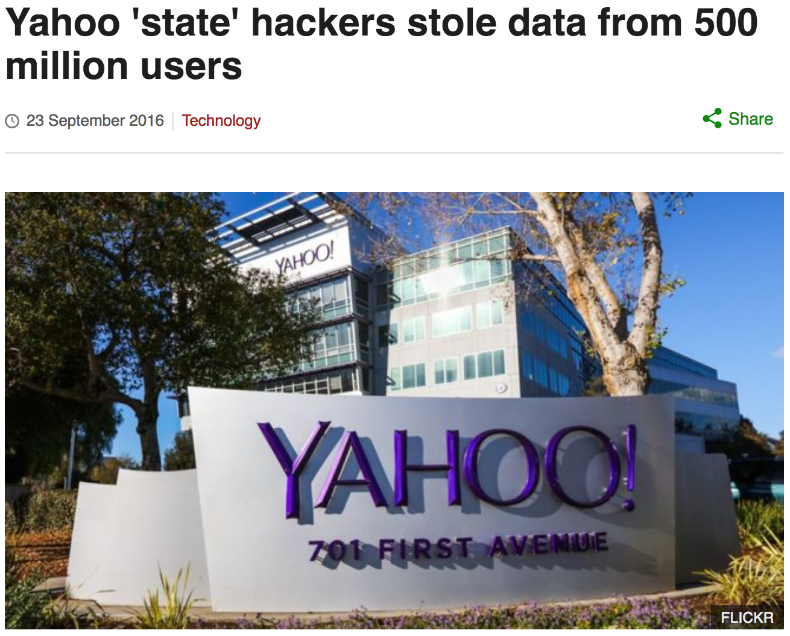
Why delegated auth?
Every service with a
“Login with Yahoo!”
2 year old problem!
Loss of trust in this
brand.

Slide 17
What’s left for eduGAIN?

Slide 18
Next steps…
Getting to 100%
CoCo and R&S to support attribute release
SIRTFI for increasing trust (MFA and 2FA at the IdP level)
Layers on top…
  Assurance
  eduTEAMS

Slide 19

New technology stacks

Slide 20


New technology stacks

Slide 21

We’re here to help…
edugain@geant.org

Slide 22
Brook.Schofield@GEANT.org

