Slide 1
Data Management Plans as Infrastructure: The Planning or the Plan?
With thanks for content & discussion:
Sarah Jones , DCC
Stephanie Simms, UC3
Daniel Mietchen, NIH
Angus Whyte, DCC
Helen Glaves, British Geological Survey
Kevin Ashley
Digital Curation Centre
www.dcc.ac.uk
@kevingashley
Kevin.ashley@ed.ac.uk

Slide 2
Why plans?

Slide 3
Lessons from History
1 – Helmuth (Karl Bernhard Graf) von Moltke the Elder

Slide 4
What we learn from history
“No battle plan survives contact with the enemy”
- Helmuth von Moltke the elder
“… I have always found that plans are useless, but planning is essental”
- Dwight D. Eisenhower
The data management plan is an evolving object, along with the research

Slide 5
Rather.. What is data management?
Thinking in advance about data collection, management, disposal, protection, description, reuse
Active work during research to ensure data is used to support current (and future) research objectives
Ensuring useful data survives the project and ends up somewhere that can care for it (and make it citable and reusable)
Part of good research design
A data management plan is a document which captures and documents this part of the project planning

Slide 6
Why do we plan?
To convince ourselves, or others
To avoid unforeseen pitfalls
To allow for discourse with peers
To be prepared for the unforeseen
To give clarity about responsibilities
Is it enough just to write the plan?

Slide 7
Is planning enough?
Sometimes, yes
Oftentimes no
Transfer of responsibilities
Automation of processes
Monitoring of risk
Some can be done with elements of plan, aggregates of plans
If plans aren’t monolithic objects, value increases

Slide 8
Possible elements of a plan
Introduction & context
Legal, rights & ethical issues
Access, data sharing & re-use
Data collection / development methods
Data standards
Short-term data storage & data management
Deposit & long-term preservation
Resourcing
Compliance & review
Agreement/ratification by stakeholders
For some areas of research, some of these areas will be empty or irrelevant – that doesn’t matter

Slide 9
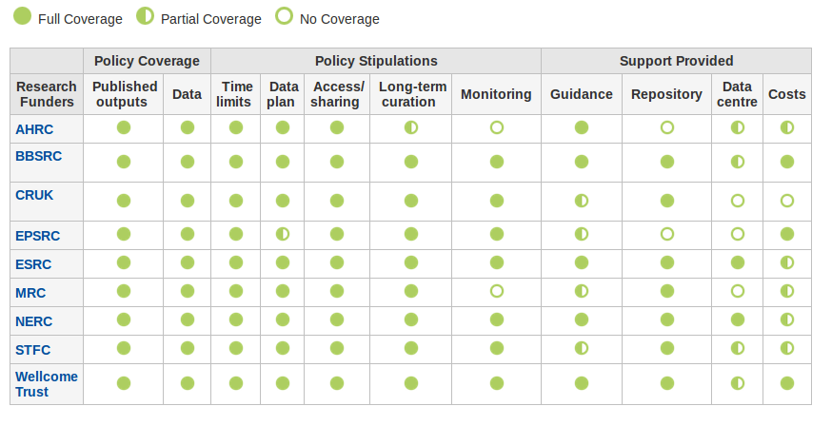
Funder requirements

Slide 10
Some other funders that require DMPs or equivalent
Institutional policies also exist

Slide 11
Result of funder requirements
DMPS become static documents that answer funder questions
Some honourable exceptions (NERC, EC)
There are some benefits, but….
Our tools weren’t designed this way
It doesn’t have to be that way

Slide 12
Dmp services as infrastructure

Slide 13
The services we have
Speaking on behalf of DMPonline & DMPTool – worlds most significant data management planning services
> 30,000 users ; >400 organisations; >40,000 plans created
Over 6 years in service
Currently merging our codebases for a single, global solution

Slide 14
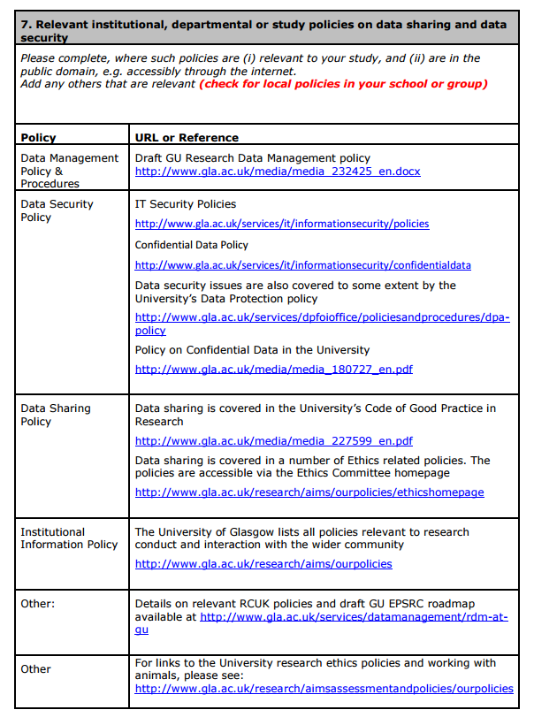
Suggested answers
The University of Glasgow has a template answer for the policy question in the MRC template.
The table is prepopulated with links to all the University policies.

Slide 15
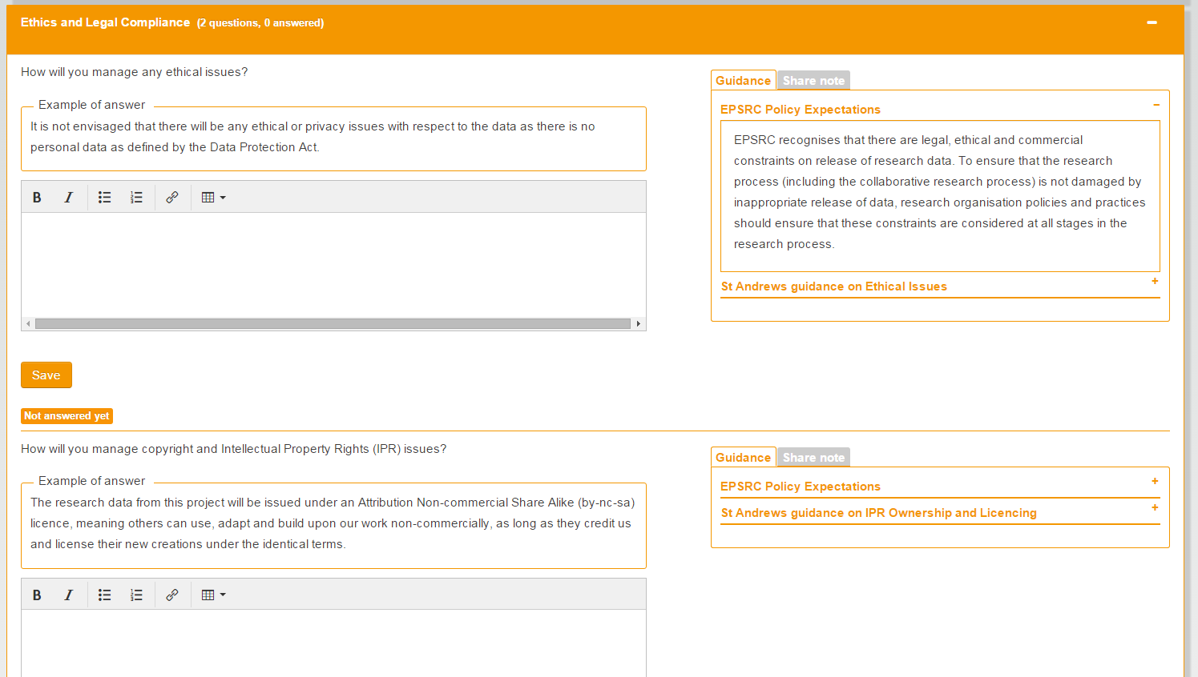
Example answers
St Andrew’s University has added example answers for every question in the EPSRC template

Slide 16
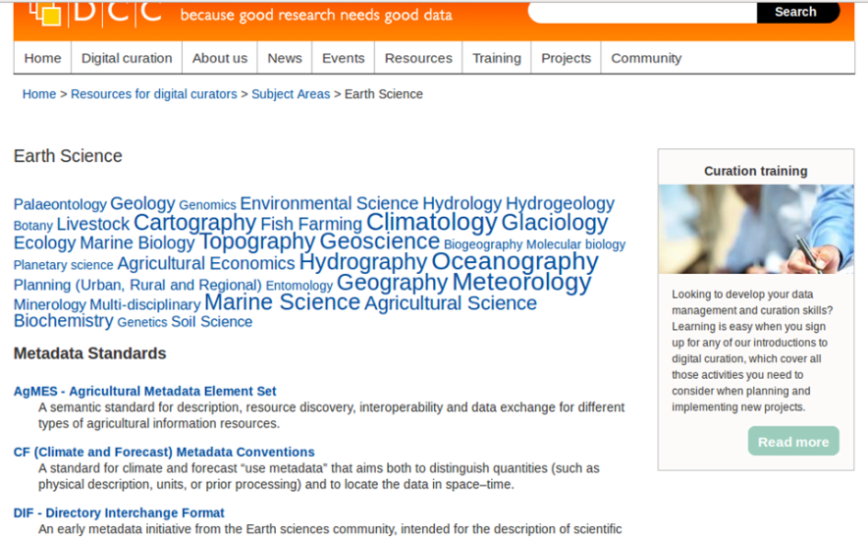
We’re using external infrastructure
Re3data – tool interrogates system to provide suggested repositories based on domain, location, funder
RDA disciplinary metadata catalogue – tool interrogates system to provide suggested standards for data description, annotation

Slide 17
A thought (and we have thought about it…)
Do you gain the benefit from planning if you don’t really write the plan?

Slide 18
Data management plans as infrastructure

Slide 19
Five common themes
Description of data to be collected / created
(i.e. content, type, format, volume...)
Standards / methodologies for data collection & management
Ethics and Intellectual Property
(highlight any restrictions on data sharing e.g. embargoes, confidentiality)
Plans for data sharing and access
(i.e. how, when, to whom)
Strategy for long-term preservation

Slide 20
Tagging by theme
http://www.dcc.ac.uk/blog/common-set-themes-dmps-seeking-input
Reducing complexity – 100s of funder questions semantically tagged with one of 17 themes
Eases extraction of knowledge from collections of DMPs or individual DMPs
Do you agree with our thematic breakdown? Tell us – comment on post above

Slide 21
Layered plans
Many large services effectively have a high-level data management plan
Individual projects produce plans which are variants or profiles of these plans
This should be expressed explicitly, by layering machine-readable expressions of plans
Many simple solutions – requires common agreement on preferred mechanisms

Slide 22
Actionable IDs
Many entities – researchers, funders, repositories, projects, datasets, services, standards , research resources – use actionable identifiers
Some already embedded in DMPs – but not exploited by infrastructure
Alert an archive that it’s expecting content
Initiate an earlier dialogue between repository and researchers
Provide usage information on standards
Many tasks in compliance and usage monitoring

Slide 23
Summary – plans and tools
Service registry
Funder system
Think of DMPs as key elements of a networked data management ecosystem:
connected via a shared vocabulary
actionable by humans and software
versioned
Public
Think of the services that produce them as consumers and producers in a wider infrastructure
Focus on benefits to research (not necessarily researcher) with other benefits as low-cost side effect
CRIS
Publishing platform
Repository
Standards Maintainer

Slide 24
LETS TALK

