Slide 1
Science engagement in GÉANT:
how we do it
Vincenzo Capone
Senior Technical Business Development Officer
Digital Infrastructure For Research
Krakow, 14 June 2016

Slide 2
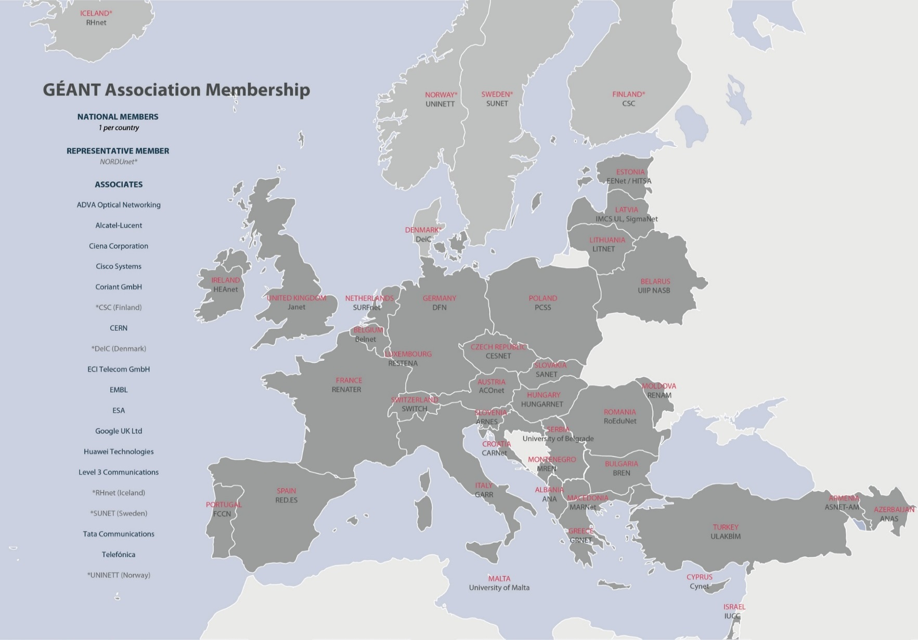
Current members
50.000.000 users
10.000 institutions
40 countries
Notes:
GEANT

Slide 3

User support: what do users see?
Imagine two collaborators in two different countries:
  Different connecting NREN
  Different services, with different T&Cs
  Which services are available to them end to end?
  What are the business models along the delivery chain?
Now imagine 30 users in 30 countries…

Slide 4
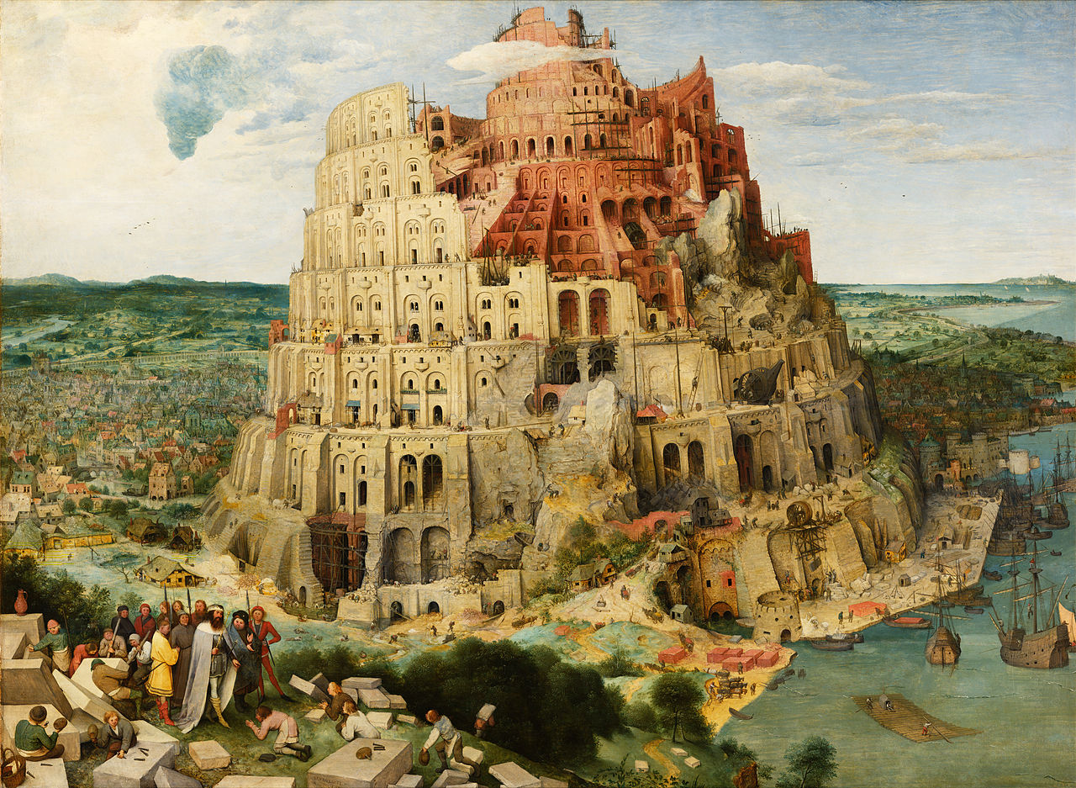


Slide 5
Support for International Users
Dedicated User Support Team
Single point-of-contact for international collaborations and organisations
Providing a one-stop-shop
Policy and technical consultancy
User’s voice within GÉANT
  International User Advisor Committee, NREN feedback, Surveys, Conferences, Focus Groups….
Notes:
to ensure users gain full benefit from the GÉANT infrastructure and services
to analyse, implement and manage international networking needs
for public and commercial organisations wishing to connect to GÉANT

Slide 6
The One-stop-shop concept
Work closely with Users, NRENs, other e-Infrastructures and GÉANT subject experts
Discuss and understand user requirements
Develop a consolidated and consistent solution for all involved sites:
technical/administrative/financial/contractual
Ensure seamless service implementation and operation through full project lifecycle management
Respect for the NRENs administrative boundaries→ GÉANT connects networks, not end-sites

Slide 7

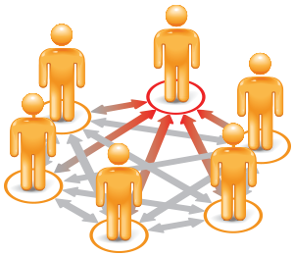

How we do it
(our very own “3 Cs”)
Communication
  Direct liaison with key contacts within the user communities
  Support from the Partner Relations team for the liaison with the NRENs
Coordination
  Project management for the whole activity or for specific tasks
Consultancy
  Solution advisory, product selection
  With the support of the Service Assurance team

Slide 8
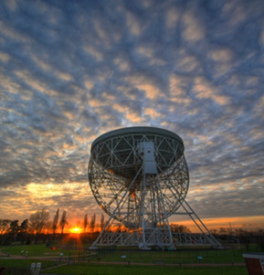
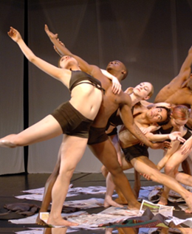
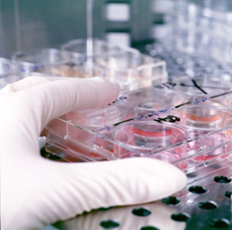
Users we work with
High-Energy Physics and Astronomy
Earth Sciences and Observations
Future Internet Projects
Life Sciences
Social Sciences, Arts and Humanities
E-Infrastructures
Notes:
Via the GÉANT User Support Function, GÉANT actively engages with a broad range of user communities

Slide 9
Some scientific user groups we liaise with
Physics sciences
  High-energy physics (LHC, BELLE II, CERN, etc.)
  Neutrino observation (KM3NET)
Astronomy and Earth observation
  Earth observation (EUMETSAT, COPERNICUS)
  Radio-astronomy (eVLBI, SKA, etc.)
  Satellite operations (ESOC)
E-Infrastructures (EGI, EUDAT, PRACE, HelixNebula)
Life sciences
  Genomics (Elixir, EBI, EMBL)
  BioImaging
Future Internet projects (XiFi, Confine, SmartFire, etc.)

Slide 10
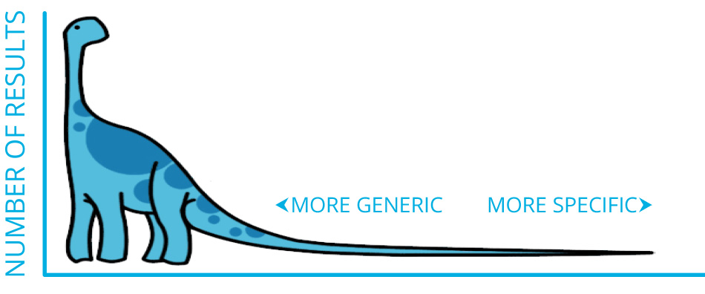
The “long tail”
New-comers
Switching from local/individual to distributed research models
New ways of sharing knowledge
  E-learning
  Digital libraries
Innovative research tools
Notes:
Lots of community and science collaborations are still beyond our reach

Slide 11



Increase liaison opportunities
Provide a common space
Organize community-specific workshops
Attend users’ events
Notes:
where the two communities can exchange information and get mutual awareness
Not all communities are created equal
E.g.: Life science researchers have different needs than climate scientists
Helps to create a (human) network and to get a deeper knowledge of what scientists do

Slide 12

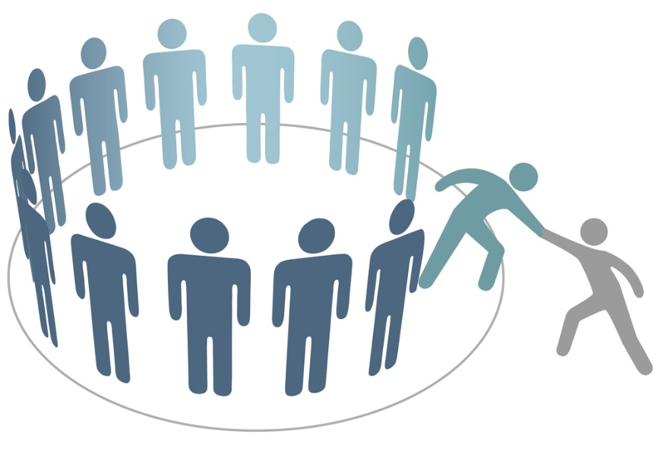
“Get into” the science
Have some science-savvy people on board
Get involved in the science collaborations
Notes:
For example, GÉANT is a member of the SKA SADT Consortium, a participant in the GEO collaboration

Slide 13





Example: Group on Earth Observations (GEO)
  Formal role in GEO Work programme (start Jan 2016)
  To secure wider and sustainable global access to Earth Observation data
  Objectives:
    Explore new technologies and cooperation to improve existing infrastructure (gaps/future demands)
    Support AfriGEOSS to improve data dissemination to and from Africa
  First successful steps made:
    Potential services for further assessment identified (SSO, Multicast, Clouds)
    Relations between AfriGEOSS and African R&E networks established
GEO Task Team: GÉANT NA3 (Lead), WMO, Météo France, DWD, EUMETSAT, GEO Secretariat
Notes:
Background
GÉANT joined GEO in 2008 on behalf of the NREN community
Active participation in GEOSS Work Programmes since 2014
GEOSS Work Programme – GEANT appointed Task Lead in current GEOSS Work Programme for Foundational Task GD11 Advancing Communication Networks
Challenge:
Further develop the GEOSS communication infrastructure (Internet, R&E networks, GCI, WIS and GEONetCast) for wider and sustainable access to Earth Observation data and information
Solution:
“Start with the known” - Focus on improvements of existing infrastructure (gaps/future demands)
Explore new technologies and cooperation to advance GEOSS communication networks (SSO, Multicast and Clouds)
Support AfriGEOSS to improve data dissemination to and from Africa
Achievements so far:
Suitable services for use cases identified (SSO, Multicast, Clouds)
First relations between AfriGEOSS and African R&E networks established,, following this ASRE joined GEO as formal member in July 2016
Proof of Concept for eduGAIN adoption of WMO incepted
GEANT re-appointed as Task Lead for WP 2017 - 2019
General Challenges:
Vast and differing communities
Two complex and big projects
Lack of knowledge about each other (also within each communities)
Rely on in kind contributions
→ In short: a lot in common!

Slide 14
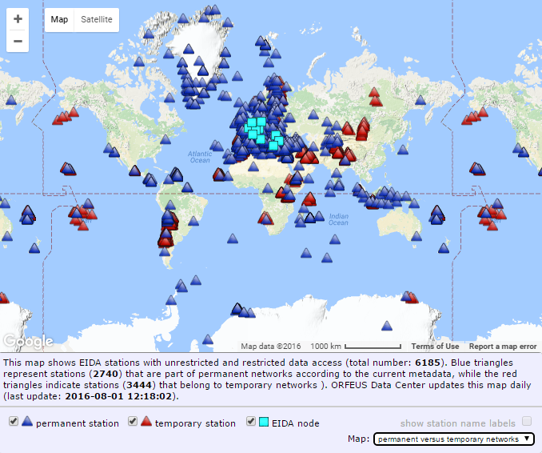




Example: European Integrated Data Archive (EIDA) for seismological data
EIDA is the largest and most advanced user community within the Earth Plate Observation System (EPOS)
Need for a scalable AAI system that works via
desktop and web client
Federated archive: 11 European seismological data centres storing globally collected data
~ 1.3TB data downloaded/day, global user
community
Joint effort of GFZ (German EIDA node), GÉANT, SWITCH & DFN (via NA4 and SA5 User Support Teams)
1. Integration of all 11 nodes into eduGAIN
2. Set up an EIDA IdP hosted at GFZ, integrate into eduGAIN
3. Development of Service Provider Pilot “EIDA Authentication Service (EAS)”
4. Support move from SP prototype into production
Notes:
Lead NREN: DFN
GFZ – EIDA main node
Background
Federated Archive comprised of 11 European seismological data centers
Most of the data (~95%) is open , ~ 1.3TB data downloaded/day, global user community
seismologist use desktop client to request data, need to sign in to each data archive individually (you need data sets from various archives for one calculation)
EIDA is largest and most advanced user community within EPOS
Challenge
Need for Authentication and Authorization System: embargoed data, accurate statistics on data usage for open data
Data access solution needs to be scalable and decentral (avoid bottlenecks)
Solution needs to work via both desktop and web client
Solution/What we have done:
1. Integration of all 11 nodes into eduGAIN
2. Set up an EIDA Identity provider hosted at GFZ and integrated into eduGAIN.
3. Development of Service Provider Pilot “EIDA Authentication Service (EAS)”:
4. Supported the move of the SP from Prototype into Production.
→ Joint effort of GFZ (German EIDA node), NA4 and SA5 User Support Teams (GEANT, SWITCH, DFN)
Next steps GN4-2
Complete integration of all EIDA nodes into eduGAIN & roll out of SP to all EIDA nodes
Invest broader adoption of SP from other research groups (there is already interest)

Slide 15
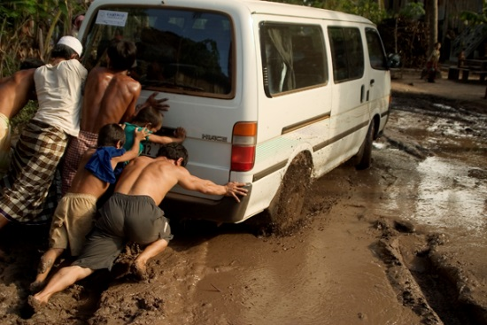
Coordinate the efforts
An “Open Informal International Science Engagement Team” is taking shape…
Notes:
Started at TNC15, going through SC15, I2GS, TNC16 and now DI4R

Slide 16
Working on a Task Force proposal
Research Engagement Development Task Force (TF-RED, in short)
More than 60 people have expressed interest in it, from both Europe and America
First informal meeting held at TNC16, in June
Currently finalizing the Terms of Reference to submit the proposal

Slide 17
Join the mailing list if you want to be part:
https://goo.gl/Hmxl1j
vincenzo.capone@geant.org

