Slide 1
Apply User-Driven Approach in Service Development:
The INDIGO Experience
Yin Chen, yin.chen@egi.eu, EGI.eu
Fernando Aguilar, aguilarf@ifca.unican.es , IFCA-CSIC
Jesus Marco, marco@ifca.unican.es , IFCA-CSIC
INDIGO WP2 Team
INDIGO Collaboration Team, infor@indigo-datacloud.eu
RIA-653549

Slide 2
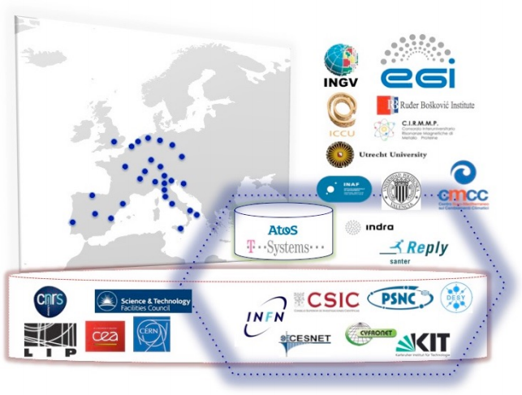
The INDIGO-DataCloud Project
INDIGO = INtegrating Distributed data Infrastructures for Global ExplOitation
H2020 project, Apr 2015 – Oct 2017, 11M EURO
26 partners in 11 European countries
Objectives: Develop a data/computing platform, targeting various scientific communities and deployable on hybrid (private or public) Cloud infrastructures
Website: https://www.indigo­‐datacloud.eu
INDIGO-DataCloud RIA-653549
2

Slide 3
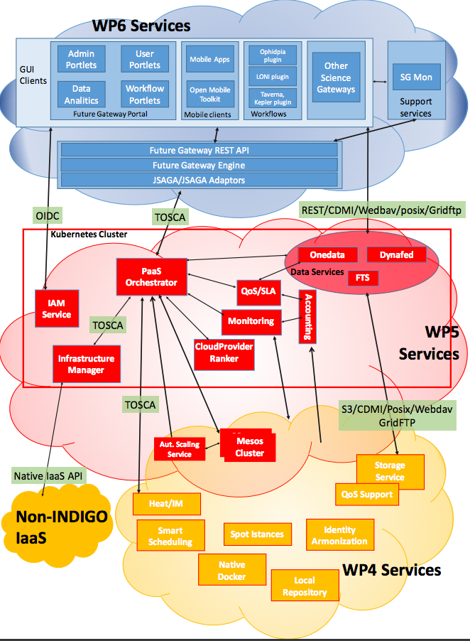
INDIGO
Architecture
Enhanced features in
  IaaS
  PaaS
  SaaS
1st release MidnightBlue
  Data Center Solutions
  Data Solutions
  Automated Solutions
  High-level User Oriented Solutions
INDIGO Session: Thurs 29th Sep, 16:00-17:00
INDIGO-DataCloud RIA-653549
3

Slide 4
User-Driven Approach
A framework give attention to users’ needs and wants
  Foresee how users are likely to use the product
  Test the validity of the assumptions at each stage
  Create a circle of proof back, confirm or modify original requirements
  Optimize the product around how users can, want or need rather than forcing the users to change their behaviors
Principles
  The design is based on an explicit understanding of users, tasks, environments
  Users are involved throughout design and development
  The design is driven and refined by user-centered evaluation
  The process is iterative
INDIGO-DataCloud RIA-653549
4

Slide 5
INDIGO Practices
Requirement Collection
Researchers to describe Case Studies, User stories, that are grouped into common Requirements
Understand how INDIGO services will match communities requirements
Confirm with developers to address requirements in design
Identify communities Champions
  Advanced research activities (postdoc+ level)
  Different Technical/Scientific background/interest
  Share activities inside INDIGO (with developers)
Using Tool for communication, i.e. OpenProject
  Record Case Studies, User Stories, Requirements
  Track INDIGO developments
  Communicate with INDIGO developers
Co-Design Interactions
Integration Testing
Explore all INDIGO service components
  Help to prepare integration solutions
  Setup Testbeds: Realistic resources where demos can be built
5

Slide 6
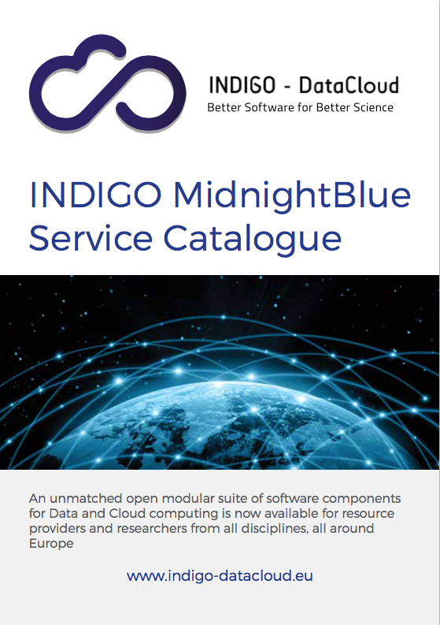
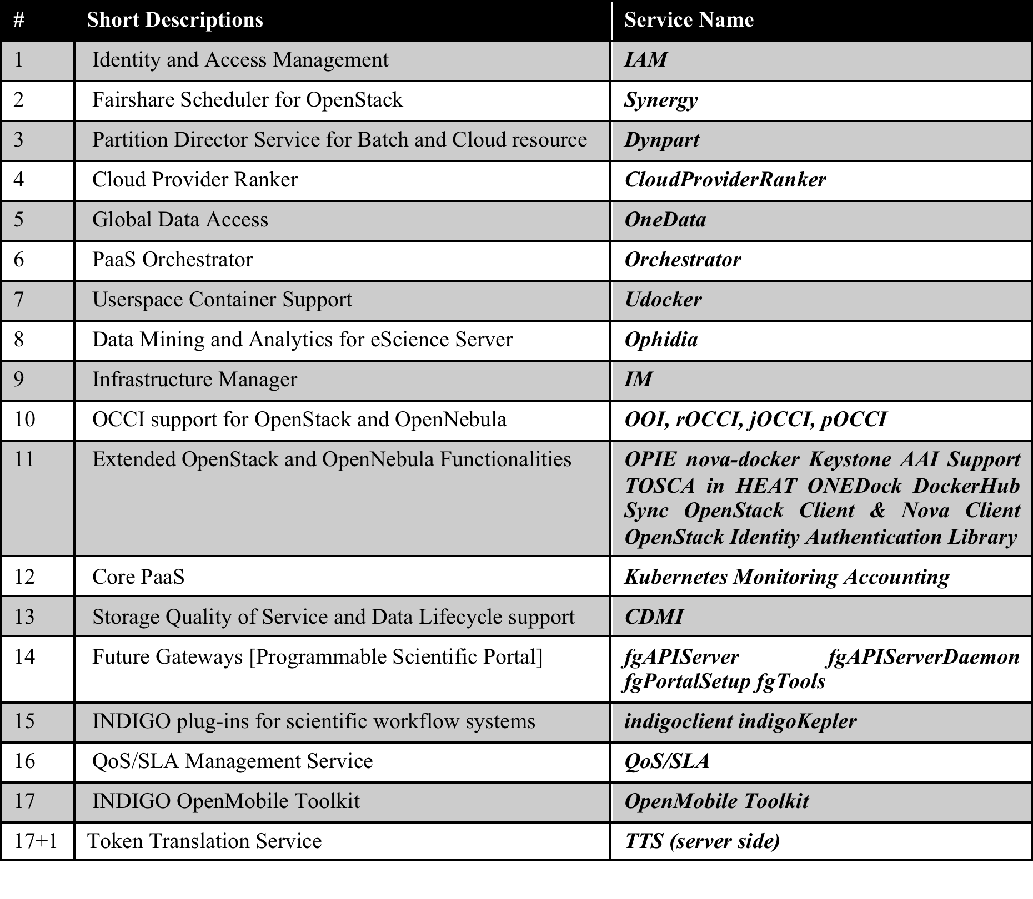
INDIGO Service Catalogue
https://www.indigo-datacloud.eu/service-component

Slide 7











Case Studies
Case Study P0_1: Monitoring and Modelling Algae Bloom in a Water Reservoir [LifeWatch]
Case Study P0_2: TRUFA (Transcriptomes User-Friendly Analysis) [LifeWatch)]
Case Study P1: Medical Imaging Biobanks [EuroBioImaging]
Case Study P2: Molecular Dynamics Simulations [INSTRUCT]
Case Study P3_1: Astronomical Data Archives [LBT]
Case Study P3_2: Archive System for the Cherenkov Telescope Array [CTA]
Case Study P4_1: HADDOCK Portal [WeMNR]
Case Study P4_2: DisVis [WeMNR]
Case Study P4_3: PowerFit [WeNMR]
Case Study P5: Climate models inter comparison data analysis [ENES]
Case Study P6: eCulture Science Gateway
Case Study P7: EGI FedCloud Community Requirements [EGI]
Case Study P8: ELIXIR-ITA: Galaxy as a Cloud Service [ELIXIR-ITA]
Case Study P9: MOIST—Multidisciplinary Oceanic Information System [EMSO]
Case Study P10: Data repository platform for DARIAH [DARIAH]

Slide 8
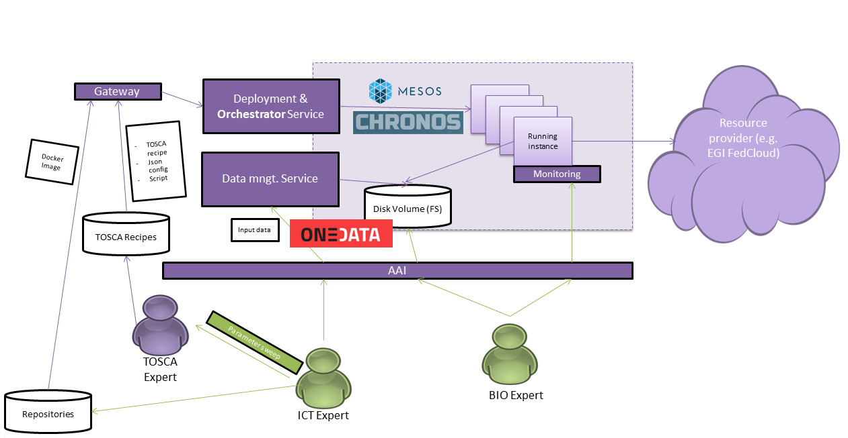
Case Study P0_1: Monitoring and Modelling Algae Bloom in a Water Reservoir
The case study aims to address a complete solution to monitor and model algae blooms in a water reservoir or similar water mass
Mange the simulation
Reads TOSCA configuration to deploy
Monitor
enables distributed data storage system
INDIGO enables deployment and compute a large number of simulations over a distributed cloud environment
INDIGO POSTER: INDIGO-DataCloud Services for Algae Bloom Forecasting, Fernando Aguilar Gomez, et al.

Slide 9
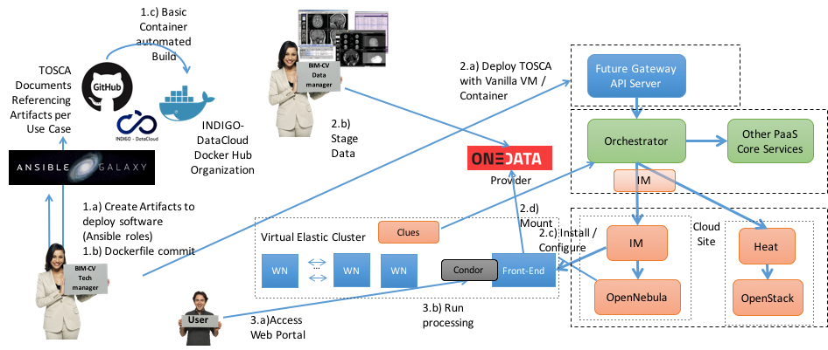
Case Study P1: Medical Imaging Biobanks
Aim to create virtual infrastructures for development, testing and applying image-processing pipelines in population-wide datasets
To instantiate the infrastructure
To create volumes, store them on deployed infra, mount to processing resources
Configuration and contextualization of the software
Provide the elasticity mechanisms to manage the Mesos cluster
INDIGO enables deployment of scalable and fully customised virtual infras with access to data

Slide 10
Case Study P2: Molecular Dynamics Simulations
The case study aims to define the implementation of different MD protocols tailored to different applications, which typically involve multi-threading
For submission of MD simulations from an existing web interface
For running calculations
INDIGO enables parallel processing of MD algorithms
INDIGO POSTER: Application of INDIGO-DataCloud Solutions to the development of an automatic workflow for Molecular Dynamics simulations, Antonio Rosato, et al.

Slide 11
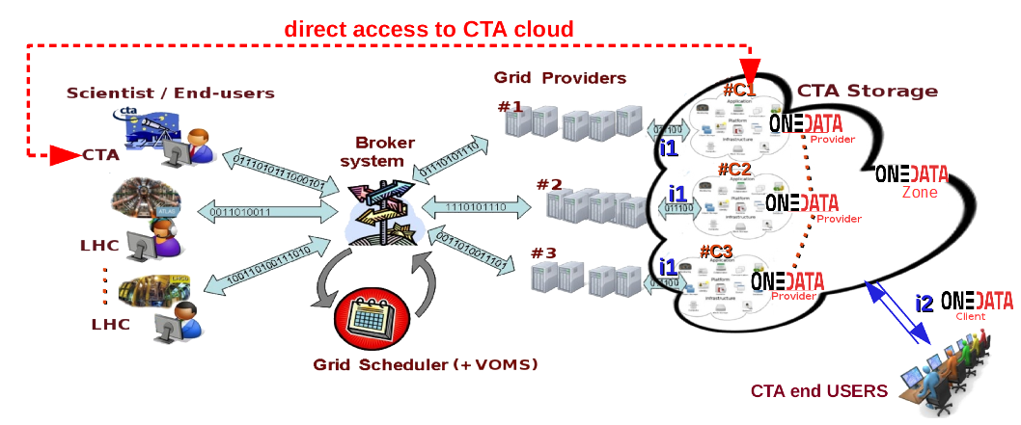
Case Study P3_2: Archive System for the Cherenkov Telescope Array
The case study aims to implement a first CTA Archive for data management, treatment and flow of data, big data archiving and processing, open data access
INDIGO enables data managements to the existing Grid-based systems

Slide 12
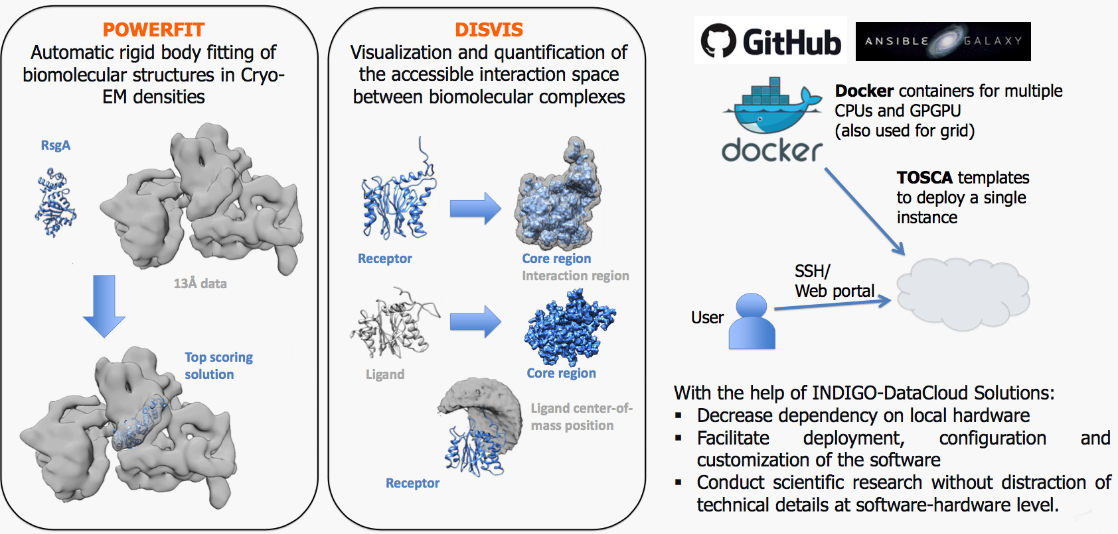
Case Study P4: POWERFIT & DISVIS
The case study aims to deploy the computing biology software POWERFIT and DISVIS to the Cloud
INDIGO enables access to GPGPU for computing intensive processing

Slide 13
Case Study P5: Climate models inter comparison data analysis
User interface to submit the analytics experiments
intermediate component between the user interface and both the INDIGO and the community-oriented services
workflow management system orchestrating the climate experiments across multiple sites
orchestrate the configuration and contextualization of the software
big data stack for running climate data analytics set of operators.
The case study aims to deal with climates models intercomparions data analysis, requiring large amount of data
INDIGO enables Big Data anaylsis

Slide 14
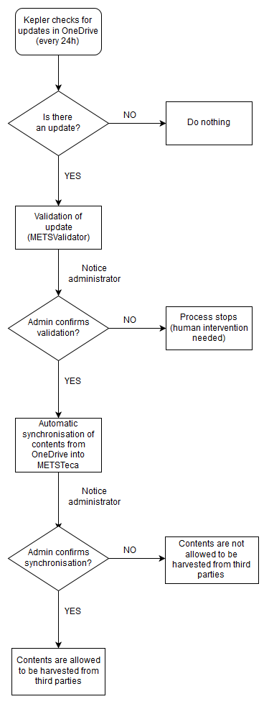
Case Study P6: eCulture Science Gateway
The case study aims to develop a digital repository collection support that allows users to upload, download digital documents and manage metadata, in collaboration with INFN Catania

Slide 15
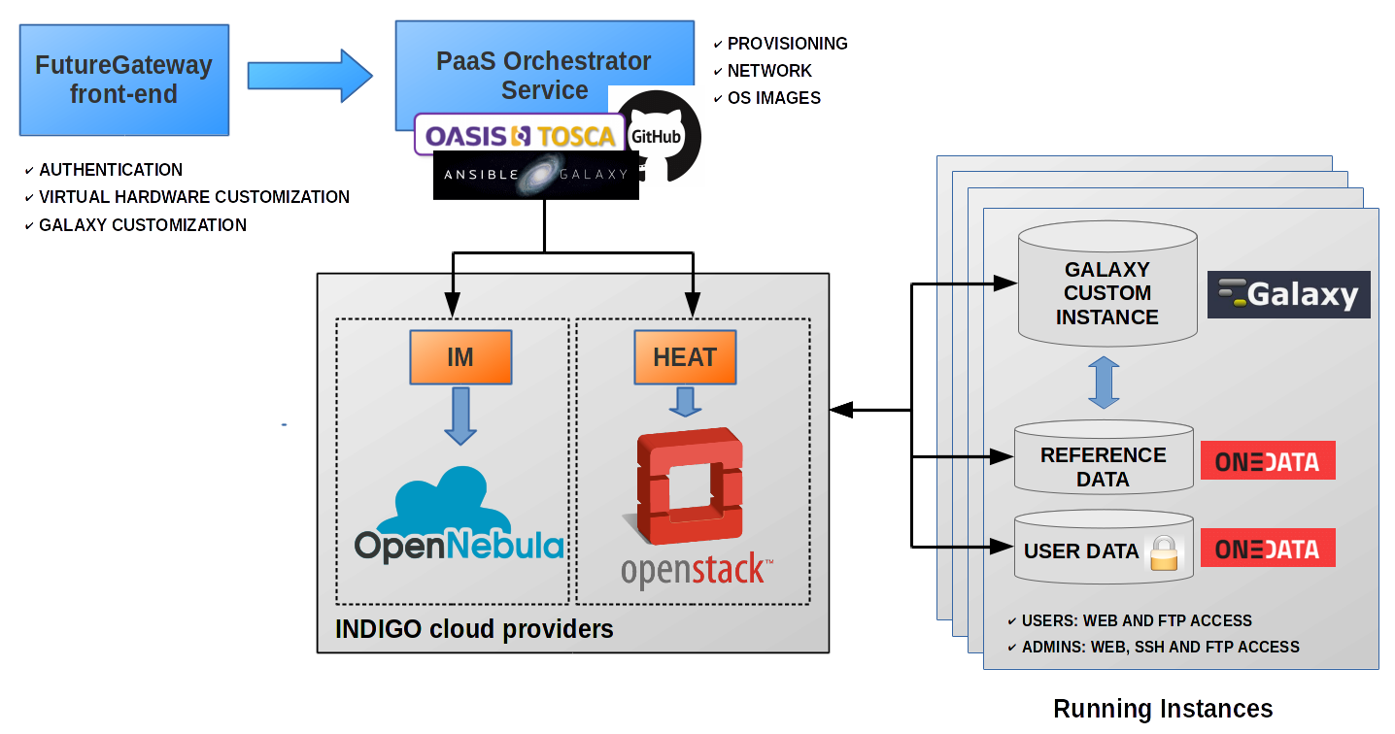
Case Study P8: ELIXIR-ITA: Galaxy as a Cloud Service
The case study aims to develop a fully customizable Galaxy instance provider platform. The goal is to provide, through an easy setup procedure, an on-demand workspace ready to be used by life scientists and bioinformaticians

Slide 16
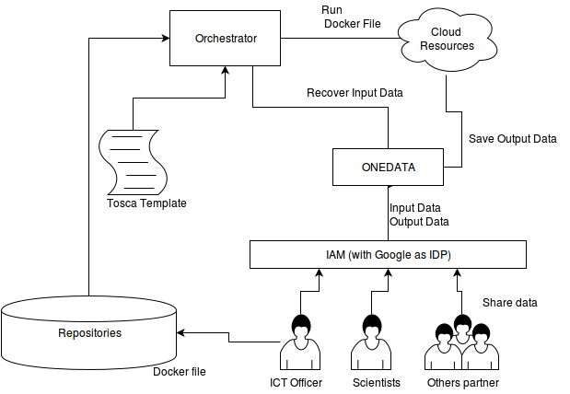
Case Study P9: MOIST—Multidisciplinary Oceanic Information System
The case study is to pilot a Cloud-base MOIST system for improving the performance of processing of deep ocean observation data

Slide 17
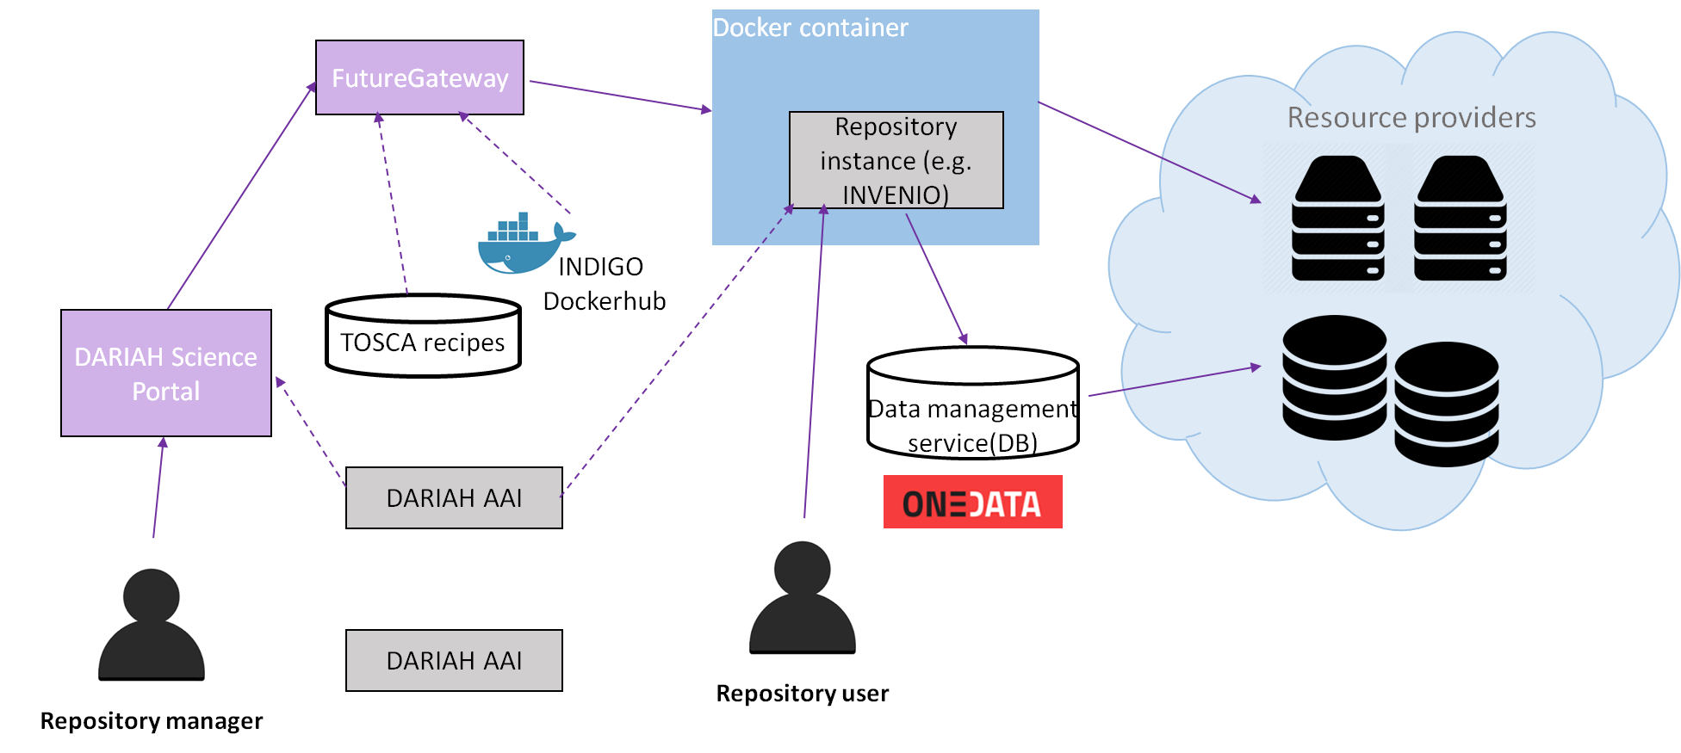
Case Study P10: Data repository platform for DARIAH
The case study aims to develop a user-friendly platform that simplifies the process of creating, setting up and managing repositories of digital assets.
INDIGO POSTER: DARIAH meets INDIGO-DataCloud: Developing a Repository Platform for Digitial Arts and Humanities Data, Davor Daviovic, et al.

Slide 18
Summary
INDIGO experience of User-Driven approach
  Ensure the results are useful to support real-world needs
  Failing to do so communities would not be willing to incorporate the solutions developed
Case Studies
  What are real-world needs
  How INDIGO can help

Slide 19
Questions?
Thanks for your attentions
INDIGO-DataCloud RIA-653549

