Slide 1
Solutions for federated services management
EGI
Diego Scardaci
Technical Outreach Expert
EGI Foundation

Slide 2
Services to enable the Federation
The EGI Platform Architecture
Community Platforms
Brokering, community-specific data, tools and applications
Collaboration Platform
VM Image Catalogue of
EGI endorsed VM images, Helpdesk
Cloud
GPGPU Platform
Open Data Platform
Data-intensive computing
EGI Core Infrastructure Platform
AAI, Service Registry, Accounting, Monitoring
Federated Service Management
Physical Infrastructure

Slide 3
Services to enable the Federation
The EGI Core Infrastructure Platform
The EGI Core Infrastructure Platform provides all the tools to operate and manage a distributed infrastructure
Single Sign-On and VO management
Catalogue of the services
Status of the infrastructure
Ticketing System
AAI
Service Registry
Information Service
Helpdesk
Services A/R
Usage or resources
VO management & Dashboards
Coord. Activities
Monitoring
Accounting
Operations Portal
Operations Support
Messaging Infrastructure
Security Coordination
EGI Core Infrastructure Platform
Notes:
Add Icons if available

Slide 4
Services to enable the Federation
EGI Federated operations
The EGI Federated Operations is organized in a distributed and hierchical structure.
Operations coordination
EGI.eu
Core infrastructure platform
Operations Management Board
Ops Centre
Ops Centre
Ops Centre
NGI/EIRO’s Resource Infrastructure
NGI/EIRO’s Resource Infrastructure
Integrated Resource Infrastructure
Resource Centre
Resource Centre
Resource Centre
Resource Centre
Resource Centre
Resource Centre
Notes:
Architecture of EGI Operations, EGI.eu, NGIs/EIROs, Resource Centres, Core activities

Slide 5









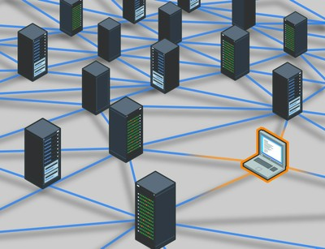

Authentication and Authorisation
The EGI AAI and trust model
Single-Sign-On over the whole infrastructure
Level of Assurance
TRUST
Information sent to service providers
Community
attributes
“User A”
User
TRUST
EGI Services
Community Attribute
Authority
Notes:
New slides from Peter with the EGI Check-in service

Slide 6






AAI
The new EGI AAI architecture
EGI infrastructure
X.509 Attribute Authority
Attributes
EGI Resources
Attributes
Community Portals
Token translator
EGI Tools
IdP
EGI CheckIn
Attribute Authorities
Attributes
SP
User
Social IDs
eGOV ID

Slide 7
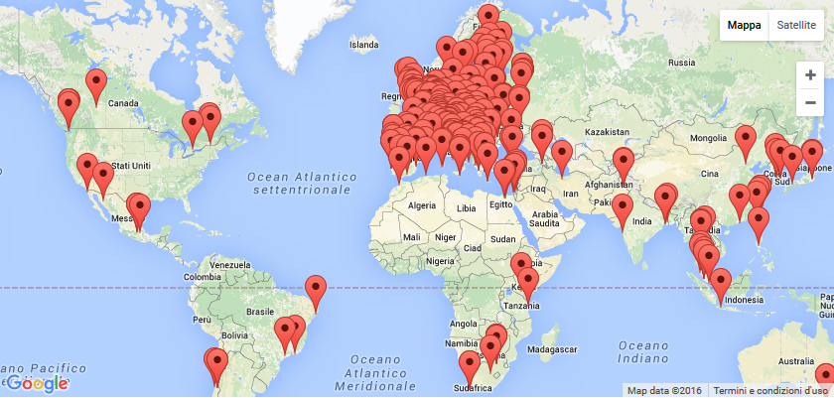
Configuration management
The EGI Service Registry - GOCDB
Catalogue to record information about resource providers, services, service-endpoint of a digital infrastructure
Central input system for recording topology information of the infra
Store:
  Service Endpoints
  Service downtime information
  Contact details for participants who maintain the infrastructure
Accessed by:
  end-users, RP managers, support teams, VO managers, by other tools (e.g. monitoring)
Fine-grained access model
Provisioned via a central instance
  Support multiple projects
Notes:
Add logo providers (for all tools)

Slide 8
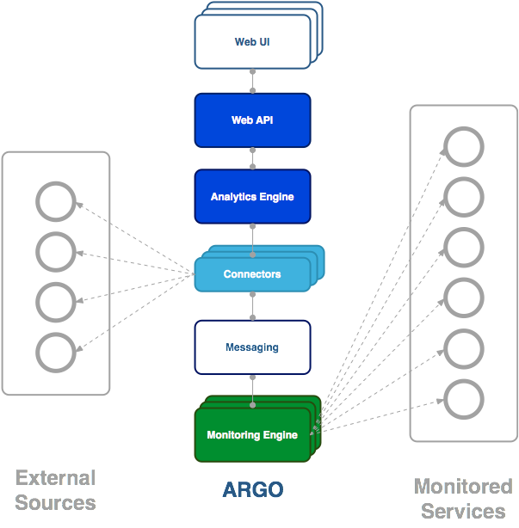
Monitoring
The EGI Monitoring System - ARGO
Framework for monitoring status, availability and reliability
Availability & Reliability monitoring:
  Rack a vast number of monitoring metrics
  Provide real-time notifications and status reports
  Monitor SLAs/OLAs
  Relies on Nagios for status monitoring
Multiple reports using customer defined profiles
  Custom monitoring for each community
Centrally provisioned
  Monitoring as a Service

Slide 9
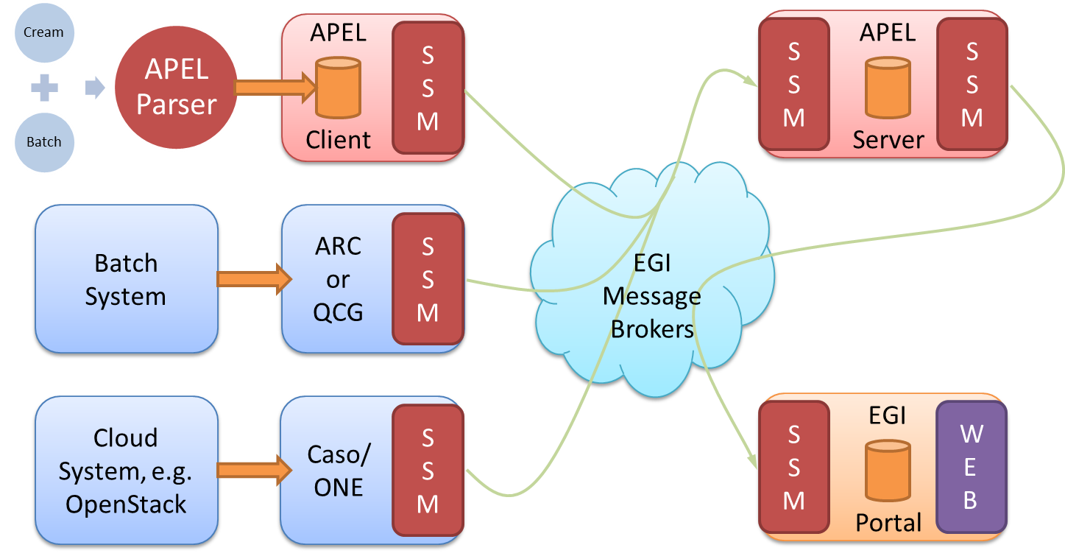
Accounting
The EGI Accounting system
Gather usage information across the whole infrastructure
System that involves various sensors in different regions, all publishing data to a central repository
The data is processed, summarized and displayed in the accounting portal
Service
Accounting Repository
Probe
Accounting Portal
Probe

Slide 10




Security
EGI Security monitoring tools
Monitor the status of the services for vulnerabilities or misconfiguration
Active monitoring: monitoring computing tasks and local probes send the list of deployed packages to a central repository
Passive monitoring: probes the external behavior of the services (e.g. HTTPS configuration)
The information are available for the security teams through a central Dashboard
EGI CSIRT
EGI SVG
O.C. CSIRT &
Sites security
Add security checks monitor services status on the dashboard
Vulnerabilities to be monitored
Monitor resource centres status on the dashboard
EGI Security Monitoring
Active and passive monitoring
EGI Resources

Slide 11
Other Services
Other services
Ops portal
  Tools and dashboards to manage the infrastructure
    VO dashboard, COD dashboard, Operation dashboard, Security dashboard, broadcast and downtime notification mechanism.
GGUS
  Ticketing system to require support
Messaging
  High Availability and high throughput Message Broker Network
    Towards 1 Billion messages per year, ~2000 Queues
  Backbone for infrastructure monitoring and accounting
  New Pub/Sub HTTP Messaging Service
Notes:
Diego

Slide 13
Questions for the Panel
How can e-infrastructures collaborate on federated service management? A common approach could be feasible?
Can your e-infra profit of some services provided by another e-infra?
  Do you see any overlap in the activities of the 4 e-e-infras? Collaboration between e-infra could reduce the development and maintenance costs?
Which services should be make interoperable to give a better experience to our users?
What are the next steps?
  Which collaborations can start now?

