Slide 1
EGI DataHub Training
Diego Scardaci (EGI.eu)
Technical Outreach Expert
diego.scardaci@egi.eu

Slide 2
Outline
What is the EGI DataHub
Training testbed
Exercise 1: Access Copernicus Data stored in the EGI DataHub
Exercise 2: Create a new space in the EGI DataHub
  Create a new space
  Support it with your provider
  Upload data through the web interface
Exercise 3: Access data with OneClient
  Mount a virtual file-system in your machine
  Create a new file in the virtual file-system
  Download the file from the EGI DataHub web interface
Exercise 4: Share your data!
  Give access to your test data to the other attendees
Notes:
TODOs:

Slide 3
EGI DataHub
EGI DataHub
  single point of entry for Data sets published and managed on EGI federated infrastructure
  provides access to
    reference scientific data of public interest
    hosts experimental or temporary scientific data
  supports fine-graind access policies
DI4R Digital Infrastructures for Research, September 2016, Krakow

Slide 4
Training testbed

Slide 5
Testbed
Central EGI DataHub
  datahub.egi.eu
5 pre-installed providers available for you
  deployed into the EGI Federated Cloud
  5 groups to be formed
  1 provider will be assigned to each group
Access via ssh needs a key
  IP and credentials to access will be given to each group

Slide 6
Excercise 1
Access Copernicus Data stored in the EGI DataHub

Slide 7
Exercise 1
Access Copernicus Data in the EGI DataHub
What you have to do:
Login to the EGI DataHub
    You can use your EGI SSO or your institute IdP
Access the PlGrid provider
Download some Copernicus files

Slide 8
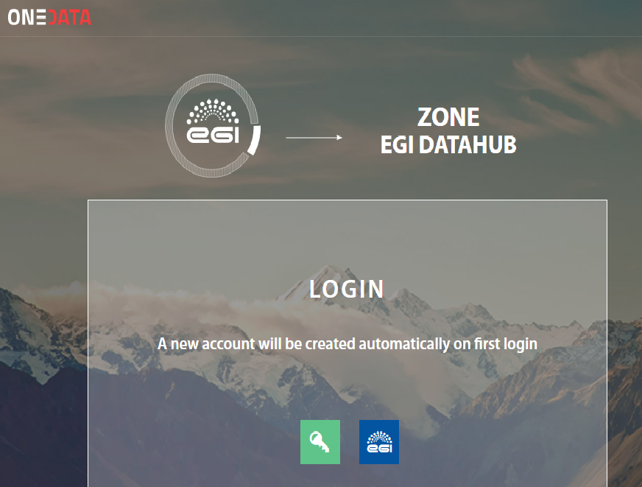
Log into the EGI DataHub (1)
Open your browser and go to
  datahub.egi.eu
Select EGI

Slide 9
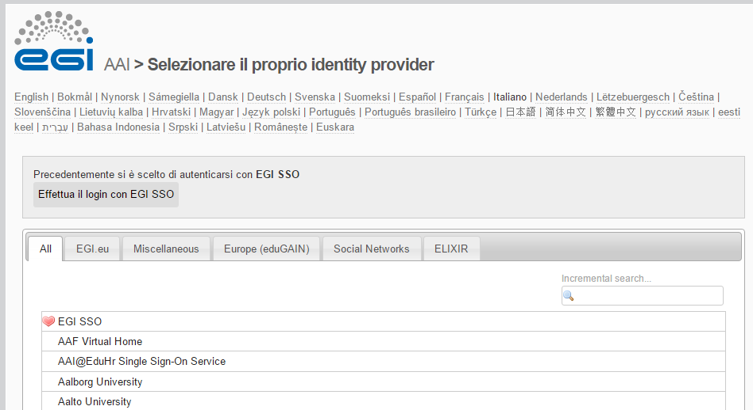
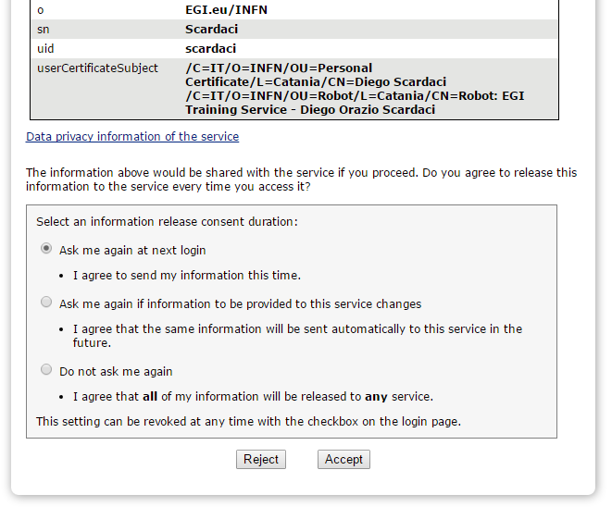
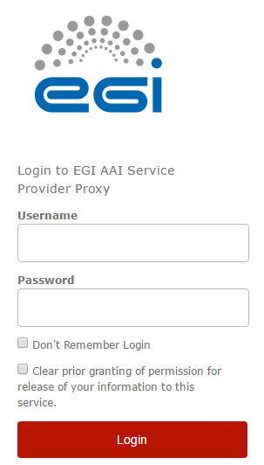
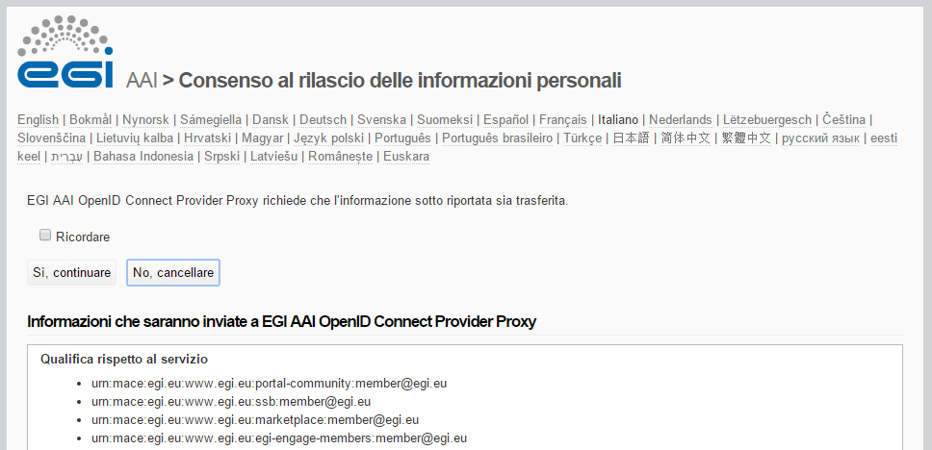
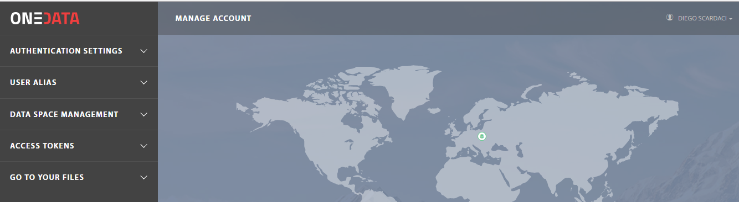
Log into the EGI DataHub (2)
You are now logged in!
Insert your username and password
Choose EGI SSO or your IDP
Select Yes
Select Accept

Slide 10
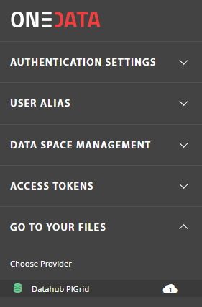
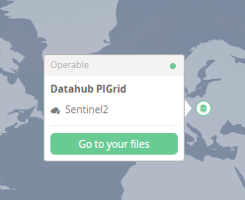
Access Copernicus Data
3. Select Go to your files
1. Select GO TO YOUR FILES
2. Select PlGrid provider

Slide 11
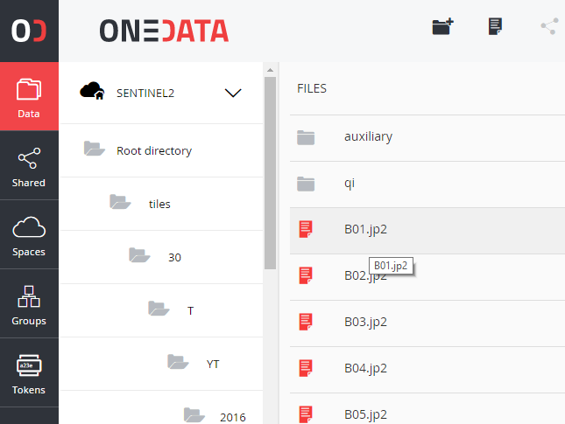
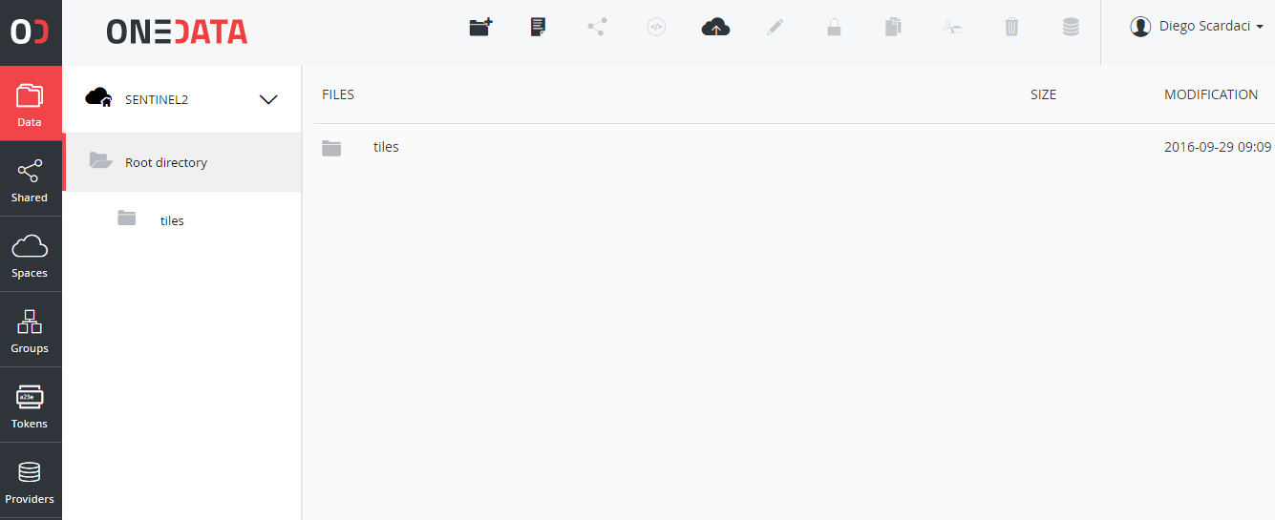
Provider view
Go through the folders
Click on a file to download it

Slide 12
Excercise 2
Create a new space in the EGI DataHub

Slide 13
Exercise 2
Create a new space in the EGI DataHub
What you have to do:
Create a new space in the EGI DataHub
Support the new space with your provider
    Get a token to support the new space
    Login into the web admin interface of your provider
    Support the new space with some storage
Upload some data on the new space through the web interface

Slide 14
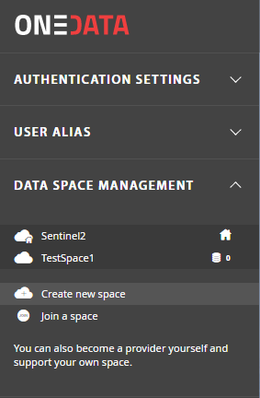
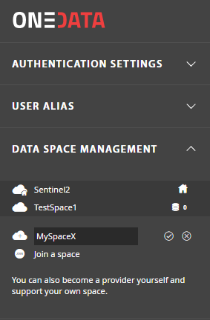
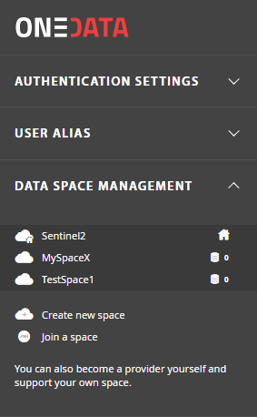
Create a new space
Create new space
Choose a name

Slide 15
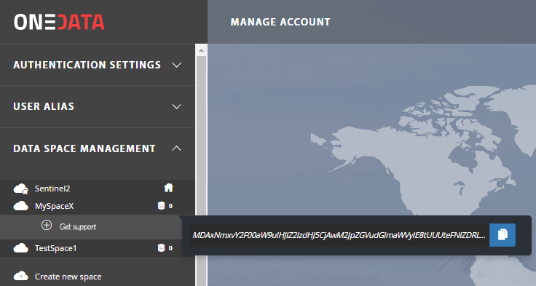
Support the new space with your provider
Select the just created space
Click on Get support and copy the token

Slide 16
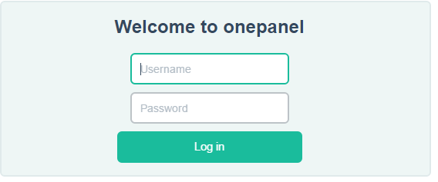
Support the new space with your provider (1)
Open your browser and access the OneProvider web administration interface:
  https://<OneProvider IP>:9443
Credentials
  Username: admin
  Password: password

Slide 17
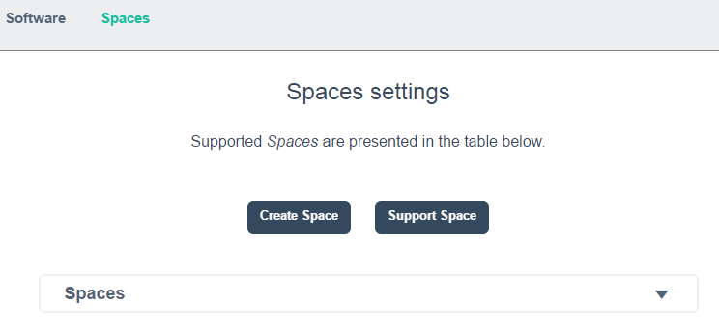
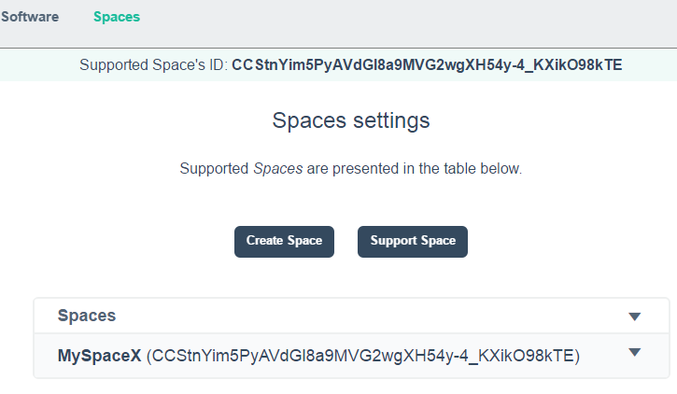
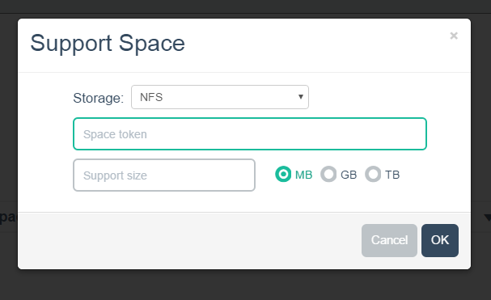
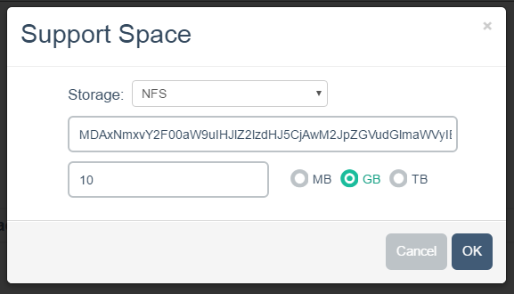
Support the new space with your provider (2)
Copy here your token
Select Support Space
Select the amount of storage
NB: test provider can offer not more than 20 GB
Your provider is now supporting the new space

Slide 18
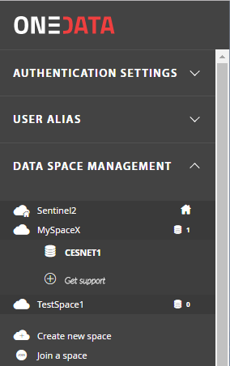
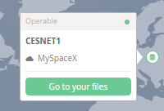
Upload data in the new space (1)
Go back to the EGI DataHub web interface
  The new space is now supported by your provider.
2. Select Go to your files
in the map
1. Select your provider name under the space

Slide 19
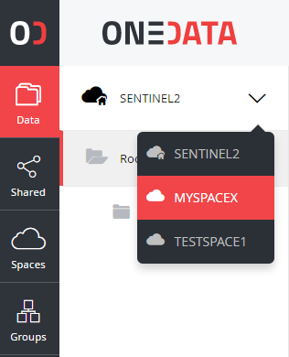
Upload data in the new space (2)
You will be redirected to the OneProvider user interface
  Select the new space

Slide 20
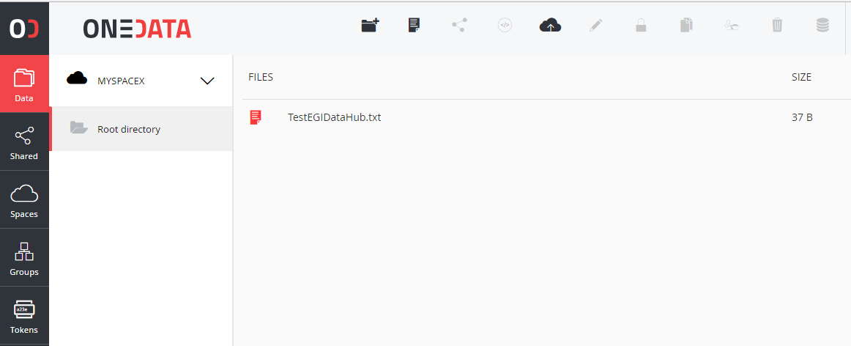
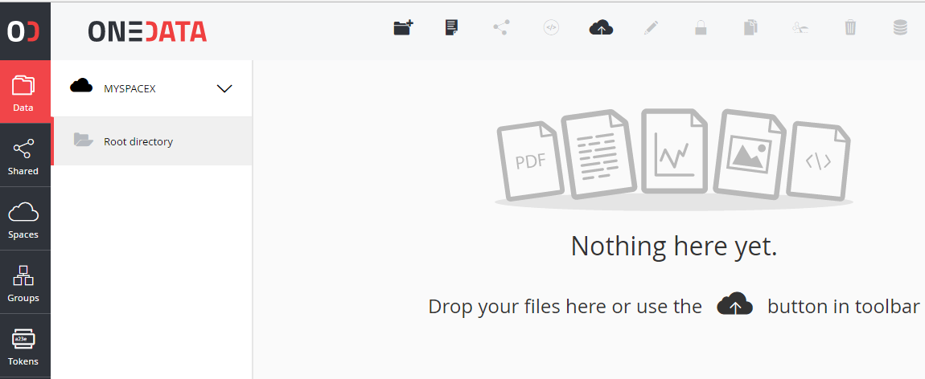
Upload data in the new space (3)
Upload some files

Slide 21
Excercise 3
Access data with OneClient

Slide 22
Exercise 3
Access data with OneClient
What you have to do:
Get an access token from the EGI DataHub web interface
Mount the virtual file-system with OneClient
    Access your OneProvider machine via ssh
    Configure and run OneClient
    Create a new file in the virtual file-system
Download the new file from the EGI DataHub web interface
Unmount the virtual file-system

Slide 23
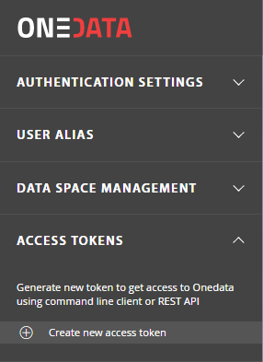
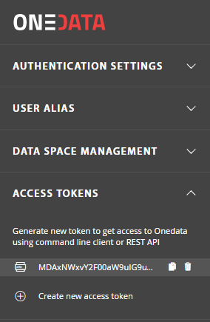
Get an access token
1. Select Access Tokens
2. Copy the Token

Slide 24
Log into the OneProvider
Log into the OneProvider shell
  ssh –i <your_key> ubuntu@<Oneprovider IP>
Configure OneClient
Create a folder to mount the OneData virtual file-system and export the mount point
~$ export PROVIDER_HOSTNAME=<Oneprovider IP>
~$ export ONECLIENT_AUTHORIZATION_TOKEN=‘<Token>’
~$ mkdir onedata
~$ export MOUNT_POINT=/home/ubuntu/onedata

Slide 25
Mount the virtual file-system
Mount the virtual file-system
Check the content
~$ oneclient --authentication token $MOUNT_POINT --no-check-certificate
Connecting to provider '147.228.242.168' ...
Getting configuration ...
oneclient has been successfully mounted in /home/ubuntu/onedata
~$ cd onedata/
ubuntu@stoor168:~/onedata$ ls -la
total 4
drwxr-xr-x 1 root root 0 Sep 29 09:24 .
drwxr-xr-x 7 ubuntu ubuntu 4096 Sep 29 12:26 ..
drwxrwxr-x 1 root 1338303 0 Sep 29 11:59 MySpaceX
drwxrwxr-x 1 root root 0 Sep 29 09:28 Sentinel2

Slide 26
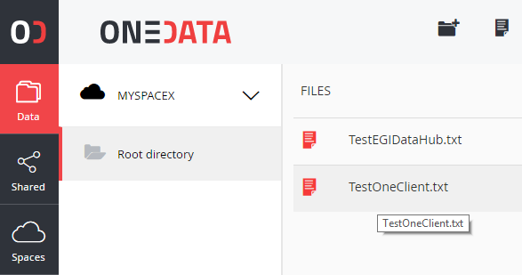
Work with the virtual file-system
Create a new file under your space
Go back to the web interface and download the new file
~/onedata$ cd MySpaceX/
ubuntu@stoor168:~/onedata/MySpaceX$ cat TestOneClient.txt
my first test with OneClient.

Slide 27
Unmount the virtual file-system
~$ fusermount -u /home/ubuntu/onedata

Slide 28
Exercise 4
Share your data

Slide 29
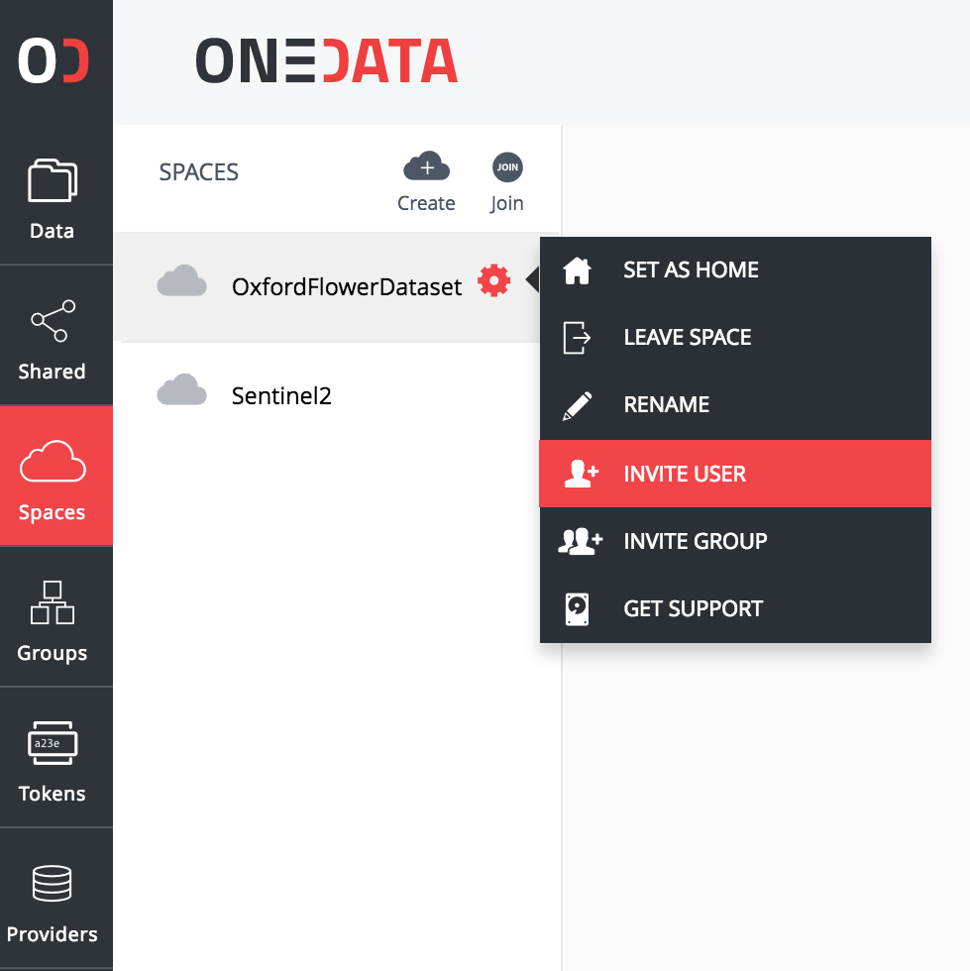
Share your data!
Go to the Oneprovider interface and generate space join token

Slide 30
Give it to another group

Slide 31
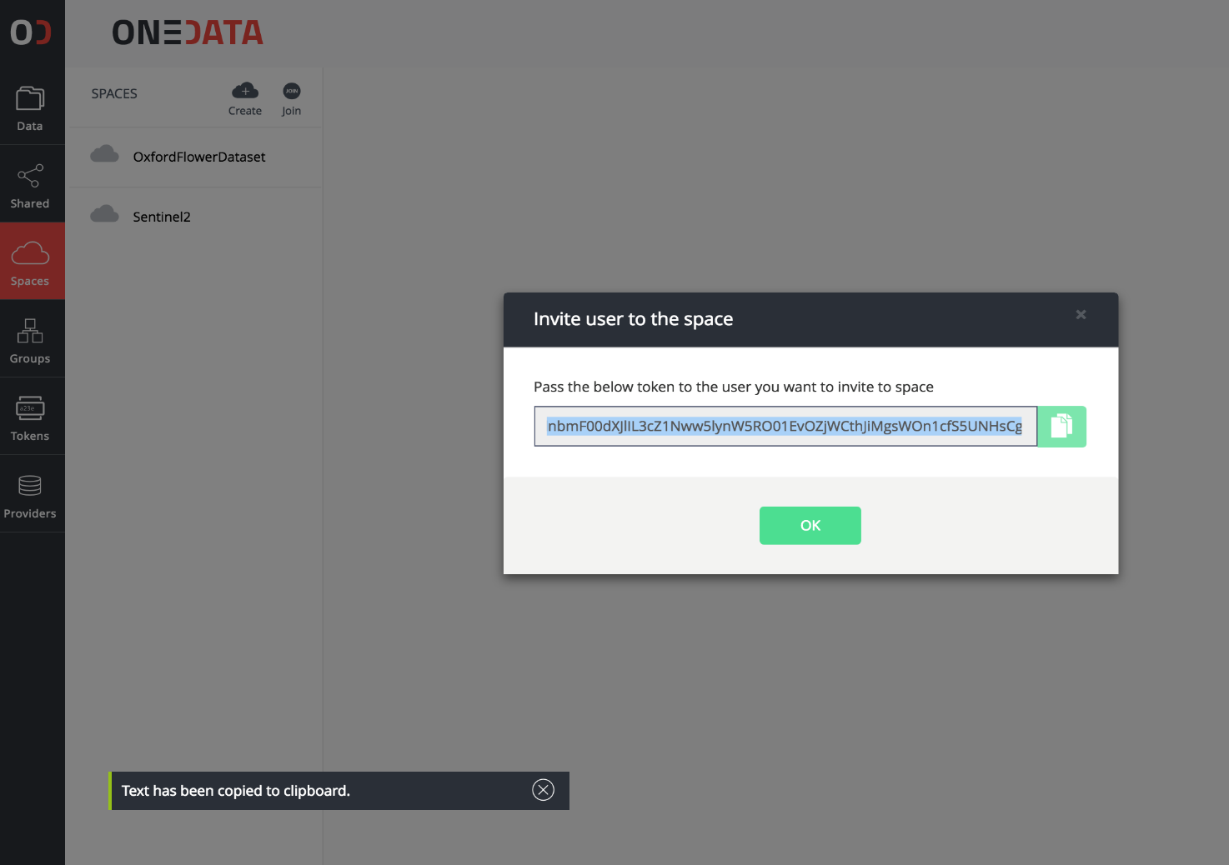
Copy the invite user token

Slide 32
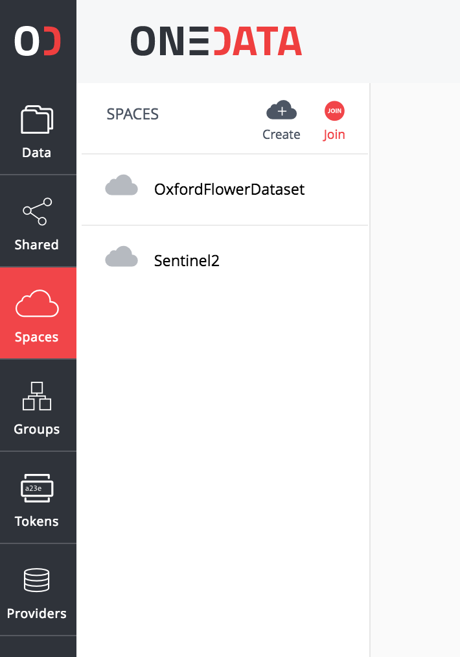
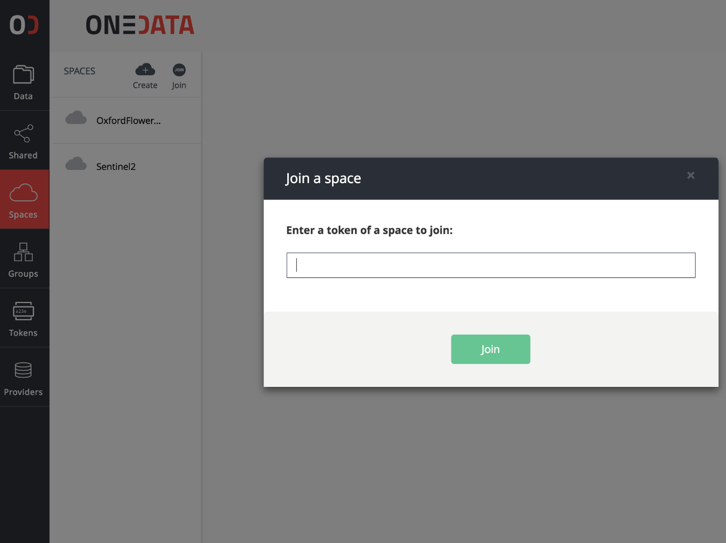
Give it to another group who should join your space

