Slide 1
The role of ENVRI reference model in the Development of European Research Infrastructures
Abraham Nieva de la Hidalga
nievadelahifalgaa@cardiff.ac.uk
Coauthors:
Yin Chen, Alex Hardisty, Dan Lear, Barbara Magagna, Rosa Filgueira Vicente, Zhiming Zhao

Slide 2
Contents
The ENVRI RM
Context of the development of the ENVRI RM
ENVRI and ENVRIplus projects
ENVRI RM Viewpoints
ENVRI RM Overview
Updates to the ENVRI RM
The data lifecycle
Classification of Environmental Research Infrastructures
Use of the ENVRI RM
Research Infrastructures
Classification of RI
Identification of core competencies
Identification of integration needs
European Digital Infrastructures
Classification of Digital Infrastructures
Identification of Service offerings
Use case example DASSH
Core competencies
Requirements
Solution Options
Summary
Incentives
Development of the ENVRI RM
ENVRI Roadmap
Notes:
In this talk I introduce the ENVRI RM and explain its role in the development of European research infrastructures
I begin presenting the ENVRI RM as the product of the ENVRI and ENVRIplus projects, describing the context of environmental research infrastructures and how this context has been used as the basis for building the ENVRI RM
I present the further development of the ENVRI RM during the ENVRIplus project.
I explain the role of the ENVRI RM in use in the broader context of research infrastructures
I introduce the idea of working with DI to facilitate the interaction/integration of Ris
I present an example of how the RM can help in the integration/interaction between RIs
I conclude with the summary of main goals of the ENVRI RM

Slide 3
Context for the development of the ENVRI RM
Situation
An active community of RIs at different stages of development with different main research expertise
Complication
Integrate data from different RI sources to encourage multidisciplinary research
Enable discovery and use of data from different RI sources
Solution
The ENVRI RM defines the context clearly, categorising RI requirements to identify actual needs and opportunities for improvement
For more details: http://envri.eu/rm
Notes:
The ever increasing number of environmental research infrastructures is a phenomenon which has accelerated in the last decade. This phenomenon has resulted in the coexistence of several RIs in different areas of environmental research. These RIs have different levels of development and range from new proposals to well stablished data archives
The problem is to try to integrate data from different RIs, which can potentially have different formats, different levels of precision and different purposes. Enabling the discovery, integration, and use of these data is a challenge faced by many RIs
The ENVRI RM is proposed as the tool to define the context in which this integration occurs. The ENVRI RM classifies the requirements of RIs and identifies the critical areas where the interaction/integration of RIs is likely to occur.

Slide 4
The ENVRI and ENVRIplus projects
ENVRI (FP7 2011 – 2014) | ENVRIplus (Horizon 2020 2015 – 2019)
Common Operations of Environmental Research infrastructures | Environmental Research Infrastructures Providing Shared Solutions for Science and Society
Requirements from six RIs were gathered and categorised as a set of basic common functionalities of environmental research infrastructures | Requirements from twenty RIs were gathered and categorised to validate the initial ENVRI RM, and to determine needs for improvement
ENVRI RM derived from ODP RM, including three viewpoints: Science, Information and Computation | Further development of the ENVRI RM, Include two new viewpoints: Engineering and Technology
Main focus: supporting acquisition, preservation, publishing, processing and use of environmental research data | Main focus: support reuse of existing services provided by e-infrastructures to build interoperable RIs
Notes:
The ENVRI RM is the product of the ENVRI and ENVRIplus projects.
The ENVRI project was focused on the characterisation of common operations of environmental research infrastructures. ENVRI analysed and classified the requirements of six European research infrastructures into a set of common requirements. From this set of requirements, ENVRI developed the ENVRI RM, which is based on the ODP RM, which is an ISO standard that supports building large scale distributed systems. The main focus of the ENVRI RM was supporting the acquisition, preservation, publishing, processing and use of environmental research data.
The ENVRIplus project is a continuation of the ENVRI project. ENVRIplus has gathered and analysed the requirements of twenty RIs which have the purpose of validating the ENVRI RM and determine the needs for improvement. This includes the complete development of the RM including Engineering and Technology perspectives. The focus of this project is the reuse of existing assets to support the collaboration of RIs to provide solutions for environmental research.

Slide 5
ENVRI RM Viewpoints
Scientific:
What for?
Why?
Who?
When?
Science
viewpoint
Design:
How does each bit work?
Information
viewpoint
Computational
viewpoint
Information:
What is it about?
systems & their environment
Solution types and distribution:
How do the parts work together?
Engineering
viewpoint
Technology
viewpoint
Implementation:
With what?
Notes:
Following the RM-ODP standard. The findings of the analysis of the requirements in ENVRI and ENVRIplus are used to create models that fulfil those requirements from different viewpoints. The initial work was focused on three design viewpoints which supported high level design of the research infrastructures concerns, Science, Information and Computation.
ENVRIplus aims at fomenting the use of the RM with those three viewpoints and to extend the RM to cover the outstanding Engineering and Technology viewpoints

Slide 6
ENVRI-RM Overview
Defines a research infrastructure (RI) as a set of components that interact in the processing of scientific data from acquisition to publication and use
Supports a generic data lifecycle (five phases)
Every phase of the data lifecycle can be related to a set of operations and components
The boundaries between the phases represent the points for interaction and integration
The reference model presents the RI components as integrated parts of a complete system; from different perspectives
The technology and engineering viewpoints are being developed

Slide 7
ENVRIplus updating the ENVRI RM
Analysed the requirements of 20 environmental research infrastructures
Verified the existence of a common set of functional requirements
Identified five generic phases in which data products are managed (the data lifecycle)
Determined that core functionalities are well understood and supported by RIs
Additional functionalities can be delegated to digital infrastructures (e.g. EUDAT, EGI, PRACE or other)
Notes:
Analysis of 20 research infrastructures confirmed the initial design of the ENVRI RM. The functionalities can be distributed across five phases of a general data lifecycle, each with their own domain of responsibility. Most environmental science research infrastructure must either support the phases of the lifecycle or delegate their support to a shared digital infrastructure (e.g. EUDAT, EGI, PRACE)

Slide 8
Research data lifecycle
Notes:
The gathering of requirements during ENVRIplus discovered the relevance of data processing in RIs as a common set of phases. This evolved in the notion of a general research data lifecycle which is observed by most RIs regardless of the areas of interest of the RI concerned.
The five phases of the cycle are Acquisition, Curation, Publishing, Processing, and Use.
In the Acquisition phase, data is generated, collected or received. In the Curation phase, data is prepared for long term preservation by storing it safely, adding metadata, and a persistent identifier. In the Publishing phase, data is made publicly available. In the processing phase, data is used to create new data products such as aggregations, visualisations, summaries, among others. In the use phase, the data products are exploited to derive new data products, which can be in turn make their way into the RI repository for preservation, restarting the cycle

Slide 9
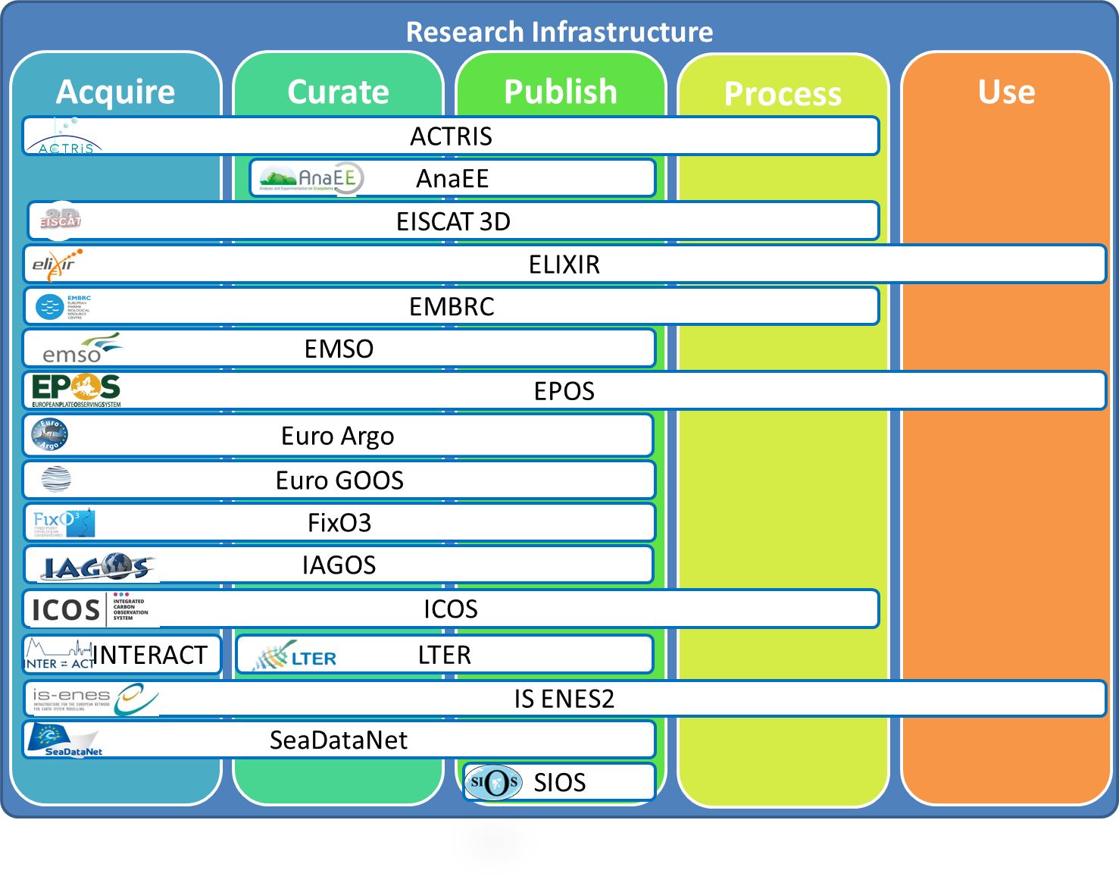
Classification of RIs
Notes:
It has been observed that different RIs will focus on different parts of the data lifecycle. Not all RIs have the capacity or the interest in supporting all the aspects of the entire data lifecycle to the same degree. Some RIs are interested in optimising data acquisition, other are more concentrated on the curation of data and publishing data products, or on providing further processing services for analysis and visualization. There are also ambitious initiatives, aimed at providing support for all stages of the data lifecycle.

Slide 10
Example: Core competencies of Marine RIs
All support Acquisition, Curation and Publishing of Data
FixO3, EuroFleets, Jerico, ESONET, EMSO, and EuroArgo are focused on management of acquisition of raw data from different types of marine observatories, fleets and device networks. The main competencies of these RIs are in the acquisition phase.
SeaDataNet is focused in integrating data from different types of observations to get a more complete picture. In this case their main competencies are in the curation and publishing phases
Beyond this, other RIs aim to integrate and use data from multiple fields such as EMBRC and SIOS. In this case their main competencies are processing and use.
Notes:
All marine RIs support Acquisition, Curation and Publishing of Data. But if you look closer they focus and specialises on different phases of the data lifecycle. Some are more focused on acquisition, others on collecting and curating data from different sources, yet others will collate and process data from different domains.
FixO3, EuroFleets, Jerico, ESONET, EMSO, and EuroArgo are focused on management of acquisition of raw data from different types of marine observatories, fleets and device networks. The main competencies of these RIs are in the acquisition phase.
SeaDataNet is focused in integrating data from different types of observations to get a more complete picture. In this case their main competencies are in the curation and publishing phases
Beyond this, other RIs aim to integrate and use data from multiple fields such as EMBRC and SIOS. In this case their main competencies are processing and use.

Slide 11
Core Competencies
The different degree to which a RI processes data within the data lifecycle constitutes the RI core competencies

Slide 12
Integration needs
Core competencies of each RI define their integration needs.
The RI can be integrated at
Acquisition/Curation: data acquisition processes are integrated with data curation
Curation/Publishing: data curation processes are integrated with data publishing
Acquisition/Publishing: data acquisition processes are integrated with data publishing
Curation/Processing: data curation processes are integrated with data processing
Acquisition/Processing: data acquisition processes are integrated with data processing
Processing/Publishing: data processing processes are integrated with data publishing
Use/All: grant access from outside the research infrastructure to data products generated during different phases of the data lifecycle
Notes:
The core competencies of RIs influence their needs for integration. The ENVRI RM identifies seven integration points which are at the boundaries between different phases of the data lifecycle.
The integration points become important to explain how the RI will integrate with other RIs or with services provided by digital infrastructures depending on the phases of the data lifecycle that each RI will predominantly support.
The integration points do not restrict the extent to which data is processed within the RI. They are intended to help in the integration of different RIs with different objectives.
There are seven integration points as depicted in the diagram.
The interesting fact in this case is that the services and functionalities for integration can be provided by the RIs themselves or by third parties.

Slide 13
European Digital Infrastructures
The focus of the further development of the ENVRI RM will be on characterising the integration needs of RIs from the engineering and technological viewpoints, having in mind that RIs can define their internal processes for their core competencies and how e-infrastructures can facilitate integration efforts
Notes:
In a similar way to what we did with RIs, DI can be classified according to the support that they provide for the different phases of the research data lifecycle
This figure presents an example. Some support is provided in the form of services, some others provide support in the form of standards and guidelines.
The advantage is that the offerings are componentised, this is the customers of these DI can pick and choose the services that match their needs.
The focus of the further development of the ENVRI RM will be on characterising the integration needs of RIs from the engineering and technological viewpoints, having in mind that RIs can define their internal processes for their core competencies and how e-infrastructures can facilitate integration efforts

Slide 14
EUDAT Services
EUDAT offers services which can help in the integration of research infrastructures.
Services can be selected and used independently
Notes:
The example of the services provided by EUDAT is interesting because the services are promoted as independent components. They can be used independently and can potentially complement the efforts of different RIs trying to integrate their data repositories. Whit the previous knowledge about integration points we can better define the requirements of the RIs and consequently find the best match for those requirements

Slide 15
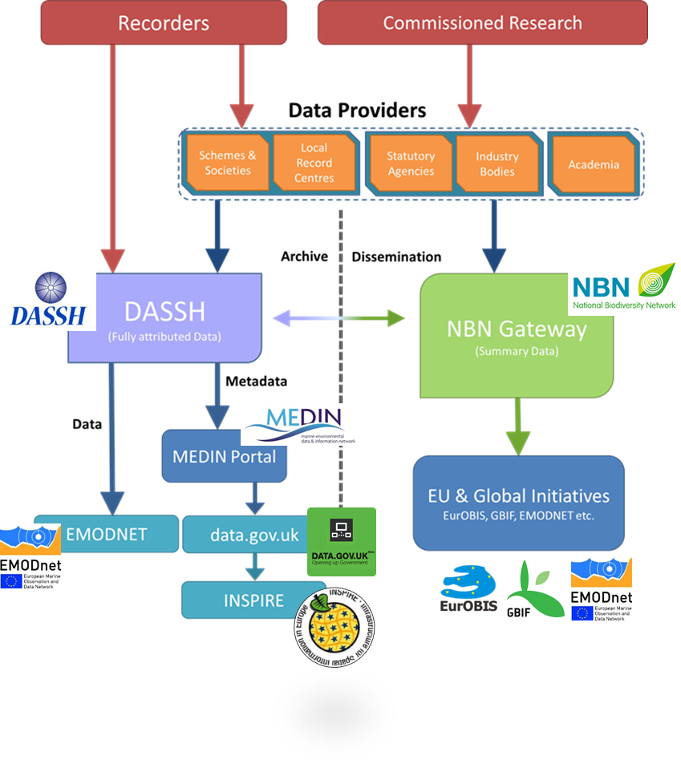
DASSH Core Competencies and Requirements
Core competencies: curate and publish marine data
Requirements
Share data and metadata with other Ris (NBN, EMBRC, GBIF)
Monitor use of data
Monitor users
Notes:
Curation and publishing of scientific data about marine species and habitats derived from marine surveys are the core competencies of DASSH.
The DASSH shares data directly via the DASSH portal and indirectly via the MEDIN portal.

Slide 16
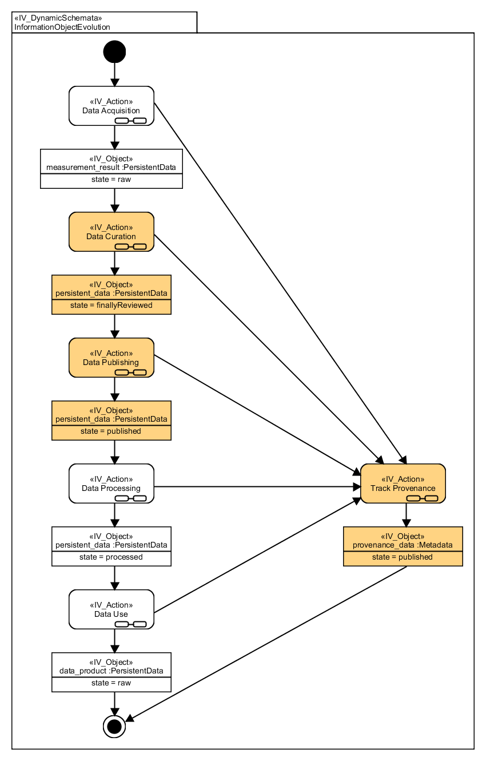
DASSH Core Competencies in detail
Notes:
The Overall picture of data the data lifecycle as specified in the information viewpoint of the ENVRI RM.
The core competencies of DASSH are highlighted in orange. DASSH is interested in Curation and Publishing of Marine Surveys. But it is also interested in tracking provenance of the data, before it is ingested in the DASSH archive, and when it is used after publishing.

Slide 17
DASSH and EMBRC Integration
Research Infrastructure
Acquire
Curate
Publish
Process
Use
DASSH
Research Infrastructure
Acquire
Curate
Publish
Process
Use
EMBRC
Notes:
For instance DASSH needs to integrate with EMBRC
We could select service from helix nebula, indigo, egi or eudat to accomplish this integration
The constraints for the integration are as follows
Integration should be automated as much as possible
The current bottle necks are identified in the transformation of MEDIN data to other metadata formats
Ideally transfers could use a service that maps data automatically
Use of DASSH data within EMBRC should be notified to DASSH in some form. Citation counts is a good candidate, but should not be the only medium. Data downloads and consultations could also be tracked.

Slide 18
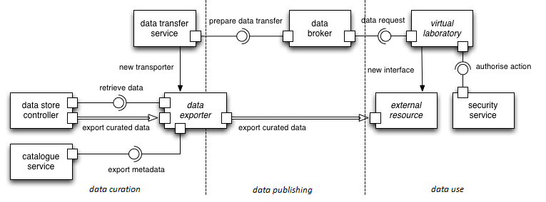
Brokered Export
Notes:
But, we can be even more specific for instance we could see this form the viewpoint of DASSH and say that we require a brokered data export composed of three main objects: data broker, transfer service and importer.

Slide 19
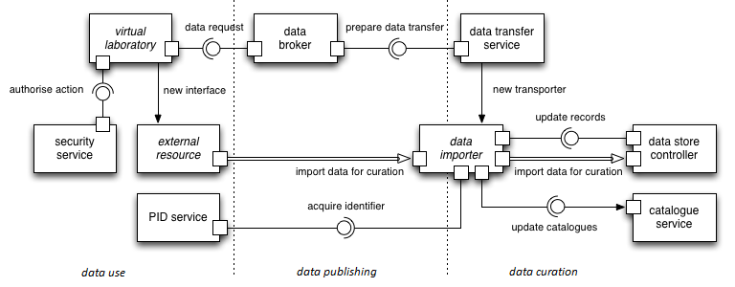
Brokered Import
Notes:
Or, we can be even more specific for instance we could see this form the viewpoint of EMBRC and say that we require a brokered data import composed of three main objects: data broker, transfer service and importer.

Slide 20
Summary
The overall focus of the ENVRI RM is to model RI systems that support the use of data for research purposes
The definition of the ENVRI RM is aligned to the concept of supporting a general lifecycle for research data
RIs can be classified according to the emphasis to aspects of the data lifecycle
RIs core competencies are understood
Requirements are made explicit rapidly and clearly
For more details: http://envri.eu/rm

Slide 21
What are the incentives to use the ENVRI RM?
Easier communication based on a common vocabulary of terms and concepts
Standardise operations and views on systems so that integration is achieved faster
Documentation of data management policies is a requirement from funding agencies
Makes explicit the things you need for stronger data management and places them in the context of an RI
Delivers stronger integration strategies
Facilitating combinations of data to produce comprehensive environmental science studies
Clearer documentation
Facilitates communication and collaboration between RIs and evaluation of RIs
Better integration and reuse of common resources will deliver economies to individual RIs, freeing resources to be spent in core research activities

Slide 22
How is the RM being developed?
Research data, how it is managed, preserved and published by different RIs
We have identified a research data lifecycle which covers the production [creation], acquisition, curation, publishing and processing of research data. We are observing the way RIs work with data by looking at how many of the data lifecycle stages they support.
By looking at this model we are able to describe the basic operations that the RIs must perform to realise essential data management activities such as identification, citation, cataloguing, provenance, processing, optimisation, curation, and community support.
ENVRI should play a major role in building a community of environmental research infrastructures supported by foundational research infrastructures (PRACE, EGI, EUDAT, etc.)

Slide 23
Roadmap for the development of the ENVRI RM
ENVRI RM V 1.1 built from work with 6 ESFRI RIs – Minimal model, depicts commonly repeated functionalities in RIs. Describes the highest levels of abstraction. Presents and outline of architectural decisions to be made about computing units.
ENVRI RM V 2.0 built from V 1.1 and from work with 20 RIs – Complete model, depicts all common functionalities supported by different RIs. Describes all levels of abstraction from a high level view for domain experts (scientists) to a low level view for technology experts (IT staff). Presents a host of architectural options using current technologies and standards.
Beyond ENVRI RM V 2.0. Reference model is continuously reviewed and updated to respond to new discoveries in applicable technologies and to respond to changes in requirements.
Provide a semantic linking framework based on the ENVRI Reference Model to support the advanced evaluation at both the conceptual and the data processing/integrity/performance levels
Provide reference architecture for new RIs to adopt and to act as a guide for existing RIs in their development which maximises the reuse of services provided by underlying e-Infrastructures (such as EGI), data infrastructures (such as EUDAT), and other similar foundation RI projects.
The ENVRI RM will provide the basic blue print not only to design and build RI systems, but a model for evaluating the implementation of the integration practices, the data procurement value chain.

