Slide 1
EUDAT
Solutions for federated services management
Johannes Reetz, MPCDF
EUDAT Operations Coordinator
DI4R - Krakow
28-30 September 2016

Slide 2

EUDAT
A resilient network of 35 European organisations providing trusted common data services for research communities
2

Slide 3

HLEG 2010: Collaborative Data Infrastructure
User functionalities, data capture & transfer, virtual research environments
Data
Generators
Users
Data discovery & navigation, workflow generation, annotation, interpretability
Data Curation
Community Services
Trust
Persistent storage, identification, authenticity, workflow execution, mining
Common Data Services
3

Slide 4






























Community Driven
ENVIRONMENTAL SCIENCES
BIOMEDICAL & MEDICAL SCIENCES
MATERIALS & ANALYTICAL FACILITIES
MAPPER
SOCIAL SCIENCES & HUMANITIES
PHYSICAL SCIENCES
& ENGINEERING
4

Slide 5
Collaborating with other e-Infrastructures
RDA
Policy & networking
Output adoption
Test beds
Open AIRE
GEANT
Policy & guidelines
Data management plans
Service integration
LERU
LIBER
PRACE
Cross-infra services & ops
Common protocols, APIs
HPC/HTC/Clouds
EGI
Helix Nebula
Data Cloud
5

Slide 6
Collaborative Data Infrastructure (CDI)
Collaboration of
Thematic and Generic Service Providers
EUDAT generic data service provider storage, workflows, processing, archive
Community Repositories
(thematic data centres)
Based on a Partnership Agreement specifying OLAs (and SLAs)
Notes:
A collaboration between Service Providers and Research Communities
A Partnership Agreement specifying the mutual obligations between the EUDAT centres
a portfolio of data management services
A data and service model that ensures the CDI’s interoperability, extensibility and stability
Looking to the future we have the CDI partnership agreement and a secretariat as a basis for future coordination.

Slide 7

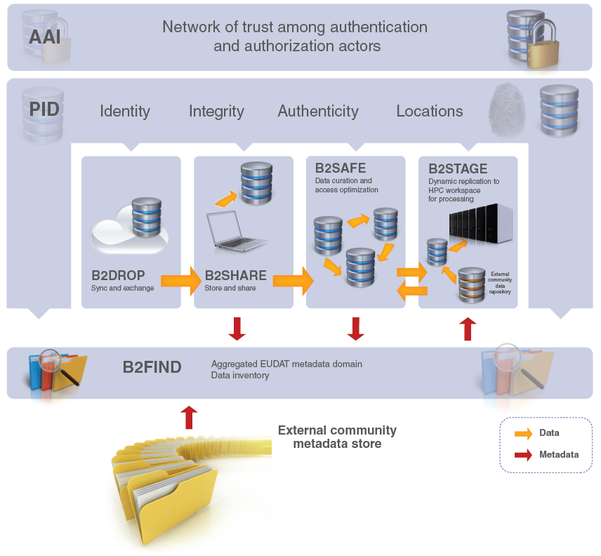






B2 Service Suite

Slide 8
Active EUDAT Service Catalog
Service | Function | Version | TRL | Individual Researcher | Community Manager | Service Provider
Data Discovery
B2FIND | Multi-disciplinary joint MD catalogue |  | 8 | ✓ | ✓
Data Hosting, Registration & Management & Sharing
B2DROP | Cloud storage, sync & exchange |  | 8 | ✓ | ✓ | ✓
B2SAFE | Policy-driven data management | 3.11 | 8 |  | ✓ | ✓
B2SHARE | Repository for sharable digital objects | 1.7 | 8 | ✓ | ✓ | ✓
B2HANDLE | Policy-based prefix & PID management | 1.0.3 | 8 |  | ✓ | ✓
Data Access, Interface & Movement
B2ACCESS | Federated multi-protocol AAI |  | 8 | ✓ | ✓ | ✓
B2STAGE | Data staging service + Workspace | 1.8.1 | 8 | ✓ | ✓ | ✓
New releases for B2SHARE, B2SAFE, B2STAGE (HTTP Gateway) available this year
New services Data Type, Annotation, Metadata Store released within next 6 months
Single and multiple services instances
Services can comprise multiple endpoints

Slide 9
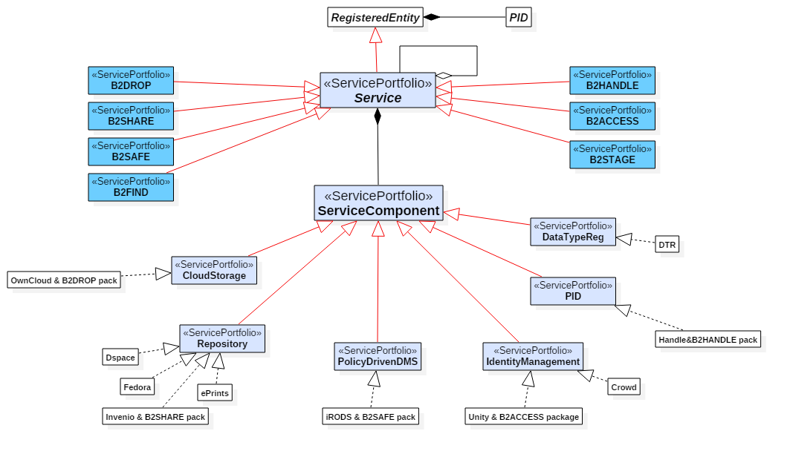
Breakdown of a Service into Service Components
A Service comprises generally Service Components that can be distributed across several sites

Slide 10
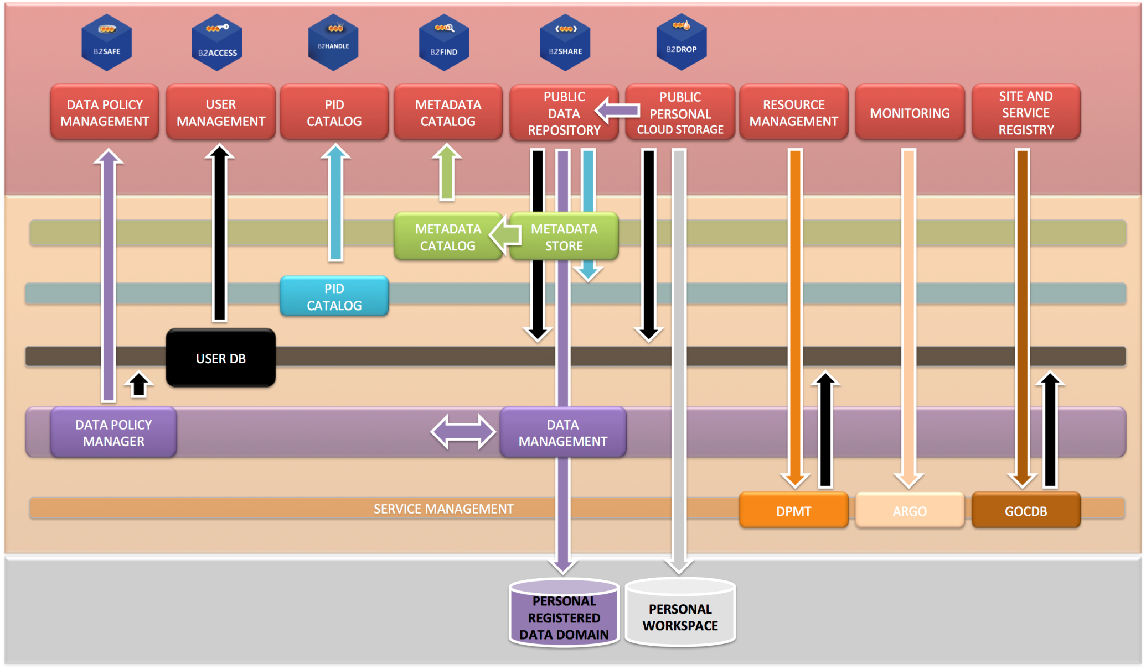
CDI Architecture
Projects, Resources, Configurations
Service Catalog
SPMT

Slide 11
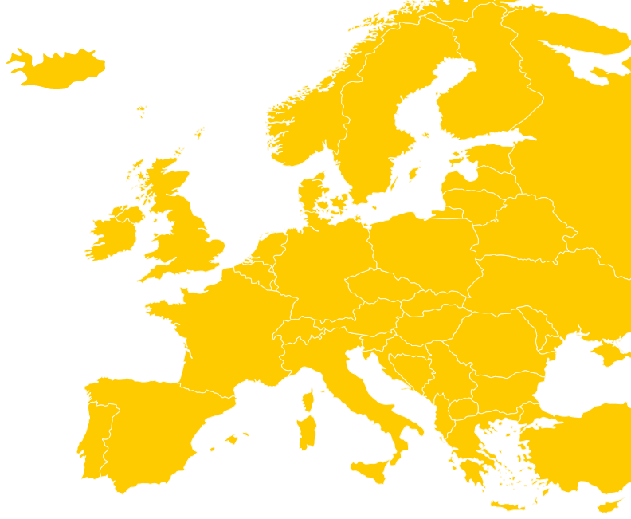







Collaborative Data Infrastructure
providing PIDs
Thematic Service Providers
Generic Service Providers
Operational, Central and Support services

Slide 12
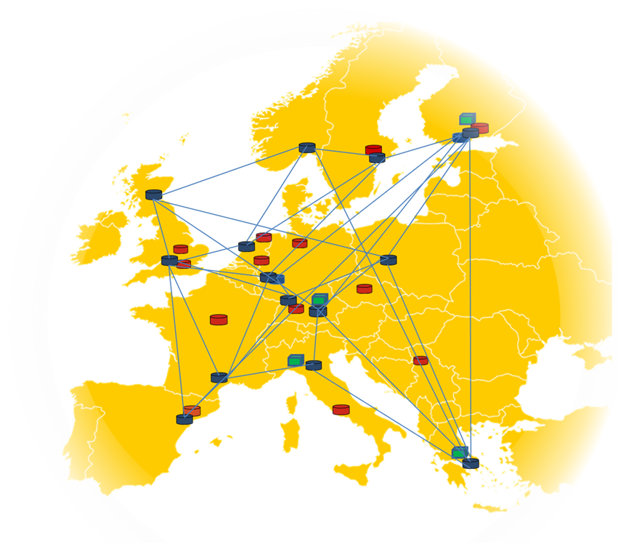


EUDAT Federated Operations
1st level support: David Vicente, BSC
2nd level support: Site Staff, Service Specialists
Data Project Consultancy & Enabling
Helpdesk & Support
Enabling Team
Giovanni Morelli, CINECA
EUDAT Security Officer
Security Team, CSIRT
Urpo Kaila, CSC
Security
Network, Configuration
Compute Resources
Service Hosting,
Service on Demand
Service Deployment
Wiki, DPMT/RCT, SPMT, Monitoring, ACCT, CREG, PID, AAI
Johannes Reetz, MPCDF
Service and Resource Provisioning & Coordination
Storage, Storage Services
Operational Tools & Services
OperationsCoord. Team, Site Deputies
Pavel Weber, KIT
current pledges 15PB (mainly archive storage, constraints) potential of > 1000 PB aggregated; 10Gb/s

Slide 13



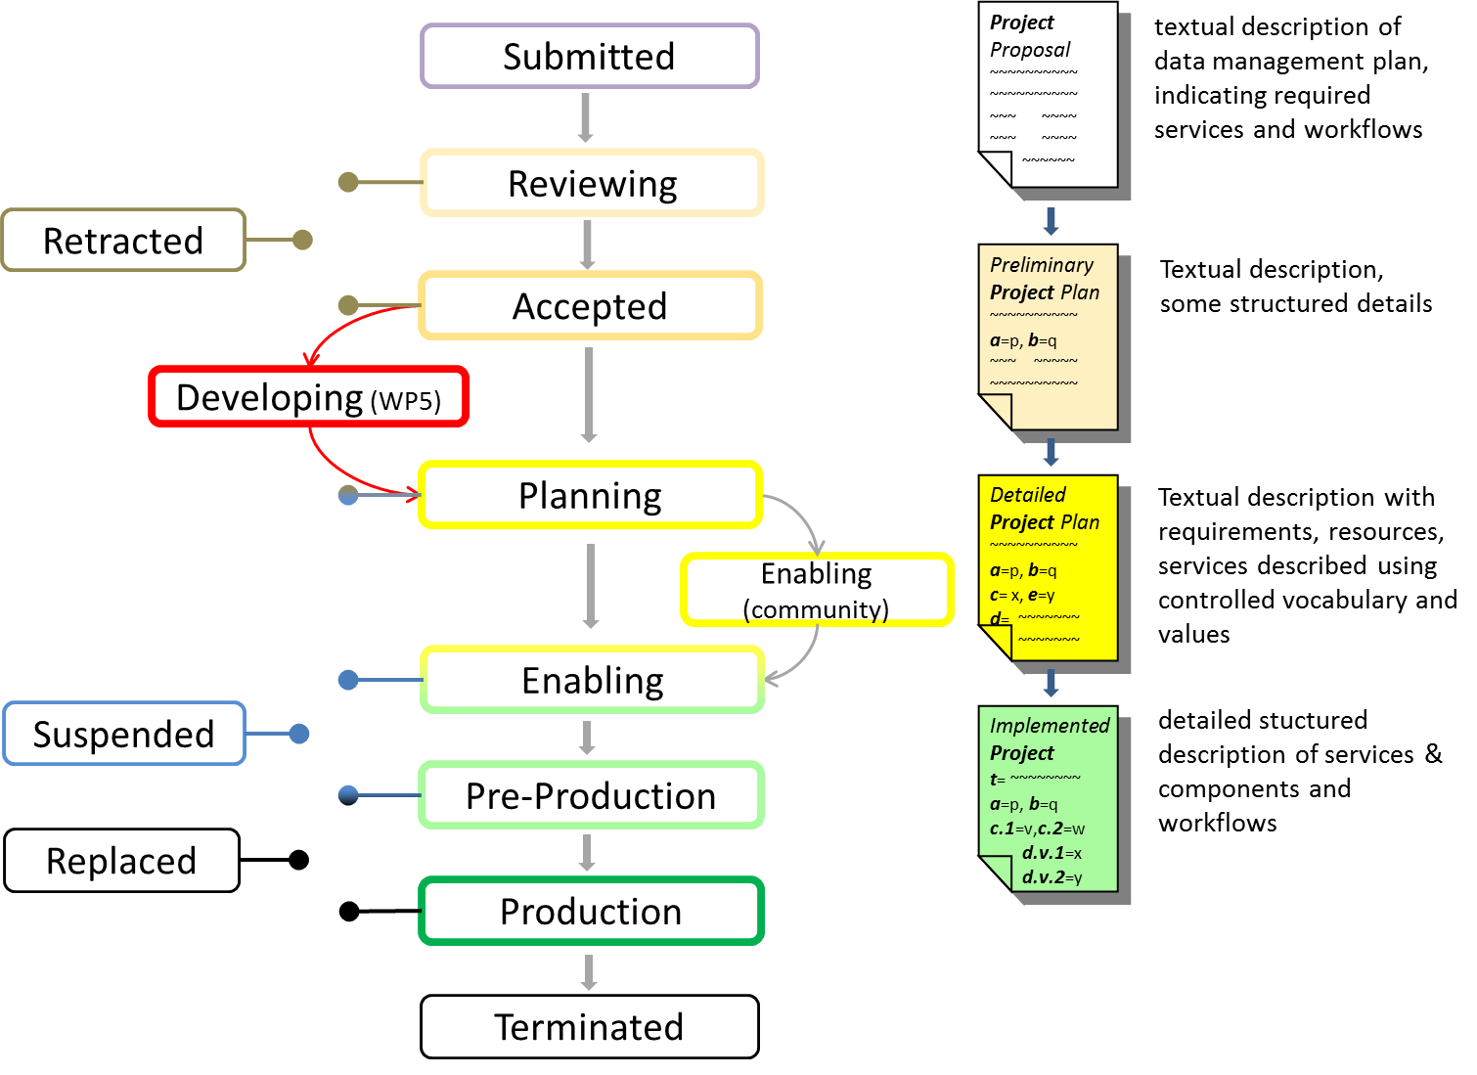
Data Project Life Cycle Management
Data Project / Management Plan
CRM - Interfaces - Customer
Community

Slide 14







Data Project Enabling
Data Project / Management Plan
EUDAT Operations
CRM - Interfaces - Customer
Community
Data Project
Management Tool
Project & Service Enabling
Data Project X
Data Project Y
Data Project Z
Service & Resource
Provisioning
Deploy
Service X
Enabling Team
Service Y
Enabling Team
Service Z
Enabling Team
Small/Large
Feature Requests
(WP5)
Production
Production
Resource and Service Booking
Helpdesk
Monitoring

Slide 15
B2ACCESS: Authentication and Authorization
Purpose
Status
Provide a single sign-on solution into the EUDAT CDI for end-users
Provide a unified set of attributes for authorization and LoA
Lower the barrier for communities IdP’s to integrate with the CDI
Integrated IdPs
  SAML: eduGAIN, extra IdP’s
  Social: Google, Facebook, Microsoft, Github, ORCID (planned)
  X.509 – IGTF, GEANT, DFN Global
  B2ACCESS accounts
Services integrated
  B2SHARE, B2SAFE, B2STAGE, B2DROP (planned)
Operational tools integrated
  CREG, DPMT, B2GETHER,
  Helpdesk, Website, SPMT and ARGO (planned)
Central Group Management & Attribute Provisioning

Slide 16

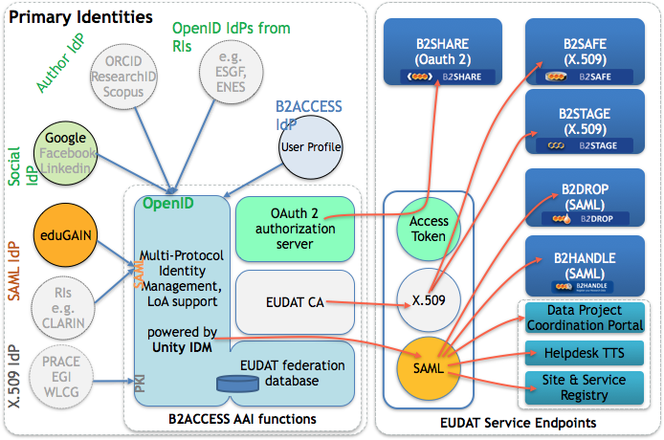

Slide 17
Operational Services & Tools
Tool | Abbrev | Provider | Host | URL
Document Repository Software | SVN GIT | CSC GitHub |  | https://svn.eudat.eu/EUDAT
Service Portfolio Mngmnt Tool | SPMT | GRNET |  | http://sp.eudat.eu
Data Project Management Tool | DPMT | MPCDF |  | https://dp.eudat.eu/
Software Version Monitoring | SVMON | KIT |  | http://eudat-tags.scc.kit.edu/eudat/
Site & Service Registry | CREG | MPCDF |  | https://creg.eudat.eu
Availability & Reliability Monitoring Tool | ARMT CMON | GRNET GRNET |  | http://avail.eudat.eu/ https://cmon.eudat.eu
Resource Coordination Tool | RCT | MPCDF |  | https://rct.eudat.eu/
Accounting | RCT ACCT |  |  | https://rct.eudat.eu/?path=/storage_space_resources/ http://accounting.eudat.eu
Web Presence (Drupal) Community Collab. Platform | Website Collab | Trust-IT | CSC CSC | https://www.eudat.eu https://b2gether.eudat.eu
HelpdeskSystem (RT) | TTS | BSC | CINECA | https://helpdesk.eudat.eu
Confluence Wiki (internal) | Wiki | CSC |  | https://confluence.csc.fi/
under development under replacement

Slide 18
CREG: Site & service registry based on an
EUDAT instance of the GOCDB
site or service admin
manages information
Site and Service
Registry
user or
service
retrieves information
via web/REST interface

Slide 19
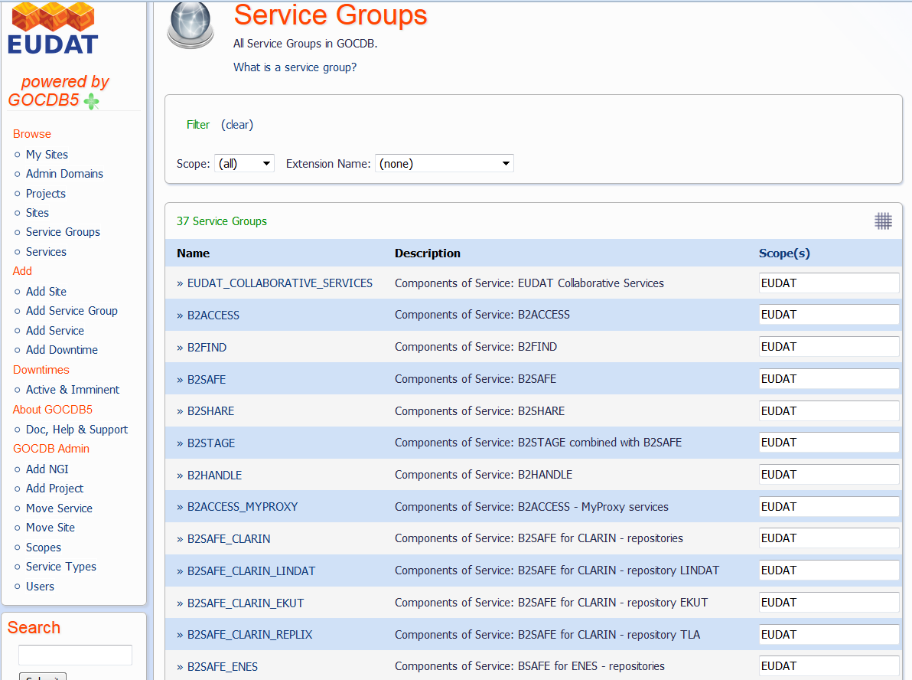
CREG: ServiceGroups used for modelling the configuration per Data Project

Slide 20
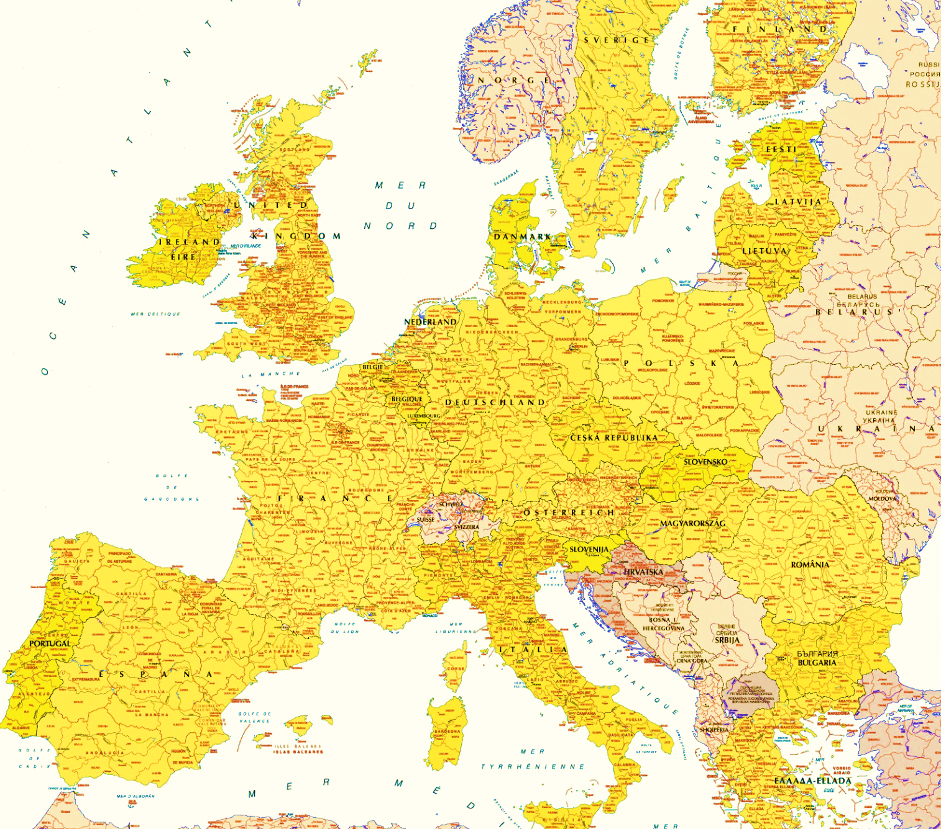

Sets of Service Components mapped to Projects
REGISTRY
Providers,
Service Components, Service Topologies
creg.eudat.eu (GOCDB)
dp.eudat.eu (DPMT)
Thematic SP
Generic SP
Information about the Topology of Service Components per Project needed.
Pre-define the Data Project specific domain of sites and services where their data can be enabled to be accessed, stored, managed and processed.
20

Slide 21
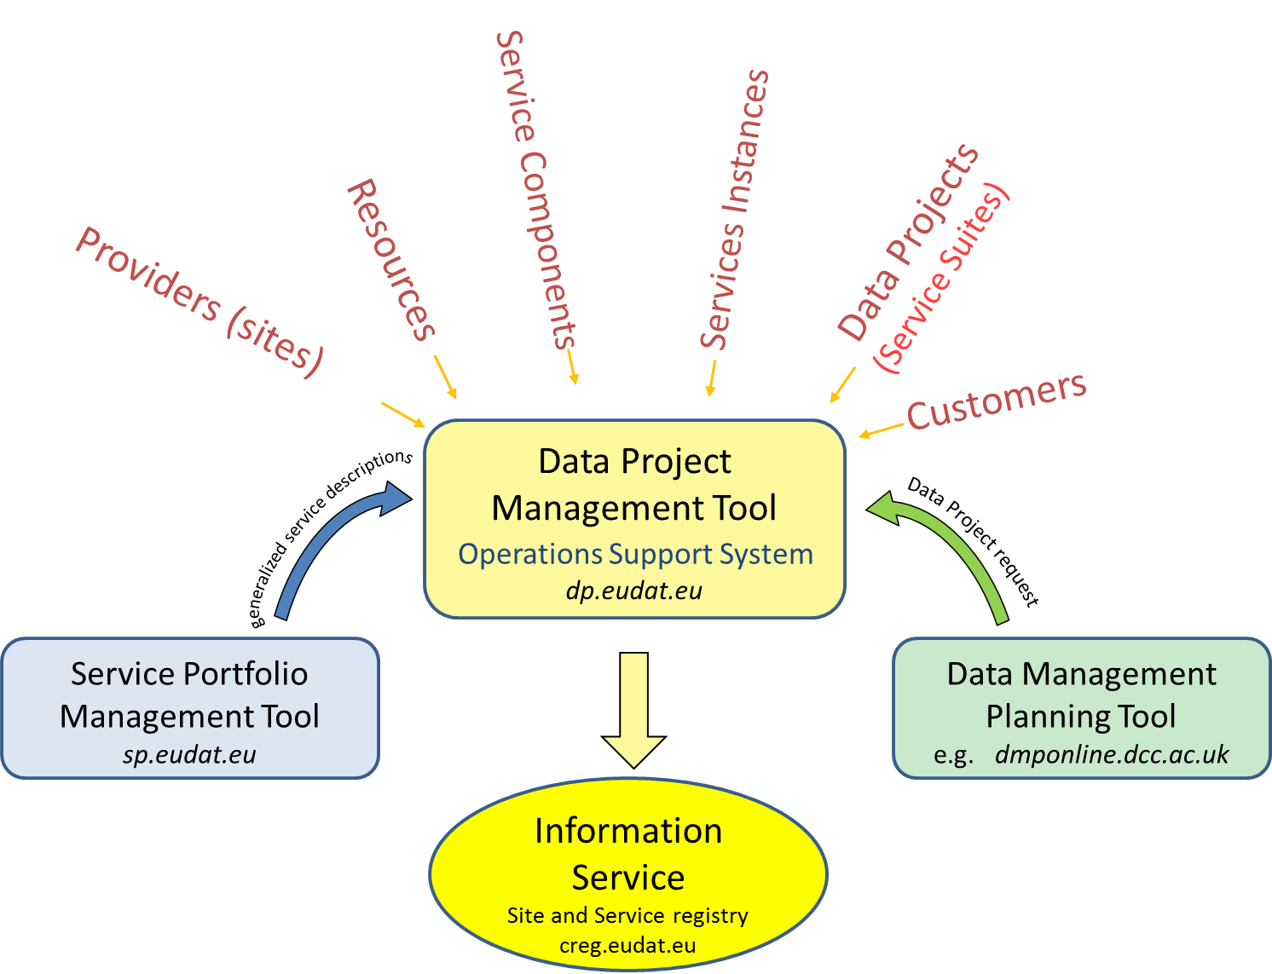



Integrated Service & Project Management
DPMT
SPMT
Release Nov‘16
SPMT & API implemented and linked,
B2ACCESS integration in progress,
Portfolio Content under review
EUDAT DMP template available for
Project request; to be linked with DPMT
Individial instance of the GOCDB (EGI, STFC)

Slide 22
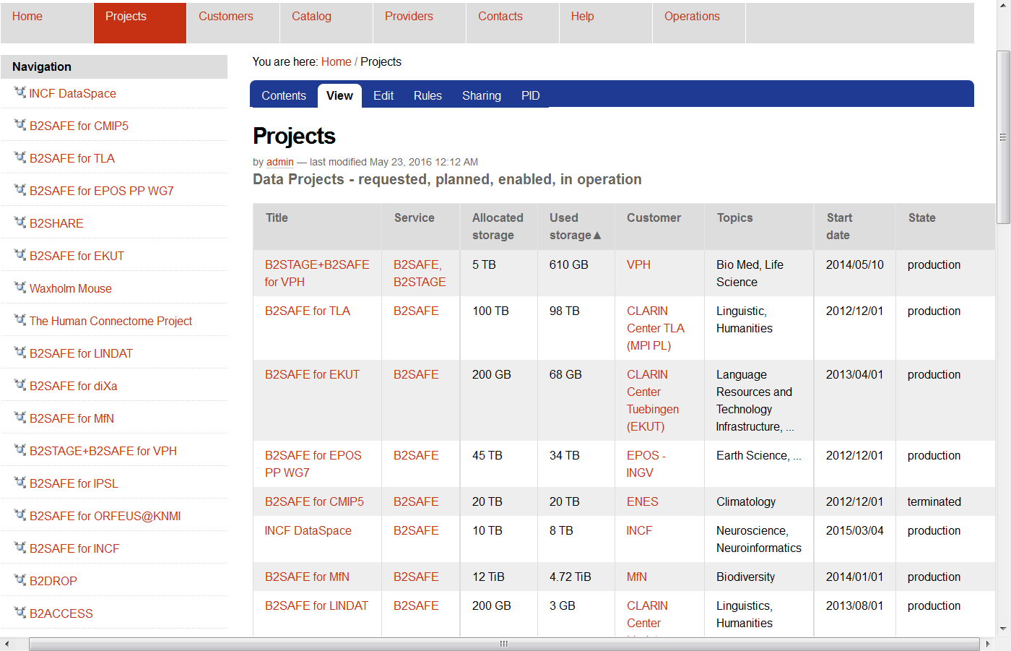
DPMT Projects Overview

Slide 23
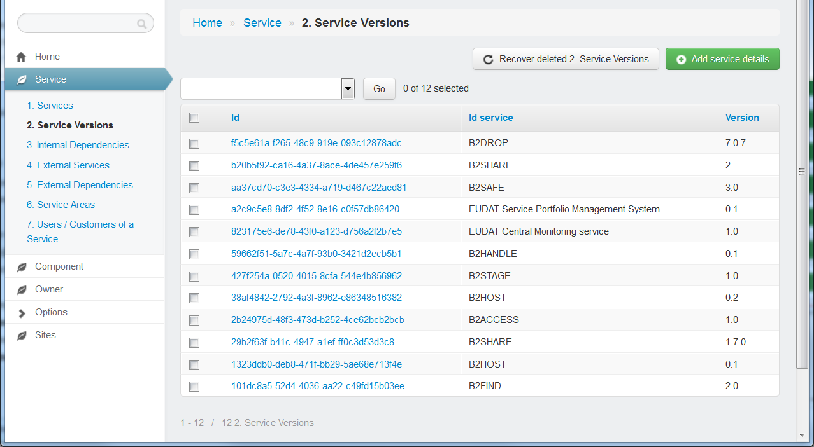
SPMT: Service Portfolio Management Tool (UI)

Slide 24
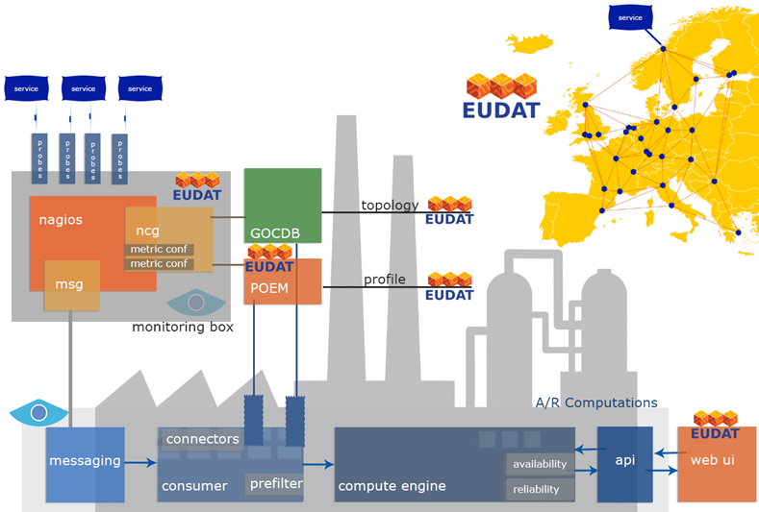
ARGO: A&R Monitoring System
Monitoring of A&R per project

Slide 25
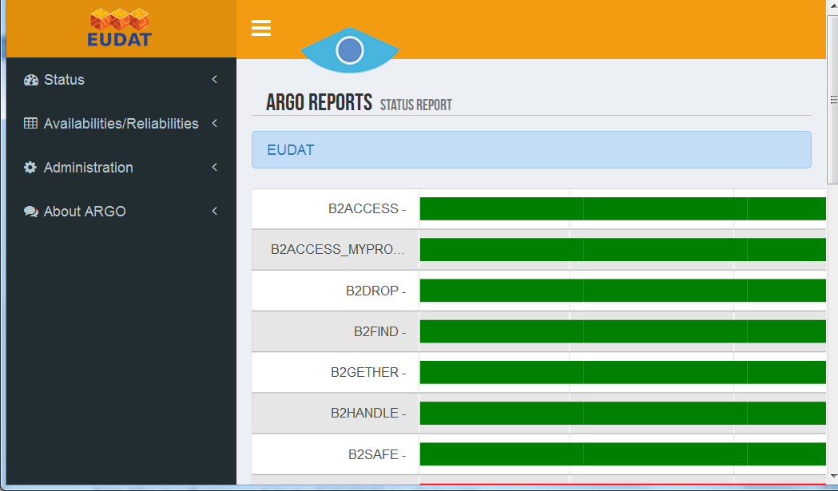
ARGO: A&R Monitoring System
Probes for Project-Service Monitoring testing A&R from user point of view

Slide 26
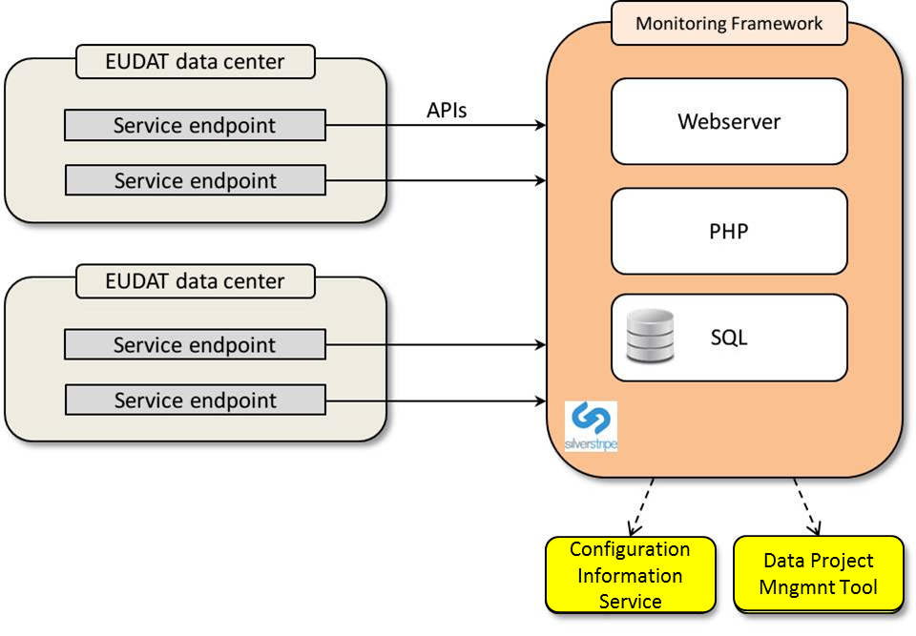
SVMON: Software Version Monitoring
Collects information about the versions of actually installed service components (information pushed from site agents to a central service)
DMPT compares the actually installed software versions with the version numbers obtained from the service cataloge.

Slide 27
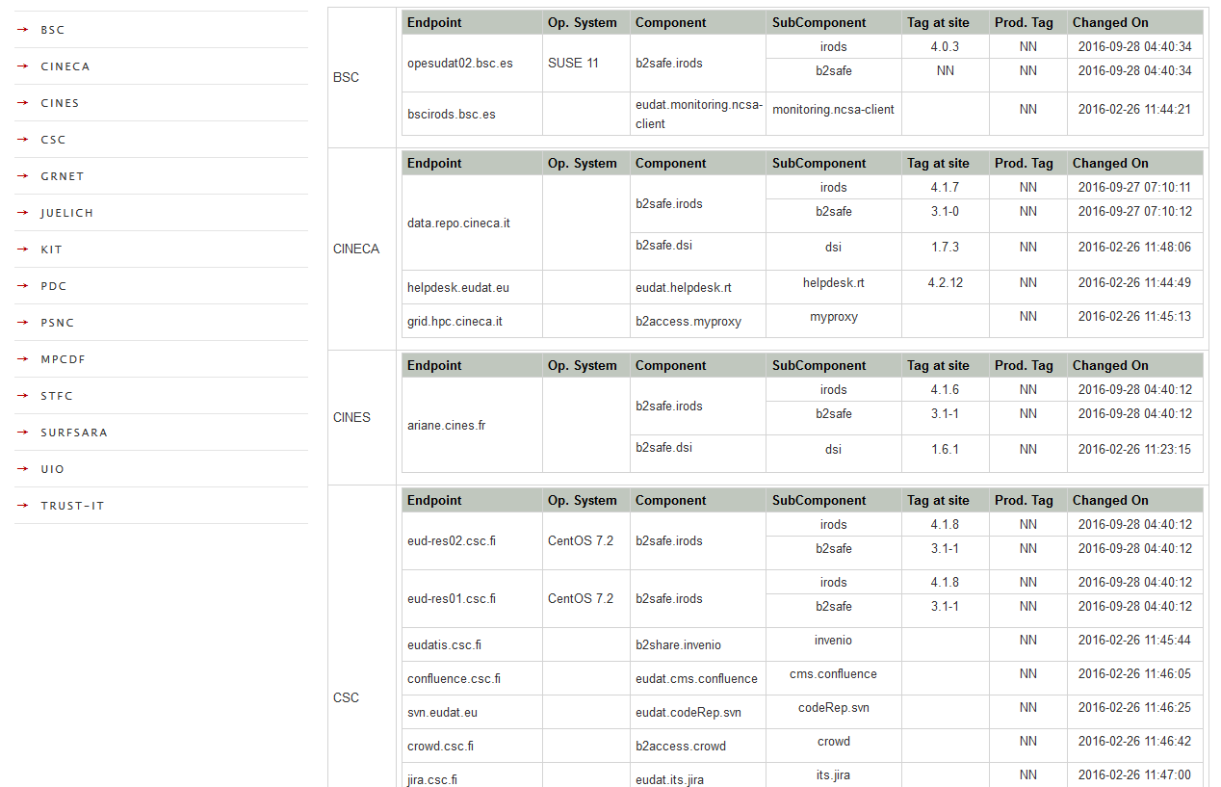
Software Version Monitoring Panel
SVMON is under development until all the versions of installed software components are fully monitored.

Slide 28
ACCT: Storage Usage Accounting
Central aggregator of the storage usage accounting records. Simple REST interface.
Webinterface for rendering the information
Integration with DPMT
„Storage Space“ per provider, project, storage class
Each Storage Space has a (persistent) Resource ID
Agents per Storage Space push accounting records to the central instance (STaR compliant)

Slide 29
ACCT: Architecture
Storage Accounting Record:
Project X (t, Resource-ID, volume, #objs, ...)
User queries
view 1
Actual list of storage spaces:
Project X – Provider A
(Resource-ID, volume, #objs)
Project Y – Provider B
(Resource-ID, volume, #objs)
Provider A
Project X
Agent
Project Z
Front-end
RCT
acctDB
API
view 2
Provider B
Details Project Y – Provider B:
Timestamp 1 (RID, volume, # objs)
. . . . . .
Timestamp N (RID, volume, # objs)
Project W
Resource ID assignment
Project X
Agent
Project Z
export
XML
StAR records Project Y – Provider B:
<sr:StorageUsageRecords>
. . . .
</sr:StorageUsageRecords>
Storage Accounting Record:
Project Y (t, Resource-ID, volume, #objs, ...)

Slide 30
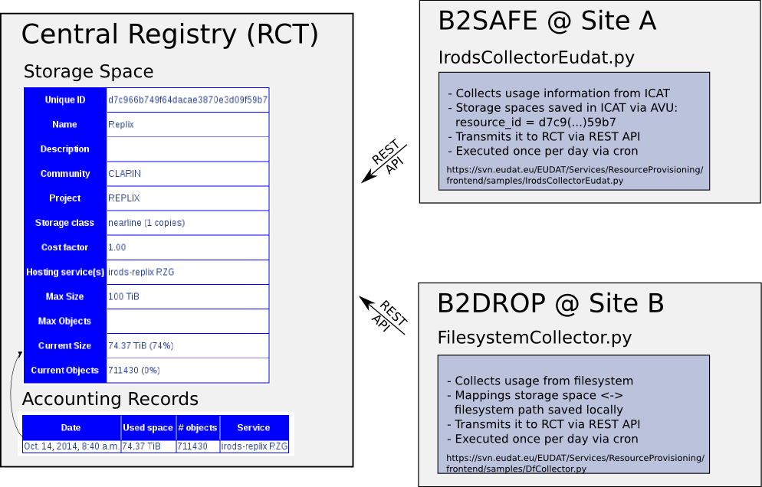
Acct

Slide 31
Security
UK/2015-10-14
Owner of the Security policy that defined the security roles and defines security guidelines.
  EUDAT Security officer, deputy security officer
  CSIRT team
  Incident handling procedure in place
Proactive security vulnerability scans for services and the infrastructure
  Port scans & application vulnerability scans
  Uses service endpoints from Configuration Information Service:
  B2DROP, B2SHARE, B2ACCESS, B2FIND, B2SAFE, OP services
  Warnings on vulnerabilities for sites sent to site security officers
  Reports to site security officers: critical vulnerabilities timely fixed
Security assessments: recently B2ACCESS (Unity)
Consultancy on
  e-infrastructure security and Data Privacy practises and issues
Cross-infrastructure Collaboration on Security
  Joint IT security workshop/training
  Close collaboration with PRACE, EGI, GÉANT, WLCG WISE

Slide 32
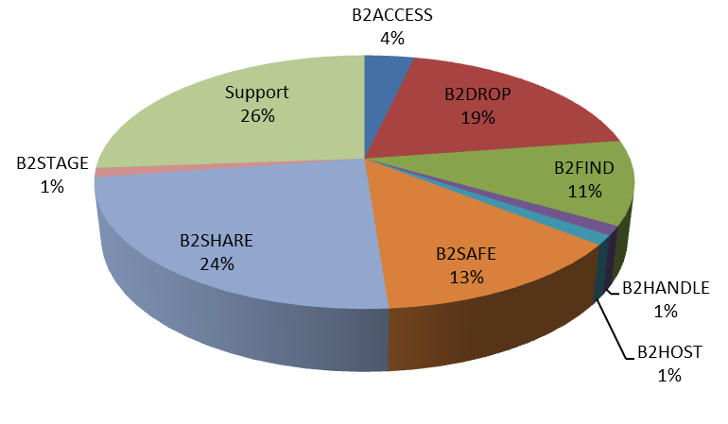
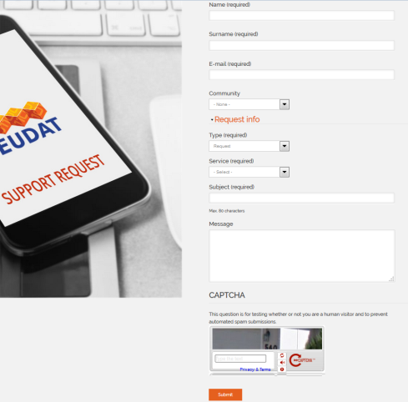
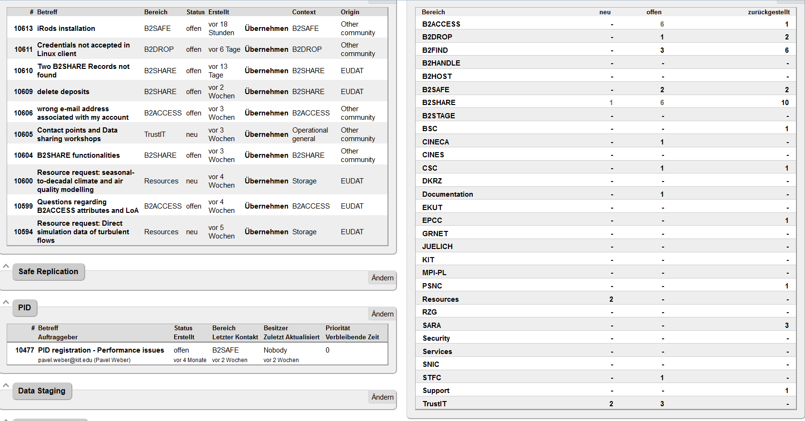
Helpdesk and Support Team
Requests via the Helpdesk Webform
Helpdesk Channels
Support Request Webform
Trouble Ticketing System
  B2-Service Queues
  Site Queues
Responsibilities
1st Level Support (BSC)
2nd Level Support:
Project Enabling Team (OP)
3rd Level Support
Service Developer Teams (DEV)

