Slide 1

EUDAT B2FIND
A Cross-Discipline Metadata Service and Discovery Portal
Heinrich Widmann, DKRZ
DI4R 2016,
Krakow, 28 September 2015

Slide 2
Outline
EUDAT and the B2 Service Suite
Guidelines and Concepts
B2FIND – EUDAT’s Discovery Service
  MD Ingestion and the B2FIND Schema
  Disciplines, Communities and the MD catalogue
  Data Access Identifiers
  Discovery Portal
Outlook and Summary

Slide 3
EUDAT and the B2 Service Suite

Slide 4
EUDAT
The project European Data Infrastructure (EUDAT)
  funded by the EU Horizon2020 program
  started in 2011, now in 2nd phase 'EUDAT2020', will end 2018
  >= 2018 : agreement of cooperation
Motivation : Manage the rising tide of research data
  Improve Interoperability in a wide cross-disciplinary scope
Objective : Build up a Collaborate Data Infrastructure,
  based on common data services
  driven by requirements of the research communities

Slide 5


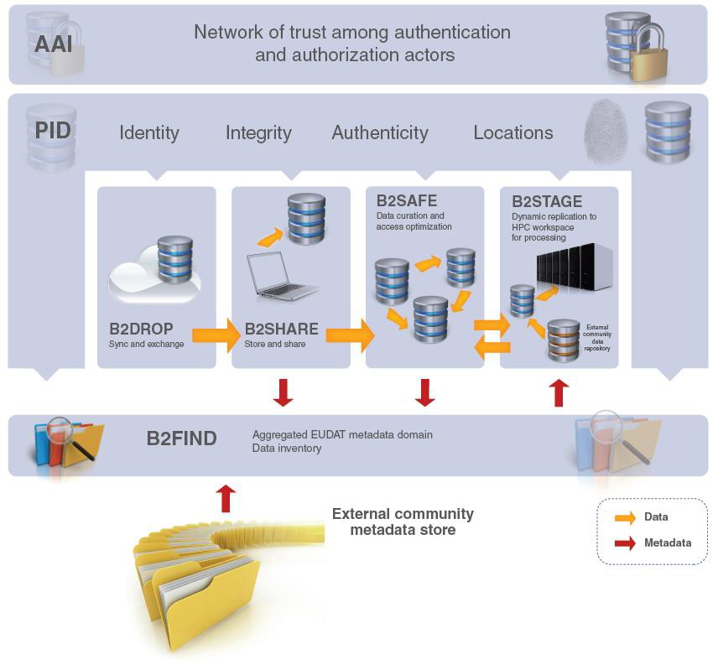





B2 Service Suite
→ http://www.eudat.eu/services

Slide 6
Guidelines and Concepts

Slide 7
The FAIR principles
B2FIND approach
Findability := “Ease with which information can be found”
  Powerful and easy-to-use search features and functionalities
Accessibility := “Ability to access [ ] data stored within repositories”
  Unique and persistent identification and resolvability of data objects
Interoperability : “Ability of multiple systems with different [] structures to exchange data with minimal loss of content []" (NISO)
  Comprehensive cross-disciplinary MD catalogue based on common standards and by minimising loss of information
Reuseability := “Ability to re-use data created by others”
  Cross-discipline approach and catalogue covering multiple sources

Slide 8







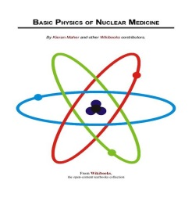

Levels of Interoperability
Heterogeneity
Homogeneity
Research Communities (Data Provider)
Data Repositories
(e.g. B2SHARE/B2SAVE or Agreggator as DataCite)
Service Provider
( e.g. EUDAT-B2FIND )
Info Loss
Schema A
Information Loss
MD generation
Collect and extract MD
!
010101010101010
Schema B2S
B2FIND harvest and mapping
Schema B
Schema B2FIND
MD generation
010101010101010
Schema C
MD generation
010101010101010
010101010101010
!
010101010101010
EUDAT B2FIND DI4R2016 28 September 2016

Slide 9
B2FIND
MD Ingestion and
Common Schema

Slide 10
B2FIND Ingestion Workflow
Data provider
(Community)
Harvest specification :
OAI-URL
OAI subsets
MD formats
Mapping specification :
XPATH rules
Community specific MD schemas and …
For joining B2FIND only a few preconditons has to be fulfilled
  Harvesting endpoint
  Spec. of MD format
Gurantee data synchronisation by frequent and incremental data harvesting
MD Generation and Specification
User (Scientist or
Researcher)
MD Provider A
MD Harvesting
MD Provider
MD Provider
Mapping and Validation
Uploading and Indexer
Search and Data Access
EUDAT-B2FIND

Slide 11
Mapping and Validation Procedure
The community specific ‘raw’ metadata are processed in the following steps
Select and convert entries from the harvested XML records by MD format specific XPATH rules
Semantic mapping : Parse and analyse these lists of entries and map according controlled vocabularies to the B2FIND schema
Validation : Check and validate the resulting JSON records
Planned developments :
Automate the mapping procedure
Use (community specific) ontologies and thesauri

Slide 12
B2FIND MD Schema (extract)
Metadata Type | B2FIND Field name | Allowed values | Semantic definition | Level of Obligation | Occurence
General information | Title | Free text (unicode) | A name or title a resource is known | Mandatory | 1
 | Description | Free text | Additional info | Recommended | 0-1
Data Access | Source | Valid URL or URN | Unique link to data resource | Mandatory (1) | 0-1 | 1-3
 | PID | Persistent Identifier | + persistent and resolvable
 |  |  |  |  | 0-1
 | DOI | Digital Object Identifier | + citable |  | 0-1
Provenance data | Creator | ‘;’-sep. list of names | Main researchers involved in data prod. | Recommended | 0-n
 | Discipline | List of values from CV | Field of research (Controlled Vocab) | Recommended | 0-n
 | Publication Year | YYYY | The year data are published | Recommended | 1
Formal data | Temporal Coverage | Interval of 2 DTimes [ Begin, End ] | The temporal limits of a date-time | Optional | 1-n
 | Spatial Coverage | Spatial box or point [[minlat,minlon…]] | The spatial limits of a place. | Optional | 1-n
Notes:
+ more facets ???

Slide 13
B2FIND
Disciplines, Communities and
MD Catalogue

Slide 14
The Facet ‚Discipline‘
Controlled Vocabulary
“Fields of Knowledge”
/
Humanities
Social sciences
Natural sciences
Professionals
Arts
History
Linguistics
Archaeo-
logy
Biology
Physics
Earth Sciences
Engineering
….
Elementary Particle Physics
Material science
taken from “List of Academic disciplines”
→ http://en.wikipedia.org/wiki/List_of_academic_disciplines_and_sub-disciplines and
„The Fields of Knowledge“
→ http://www.thingsmadethinkable.com/item/fields_of_knowledge.php?focus=natural_sciences
Crystallography

Slide 15
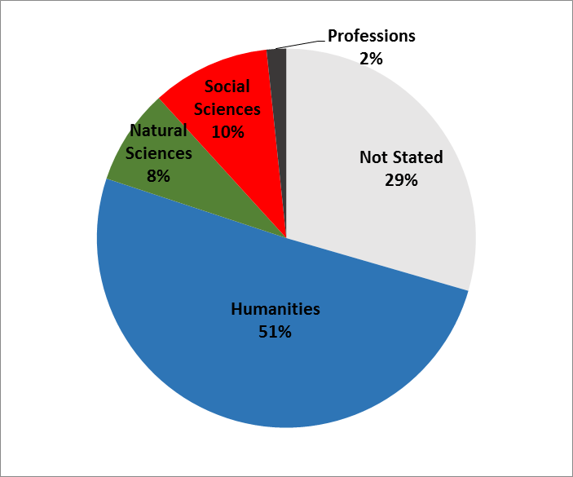
Coverage of Disciplines in B2FIND

Slide 16
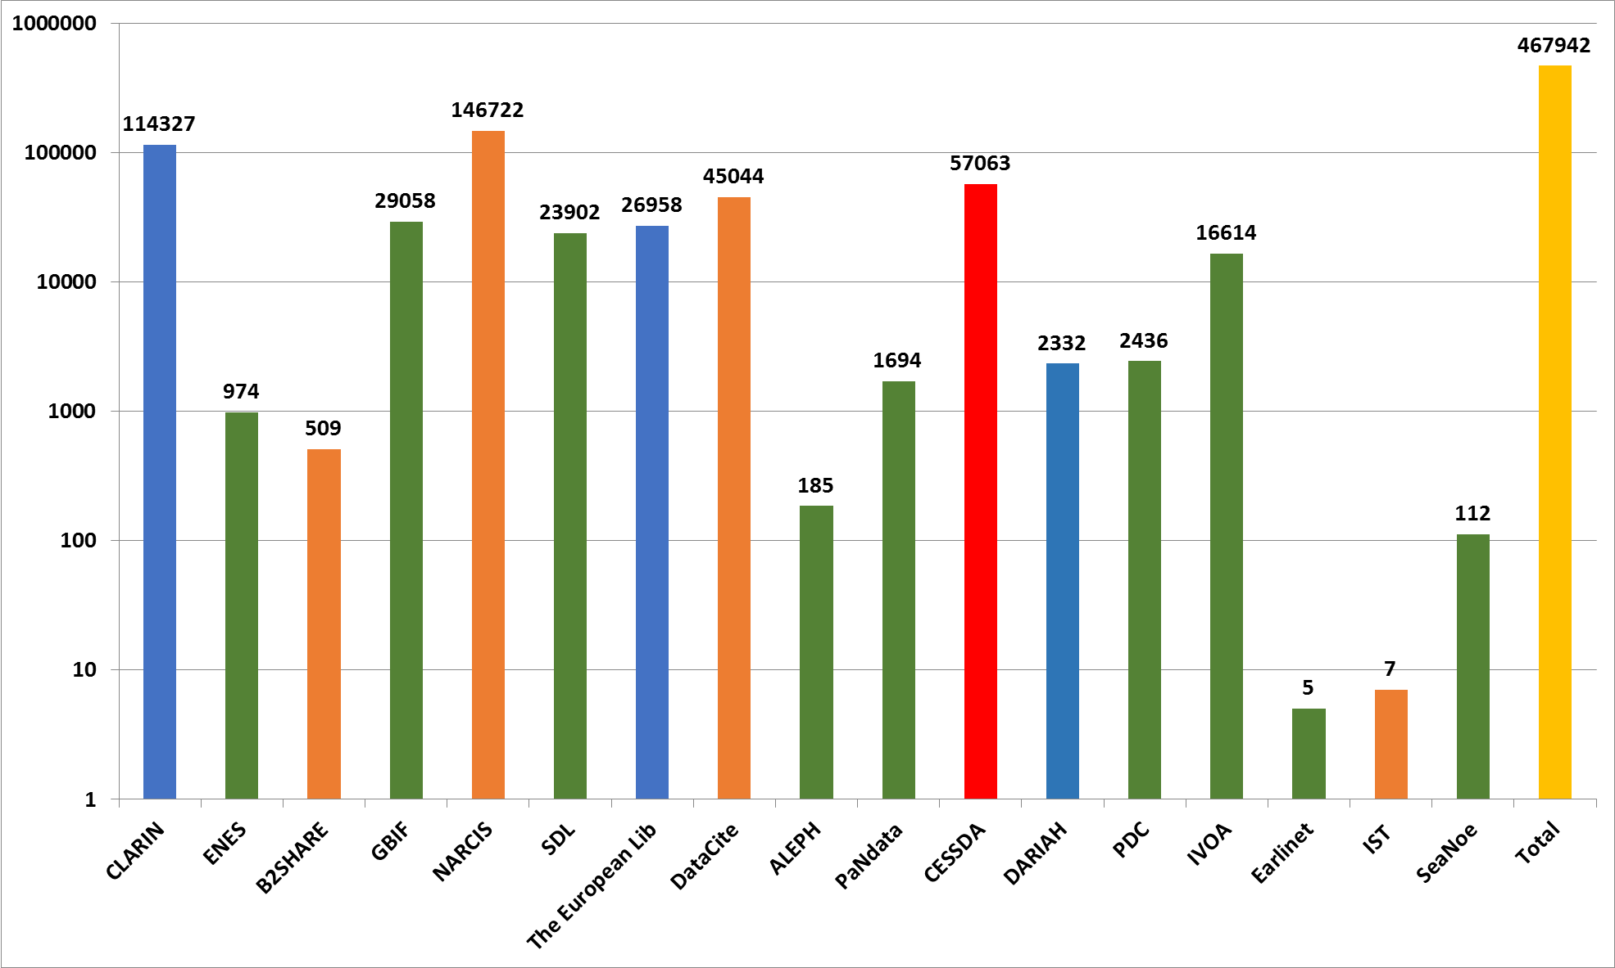
B2FIND MD Catalogue
Ingestion status
Humanities
Social Sciences
Natural Sciences
Cross Discipline
17 communities
> 450000 MD records

Slide 17
B2FIND
Data Access

Slide 18
Data Access Identifiers
Type | Unique | Persistent | Resolvable | Citable
DOI
PID |  |  |  | x
URL (Source) |  | ? | ? | x
Stricter Policies

Slide 19

Data Access
Resolvability and ‚Levels of aggregation‘
B2FIND
Resource
XML
Data Collection
<//dc:identifier value>
010101010101010
Resolution and Access
</>
Handle Server
010101010101010
B2FIND Metadta
Landing Page
Source
DOI Resolver
PID_1
010101010101010
PID
PID_2
DOI
PID_3
EUDAT B2FIND DI4R2016 28 September 2016
19

Slide 20
Data Access Identifiers
Resolvability and ‚Levels of aggregation‘
B2FIND
Resource
XML
Data Collection
<//dc:identifier value>
010101010101010
Resolution and Access
</>
Handle Server
Type | Unique | Persistent | Resolvable | Citable
DOI
PID |  |  |  | x
URL (Source) |  | ? | ? | x
Stricter Policies
010101010101010
B2FIND Metadta
Landing Page
Source
DOI Resolver
PID_1
010101010101010
PID
PID_2
DOI
PID_3
EUDAT B2FIND DI4R2016 28 September 2016
20

Slide 21
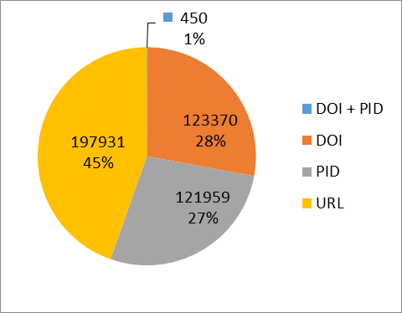
Coverage of Data Access Identifiers

Slide 22
B2FIND
Discovery Portal

Slide 23
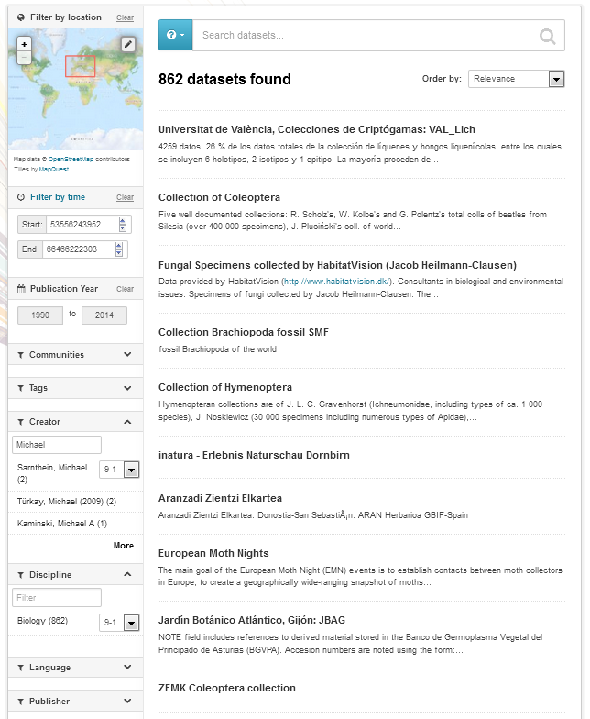
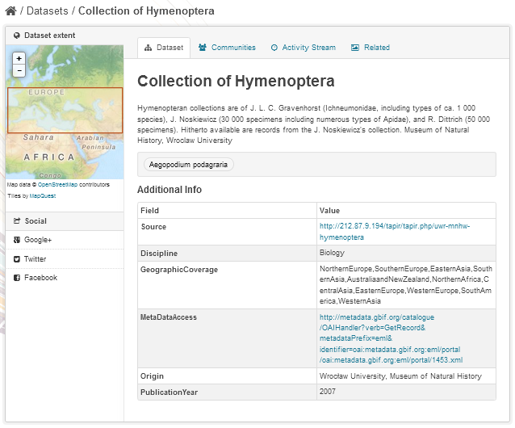
B2FIND Discovery Portal
Faceted Search and Data Access
B2FIND provides ‘faceted’ search for
Free text
Geo spatial
Temporal coverage
Publication year
Textual facets as
  Tags
  Creator
  Discipline etc.
Dataset view provides
display of metadata :
Spatial extent
Table of field-value pairs
Links to data resources

Slide 24
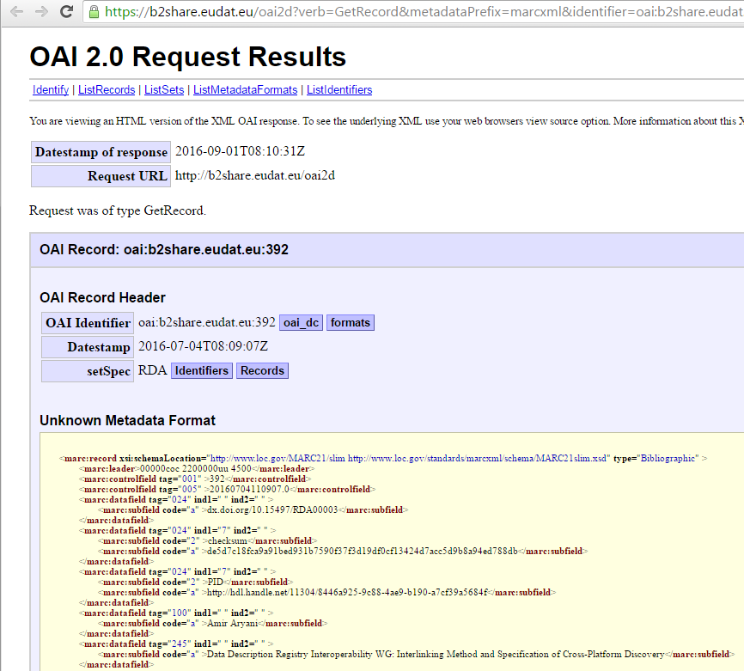
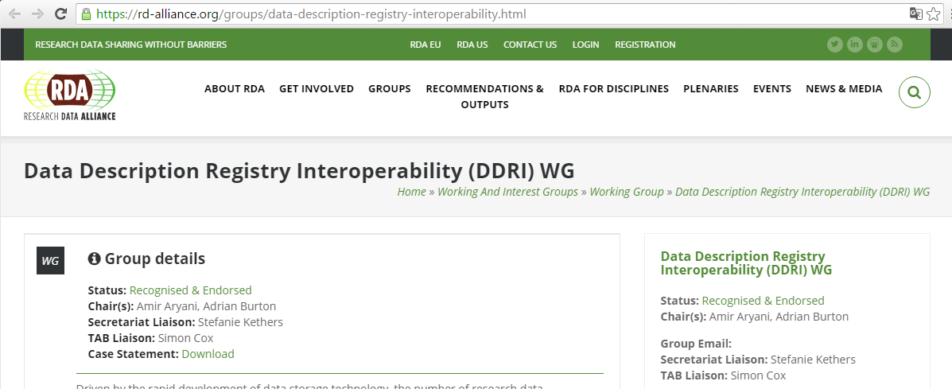
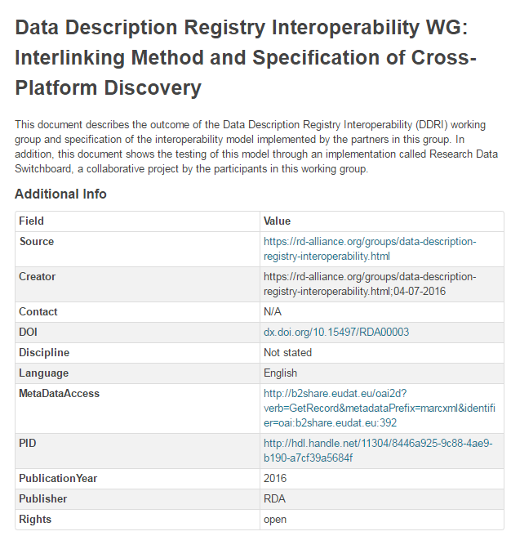
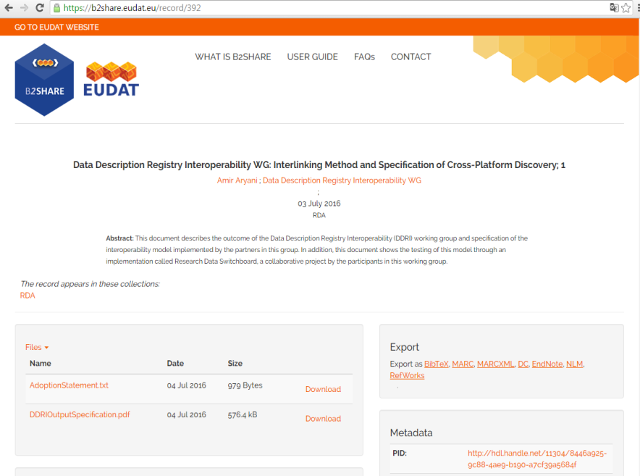
Data Access
Example
Notes:
!! Renew dataset display : correct DOI starting with http://...

Slide 25
Outlook and Summary

Slide 26
Outlook
Handle scalability and granularity issues
  ‘Levels of aggregation’
Metrics for Key Indicators and Metadata Quality
  Establish content-related quality assurance
Add further search and distribution channels, e.g.
  Use linked data : Potential for semantic enrichment
  ‘Annotation’ functionality : Users link datasets to external reference materials (vocabularies, ontologies, etc.)
  Query-based Taxonomies : Enabling hierarchical search, e.g. in trees of ‘Disciplines’

Slide 27
Summary
EUDAT-B2FIND
  established an operative service based on agreed standards and guidelines as the FAIR principles,
  provides a discovery portal with powerful search functionalities and
  is based on a unique catalogue of research data , combining many heterogeneous and cross-discipline sources
Improved interoperability is achieved by homogenisation to a common metadata schema
Further efforts are made to address the demands of the communities and data projects, to adapt the system for future challenges

Slide 28
Thank you for your attention !
Links :
  info : http://eudat.eu/b2find
  portal : http://b2find.eudat.eu
Contact
  www.eudat.eu/support-request
  widmann@dkrz.de

Slide 29
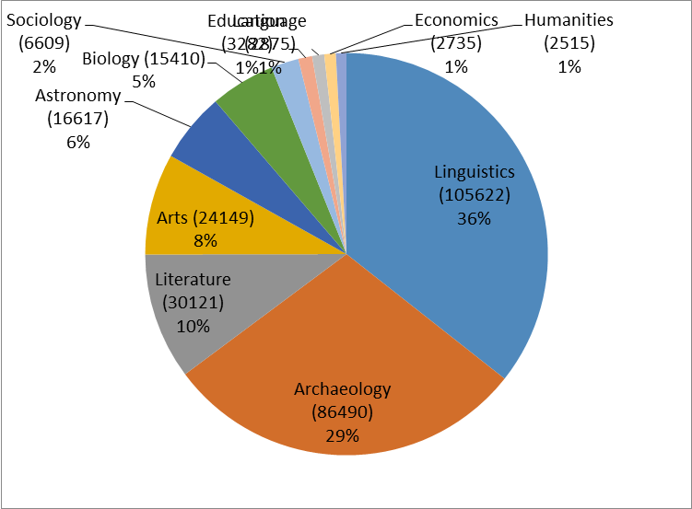
Coverage of Disciplines in B2FIND

Slide 30
The EUDAT Metadata (MD) Service B2FIND
based on a comprehensive MD catalogue that spans a large number of multi formatted datasets
  harvested from various research communities
  stored through the EUDAT service B2SHARE
  covering a wide range of highly diverse disciplines
  mapped to a common MD schema
provides an open discovery portal allowing researchers
  to find easily collections of scientific resources
  to access those resources through the given references in the metadata
The repository and portal is implemented through the open source portal software CKAN (ckan.org)
Notes:
- Noch mehr zu CKAN ???

Slide 31












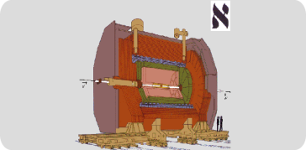
Communities and Disciplines
Integrated in B2FIND
Humanities
Social sciences
Natural sciences

Slide 32

Implementation of the Mapping
Mapfiles
<community>-<mdformat>
(XPATH rules)
B2FIND schema
"Title" : { "name" : "title",
"definition" : "A name or …",
" obligation " : "mandatory ", ... }
“Creator" : { “ckanName" : “author",
"definition" : "A person …´”,
"occurence " : " 0-n ", …. }
Closed vocabularies for
Disciplines
Languages (iso636)
ENES in ISO119…
XML
ENES
Facet specific
mapping methods as
map_title()
map_discipline()
<//gmd:title value>
</>
selecting and converting
CESSDA
JSON
JSON
XML
CESSDA
<field name=
"title">
<xpath>
//dc:title/text()
</xpath>
</field>
{"key" :value},
{ "Title" :
mapped-value }
<//dc:title value>
"community" cessda
"title" value
{ : }
{ : }
</>
ALEPH
ALEPH
<//marc:df[@tag = '245']
/marc:sf[@code = 'a'] value>
XML
…
</>
32
EUDAT B2FIND DI4R2016 28 September 2016

Slide 33
Mapping of the Facet ‘Discipline’
B2FIND closed vocab
for ‚Discipline‘
community-mdf.xml:
<field name="Discipline„
XPATH />
XPATH
= = <string value />
value
in
cv_disc
{ Discipline : value }
Loop over
XML records
of community-mdf
XPATH
= = <xpath // mdf:element />
value_n
in
cv_disc
{ Discipline : value += value_n }
XML
XML
XML
<mdf:element value_n>
<mdf:element value_n>
<mdf:element value_n>
Loop over values (n)
</>
</>

Slide 34
Mapping of ‘Spatial Coverage’
community-mdf.xml:
Loop over values (n)
<field name=
„SpatialCoverage„
XPATH />
Extract and loop over values, e.g
( 42.7, -12.7, …, „Krakow“, „Polen“, … )
Value is coordinate, e.g. -12.7
Build polygon dict
Spatial = [,,,,] }
Loop over
XML records
Optional : Check if value is a geoname
XML
XML
XML
<mdf:element value_n>
<mdf:element value_n>
<mdf:element value_n>, e.g.
<//gmd:southLat 42.7, …
<//dc:spatial „Krakau in Polen“
</>
</>

