Slide 1
eInfrastructure interoperation approach and developments
The GÉANT-CSP integration use case
Afrodite Sevasti, GÉANT/GRNET
Activity Leader for eInfrastructure Integration
Digital Infrastructures for Research event
28-30th September 2016

Slide 2
eInfrastructure interoperation In this talk...
Federated identity management
Business and operational interoperation
Governance

Slide 3
The drive for interoperation Forecasts and expectations
eInfrastructure user base
1,000s of campuses and institutions
1,000,000s of users
Multiple levels of user relations
Evolving user community requests
On-demand delivery
Minimum lead times
One-stop-shop
Service bundling/composite services
A European scale environment
Demand for eInfrastructure services
Requirements for both eInfrastructure and commercial services
Notes:
The infrastructure layer of the ECI should be ready to handle the increasing demand in volumes and capabilities

Slide 4
Digitizing European Industry European Cloud Initiative
“How to better connect the new and existing infrastructures across Europe?”
European Data Infrastructure
Super-computing capacity
Fast connectivity
High-capacity cloud solutions
Challenges
Fragmentation (domains and countries)
Governance
Disconnection
Silos
The high-bandwidth networks & supercomputing capacity to access & process large datasets stored in the Cloud
Notes:
ECI to better connect and enable federation of infrastructures across Europe (from intro section)
There is an infra layer and it is fragmented
This needs to be fixed
Data not there as the focus is on the infrastructure layer
The presentation will focus on three out of the four challenges

Slide 5
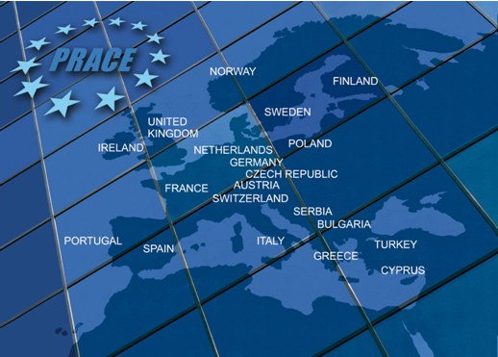
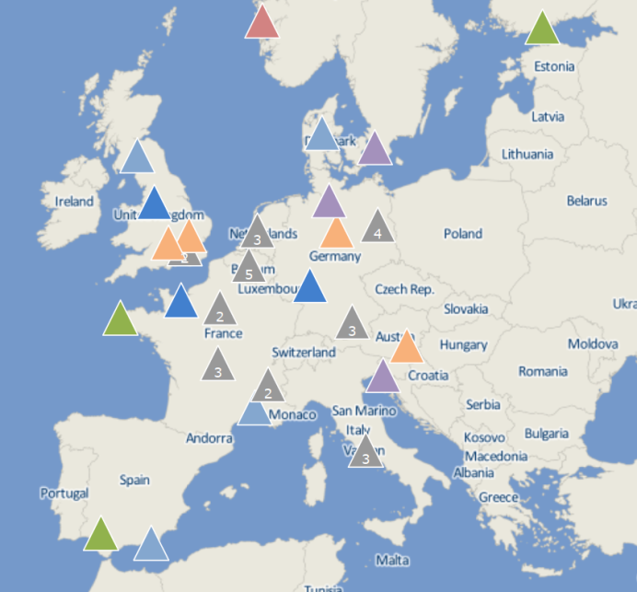
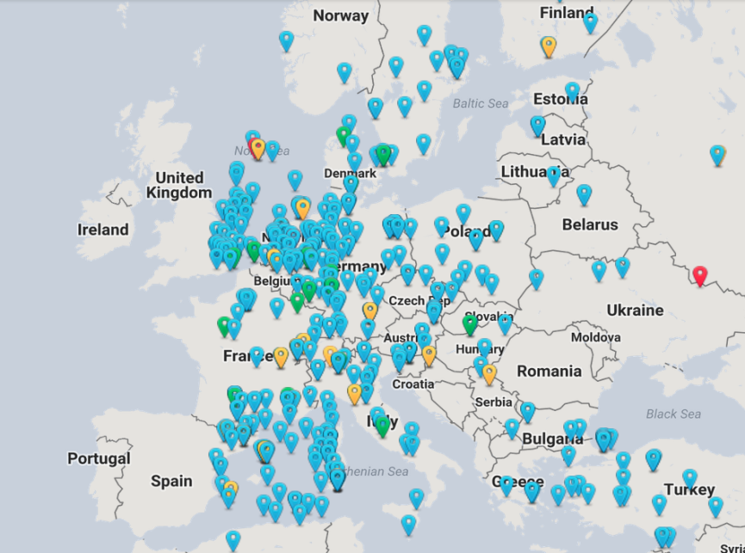
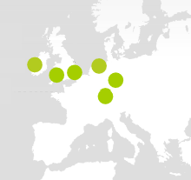
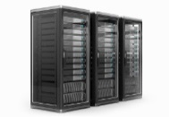
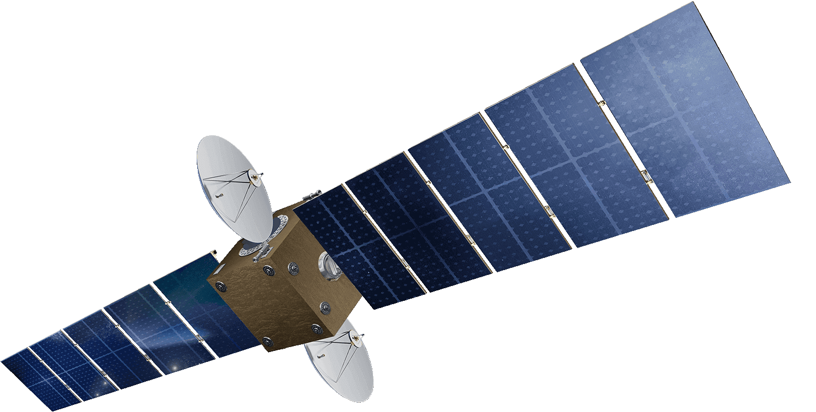
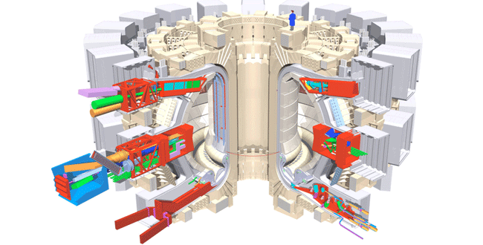
A shared high-speed connectivity substrate
OpenAIRE
European RIs
Cloud Service Provider (PoPs)
NREN
NREN
Regional
Notes:
Forthcoming GEANT service era
Getting very complex for GEANT/NRENs
Requests from individuals, labs, VROs, campuses
Different kinds of SPs connected
Demos have been done on things like OCX (including CSPs)
Indicative, not happening today, but we need to be prepared
Getting more complex to coordinate and orchestrate
Users getting more demanding in terms of capabilities and lead times

Slide 6
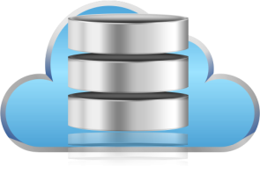
Accessing Cloud Service Provider resources
CSP
CSP
CSP Portal
Cloud Service Provider (CSP)
NREN
NREN
SERVICE =
VMs + network access
How/when is my traffic steered to my pool of VMs?
When does charging start?
Who do I turn to in case of performance incidents?
What is the guaranteed uptime of my service?
How can I dynamically update my services?

Slide 7
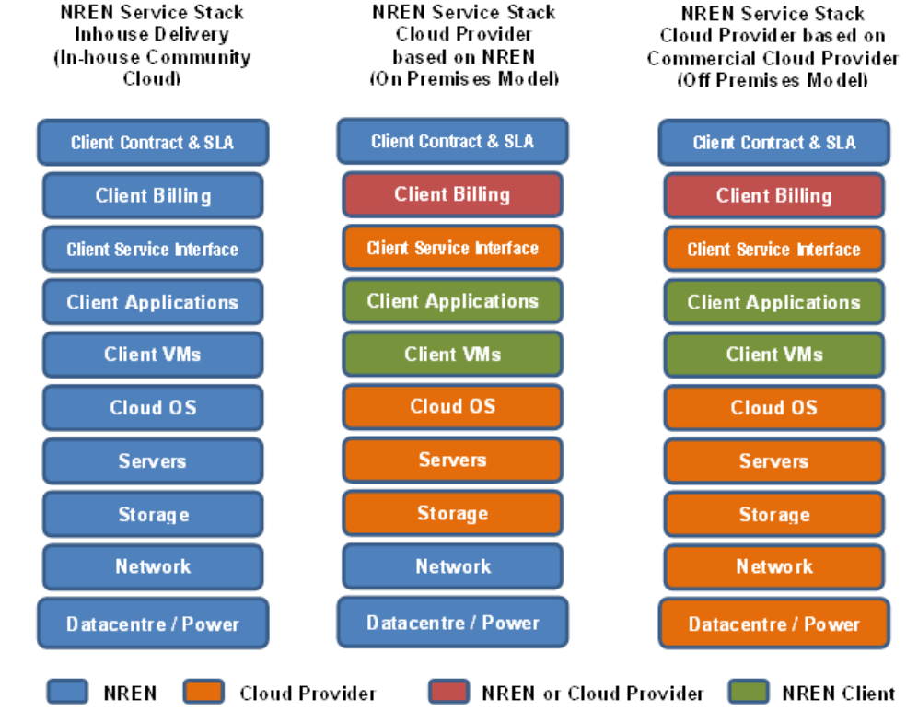
NREN service stack for CSP services’ delivery
Infrastructure/
network connectivity provider(s)
Cloud VM provider
Composite service offering requires business-to-business and operational interoperation

Slide 8
IP access to CSP resources Solution at the data plane (*)
NREN
NREN
GEANT CLOUD VRF
BGP-based routing overlay
PEERING REN
IX
CSP
BGP announcements
No tag
CSP
NREN tag
CSP
Cloud Provider tag
(*) figure by E. Capone, GEANT Ltd.

Slide 9
L2 private access to CSP resources Solution at the data plane
‘CSP order ID’ and ‘S-VLAN’
CSP portal
S-VLAN provides the service ID at the physical connection point
End-to-End QinQ
NREN
Primary & backup customer circuits
C-VLAN tag
Primary (& backup) provider L2 VPNs
S-VLAN tag
Utilizing different technologies across domains

Slide 10
User expectations
One-stop shop for cloud and connectivity services
Clear indication of status for VM and e2e connectivity orders and live services
Visibility to business operations
Is my institution eligible to service?
What is the status of my order?
Can I upgrade my service?
I wish to submit a service incident
Visibility to service health and operations
What is the connectivity throughput to my VM?
What is the current utilization of my VM?
When is the next scheduled maintenance for my service?
What has been the uptime for my service for the past 3 months?
CSP portal
?
NREN

Slide 11
Short-term plan: ‘two-stops’ shop
Cloud SP portal
Order VMs
Select network connectivity provider -> GEANT
Retrieve ‘CSP Service ID’ and ‘S-VLAN’
Step 1
Network connectivity one-stop-shop portal
Insert institution, CSP and ‘CSP Service ID’ information
Insert S-VLAN information
Order e2e L2 VPN to VMs
Step 2
Orchestration
CSP
Network service providers - NSPs
NREN

Slide 12
Long-term plan: one-stop shop
R&E Cloud Services one-stop-shop portal
Authenticate in institution via eduGAIN
Select CSP
(CSP catalogue retrieved) order VMs
(Network services catalogue retrieved) order L2 link
Use dashboard to manage/monitor service
1
2
4
3
5
6
Orchestration
NSPs
NREN
CSP
Dynamically populated GÉANT Cloud Service Provider Catalogue
Catalogue offerings of the selected CSP
Network services catalogue offerings (e.g. L3 connectivity, L2 VPN)
Invoke CSP API or B2B interfaces for order management & provisioning
Invoke NSP API or B2B interfaces for order management & provisioning
Invoke CSP/NSP API or B2B interfaces for monitoring and service management
C2B and B2B interactions

Slide 13
What is the orchestrator?
A workflow engine exposing a service bus for external communications
SP interactions are implemented as services
Controls party interactions and implements e2e service delivery and management logic
Different workflows can be defined for different services or business agreements
Orchestrators can be deployed either:
in a centralized mode (e.g. a single orchestrator overarching campus, NREN, GEANT network SPs) or
in a distributed mode: each SP deploys a workflow engine that supports east-west interactions with peering SPs
GEANT is working on an open-source reference implementation of an orchestrator+service bus solution

Slide 14
Network and Cloud SP: Fulfilling orders
any
Each R&E cloud service order is being decomposed by the receiving orchestrator:
VM resources order dispatched to the CSP
e2e connectivity order can be further decomposed per NSP
Either the orchestrator or the NSP can receive the e2e connectivity service order
Then invoke the required B2B transactions between NSPs to fulfill the order
NSPs that expose B2B interfaces communicate directly and minimize interaction with the orchestrator
All other NSPs (non B2B-capable, supporting manual provisioning) communicate via the orchestrator

Slide 15
Network and Cloud SP: B2B operations
any
Service/resource programmability
Catalogue information exchange
Common baseline Network Service Descriptors – e.g. TOSCA NSD
Resource topology/reachability information exchange – e.g. NSI DDS*
Provisioning – common Order State semantics
Service lifecycle management – common Service Lifecycle semantics
Ticketing – common Trouble Ticketing semantics – e.g. Trouble Ticket APIs
Incident management
SLA monitoring and negotiation
Common baseline SLA models/descriptors
Accounting/billing
Federated service management
*Document Distribution Service

Slide 16
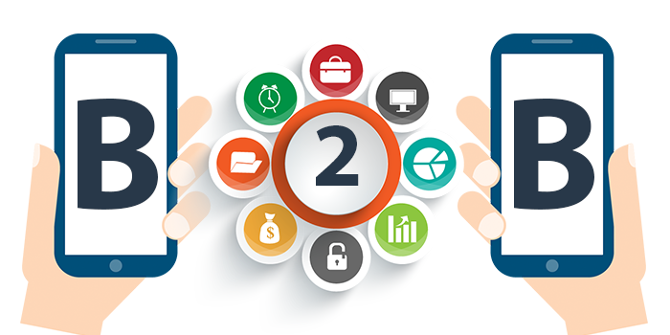
Adopting standards Application Programming Interfaces
Operations Management Interfaces
Catalog to Catalog Interface
Service Ordering & Activation
Service Quality Management
Performance
Fault Management
Inventory
Resource Order
Policy Information Exchange
Security
…..
Global Digital Marketplace

Slide 17
A flexible model Opt-in interoperability
Orchestration
NSPs
NREN
CSP
Orchestrator-invoked interfaces
No automation required
Basic information exposed via RESTful APIs towards the orchestrator
Notifications via emails, ticketing system etc.
B2B/operational interfaces
Orchestration entry points (e.g. URIs)
Advertising catalogue
Resource topology
Order Management & Provisioning
Service Lifecycle Management
Operations (Monitoring, Troubleshooting, SLAs)
Accounting/billing
User-demand as an incentive for automation

Slide 18
Network connectivity provisioning Technologies at GÉANT/NRENs
Orchestration
BoD cloud
NSPs
Network Services Agent (NSA)
IX
NREN
NSI-capable NSPs
Orchestration
MDVPN fabric (*)
NSPs
IX
NREN
NREN
Orchestration
EVPN /DCI fabric (*)
IX
Data center
NREN
Data center
(*) see presentation from X. Jeannin in 8B

Slide 19
An eInfrastructure interoperation scenario
Orchestration with WAN connectivity services
Orchestration
PaaS orchestrator
NSPs
NREN
TOSCA NSD
IaaS/PaaS providers expose selected orchestration capabilities
Request for inter-domain/WAN services via agreed Network Service Descriptors (e.g. TOSCA)
All other B2B interactions are possible
Opt-in applies again
GÉANT/NRENs serving as specialized/on-demand network service providers for all eInfrastructures

Slide 20
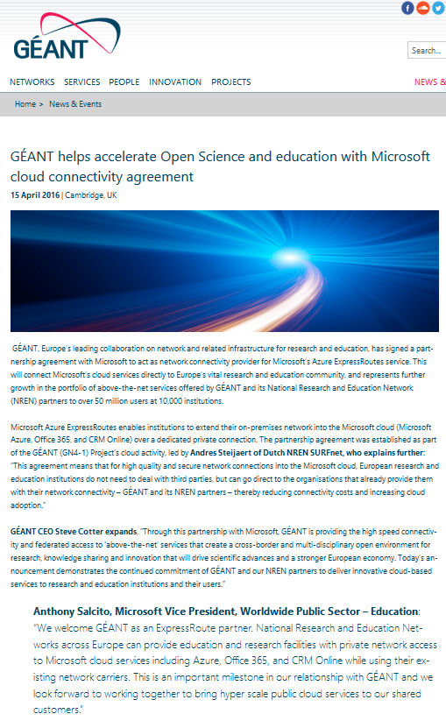
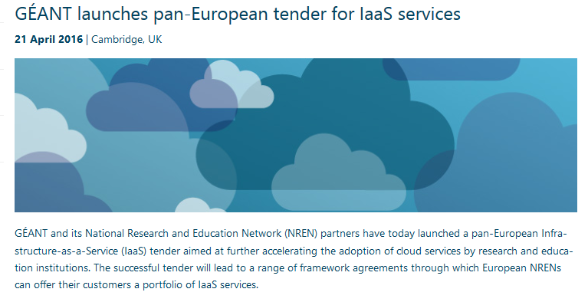
A business case for GÉANT/NRENs
GÉANT-Microsoft partnership for ExpressRoute offering:
Institutions to extend their on-premises network into the Microsoft cloud over dedicated private connections
More CSPs, more IaaS services

Slide 21
GÉANT’s Pan-European tender for IaaS services Multi-provider interoperability is inevitable
Portfolio of services and joint cloud delivery and adoption
NRENs bring the portfolio to their Institutions to consume
Participating CSPs
Amazon (through resellers)
Cloudsigma
Dimension Data
Interoute
itSoft
KPN
Lattelecom
Microsoft (through resellers)
NTT Europe
T-Systems
Telecom Italia
Vancis​
Concluded within September

Slide 22
Conclusions
GÉANT/NRENs challenged to join the global IT services marketplace
Orchestrated solution underway
For the GEANT/NREN-Microsoft Azure ExpressRoute offering
Modular, opt-in approach
Standards-based interfaces and B2B interactions
Fully reusable for eInfrastructure integration
Open to collaborations
Complementarity with on-going efforts
eInfrastructure service catalogues
Federated service management
If you cannot fully automate then…. orchestrate !

Slide 23
sevasti@grnet.gr

