Slide 1
Serving the long tail
Giuseppe La Rocca giuseppe.larocca@egi.eu
Technical Outreach Expert

Slide 2
Agenda
Some introductory concepts and driving consideration
Overview of the EGI platform serving the long tail
Services available in the platform
Progresses of the platform since April 2016
Roadmap for the next months
DI4R Conference – 28th. Sept 2016 - Krakow

Slide 3
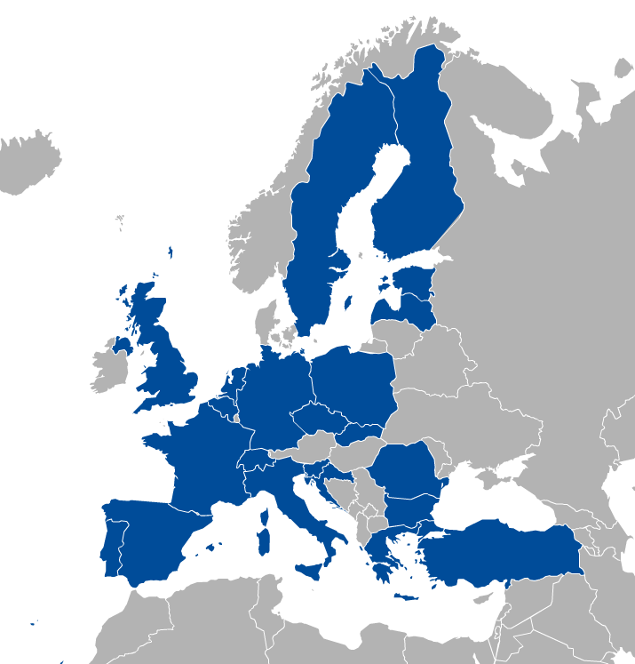
EGI Foundation: A sustainable e-infrastructure provider for Open Science
Major national e-Infrastructures: 22 NGIs
EIROs: CERN and EMBL-EBI
EGI Foundation
DI4R Conference – 28th. Sept 2016 - Krakow

Slide 4
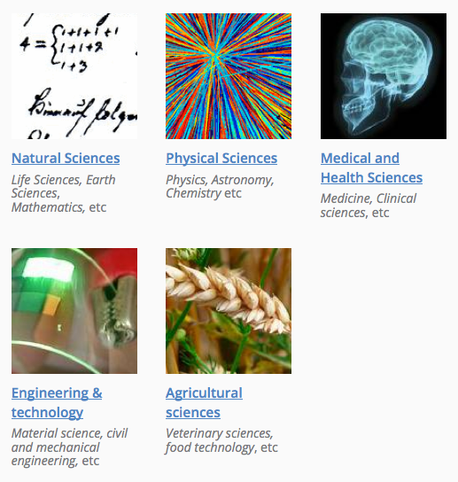
EGI Foundation: A sustainable e-infrastructure provider for Open Science
A globally distributed ICT infrastructure that federates digital capabilities, resources and expertise of national providers and international research communities
Mission: empower researchers from all disciplines to collaborate and to carry out data- and compute-intensive science and innovation.
DI4R Conference – 28th. Sept 2016 - Krakow

Slide 5
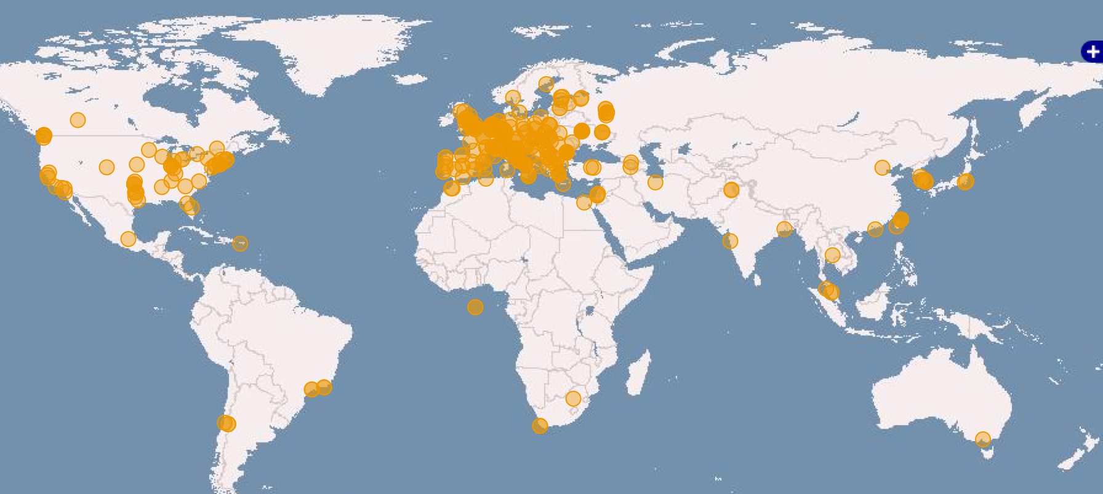
EGI federated infrastructure
Russia
Ukraine
Canada
USA
Asia
Pacific
820,000 CPU Cores
+23.6%
560 PB of disk and tape storage
22 Cloud providers
325 resource providers
48,000 users
+21%
+4,000 research papers
> 790 in 2015
Latin America
Africa
Arabia
DI4R Conference – 28th. Sept 2016 - Krakow

Slide 6
The engagement of new communities
The process of integrating new user communities in EGI has been successful many times
Hundreds of new users/communities every year access to EGI resources
230 active projects with 48,000 of users accessing the federated infrastructure every day for scientific analysis
Engage with new communities involves some overhead effort from EGI/NGIs and the user community side
Allocate resources for supporting communities activities
Set up a dedicated Virtual Organisation (VO)
Enable the VO in the resource providers
Accounting, monitoring
DI4R Conference – 28th. Sept 2016 - Krakow

Slide 7
From co-design to production services: SLA negotiation
EGI.eu is acting as negotiator
Finds and arranges resources that ‘fit for purpose’
SLA agreed with
BILS, MoBrain, DRIHM, EXTraS, DARIAH-CC, Terradue (ESA TEPs), LSGC
Finalising requests of D4Science, Peachnote, Bioisi, EMSO_DEV, …
OLAs
Provider A
SLAs
Customer
Negotiator
Provider B
Request submission
Matchmaking
Propose & Sign OLAs
Creating SLA
Propose & Sign SLA
2nd ENVRIplus week

Slide 8
Challenges when serving the long tail
Sometimes, in some cases, the overhead of creating a VO and/or getting certificate discouraged new users from joining EGI
WLCG
CTA
ELIXIR
EPOS
EISCAT_3D
BBMRI
CLARIN
LOFAR
EMSO
ELI
LifeWatch
ICOS
EMSO
CORBEL
ENVRIplus
…
Size of individual groups
PeachNote
CEBA Galaxy eLab
Semiconductor design
Main-belt comets
Quantum pysics studies
Virtual imaging (LS)
Bovine tuberculosis spread
Convergent evol. in genomes
Geography evolution
Seafloor seismic waves
3D liver maps with MRI
Metabolic rate modelling
Genome alignment
Tapeworms infection on fish
…
VRE projects
WeNMR
DRIHM
VERCE
MuG
AgINFRA
CMMST
LSGC
SuperSites Exploitation
Environmental sci.
neuGRID
…
Agroknow
CloudEO
CloudSME
Ecohydros
gnublia
Sinergise
SixSq
TEISS
Terradue
Ubercloud
…
ESFRIs, FET flagships
Multinational communities
Industry, SMEs
‘Long tail’
DI4R Conference – 28th. Sept 2016 - Krakow

Slide 9
Challenges when serving the long tail
One of the most common technical barriers to access is the process of requesting X.509 certificates.
Lack of visibility of long tail activities at European level
No dedicated VOs for supporting long tail activities
No (or very hard) access to and with digital certificates
High cost of maintenance vs. low national funding
EGI is developing a dedicated platform to make easy and quick for individual users to access EGI high throughput and cloud resources
DI4R Conference – 28th. Sept 2016 - Krakow

Slide 10
Requirements for a Long Tail of Science platform
Streamlined access and resource allocation for users who cannot access to national services available
No need for specialized relationship with an NGI, NREN or CA
No need to establish a Registration Authority at user’s institute
100% coverage: anyone with internet access can become a user
Secure: provide acceptable level of tracking of users and user activities
Scalable: can scale up to support large number of resource providers, technology providers, users and use case
Resource providers can join with their own resources
Science Gateways/VRE providers can join with custom tools
User-centric: user support is available through the NGIs
DI4R Conference – 28th. Sept 2016 - Krakow

Slide 11
Requirements for a Long Tail of Science platform
Reuse existing technology building blocks as much as possible
Traceability of scientific publications/user stories from the long-tail platform
With EGI acknowledgement
Easier to involve new users
DI4R Conference – 28th. Sept 2016 - Krakow

Slide 12
Services for the long-tail of science
The platform for supporting the long-tail of science is composed by the main technical components:
An User Registration Portal (URP)
A catch-all VO
A pool of grid/cloud-based resources where the catch-all VO is pre-enabled
A set of Science Gateways and Portals
A X.509 Credentials Management system
Science gateway
Science gateway
…
Resource pool with cloud, HTC and storage sites
User Registration Portal
Users
Science gateway
Science gateway
…
Support team
DI4R Conference – 28th. Sept 2016 - Krakow

Slide 13
The User Registration Portal (URP)
The URP is the entry point to access the platform and uses available services
URP AUP
User Registration Portal (URP) access.egi.eu
User UID
The user can:
Log in using his/her social accounts or using the EGI SSO
Provide additional information about their contacts, institutions and research topic
Submit a request for resource allocation
EGI /NGIs can:
Approve the user’s request, or suspend the user
Check the user’s usage of resource
If user’s request is approved an unique UID is assigned to identify the user in the platform
DI4R Conference – 28th. Sept 2016 - Krakow

Slide 14
Front page: http://access.egi.eu

Slide 15
Catch-all VO and the Infrastructure
A catch-all VO Virtual Organization (vo.access.egi.eu) under which all the activities of the LToS users are performed and accounted for has been created in the Operations Portal
VO ID card
The pre-allocated pool of resources is operated by various geographically distributed EGI Resource Centres
both cloud and HTC resource centres have accepted to enable the vo.access.egi.eu VO on their resources.
DI4R Conference – 28th. Sept 2016 - Krakow

Slide 16
OLA agreements with resource providers
OLA agreements with Cloud resource providers
Cloud Provider | Resources | OLA Status
INFN-CATANIA | 20 vCPU cores, 50GB RAM, 1TB storage | Signed
INFN-BARI | 15 vCPU cores, 30GB RAM, 1TB storage | Signed
CESGA | 32 vCPU cores, 64GB RAM, 2TB of storage | Signed
OLA agreements with HTC resource providers
HTC Provider | Resources | OLA Status
INFN-CATANIA | 1M HEPSPEC, 1GB RAM per core, 100GB storage | Signed
INFN-BARI | 0.5M HEPSPEC, 2GB RAM per core, 100GB storage | Signed
CYFRONET-LCG2 | 5M HEPSPEC, 3GB RAM per core, 500GB storage | Signed
BEgrid-ULB-VUB | 5M HEPSPEC, 2GB RAM per core, 500GB storage | Signed
DI4R Conference – 28th. Sept 2016 - Krakow

Slide 17
Science Gateways and portals for serving the long tail
The users can access EGI resources through dedicated Science Gateways deployed specifically for this use case and integrated with the User Management Portal
Science Gateways in the LToS are configured to consume authorization information from the User Registration Portal (user UID) and generate short-term proxies from robot certificates
For the traceability of user identities proxies have been extended creating Per-User Sub-Proxies (PUSP)
DI4R Conference – 28th. Sept 2016 - Krakow

Slide 18
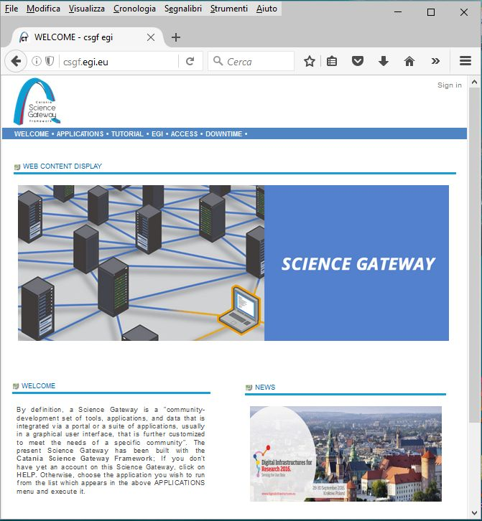
Science Gateways and portals for serving the long tail
The Catania Science Gateway (CSG) provides small groups/researchers with the possibility to seamlessly execute scientific applications on the resources supporting the catch-all VO
Jointly developed by the Division of Catania of the Italian National Instituted for Nuclear Physics (INFN) and by the Department of Physics and Astronomy of the University of Catania
http://www.catania-science-gateways.it/
https://github.com/csgf/
DI4R Conference – 28th. Sept 2016 - Krakow

Slide 19
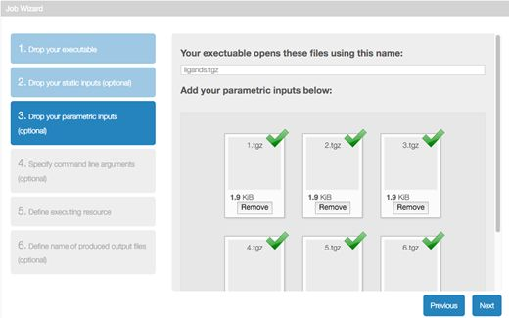
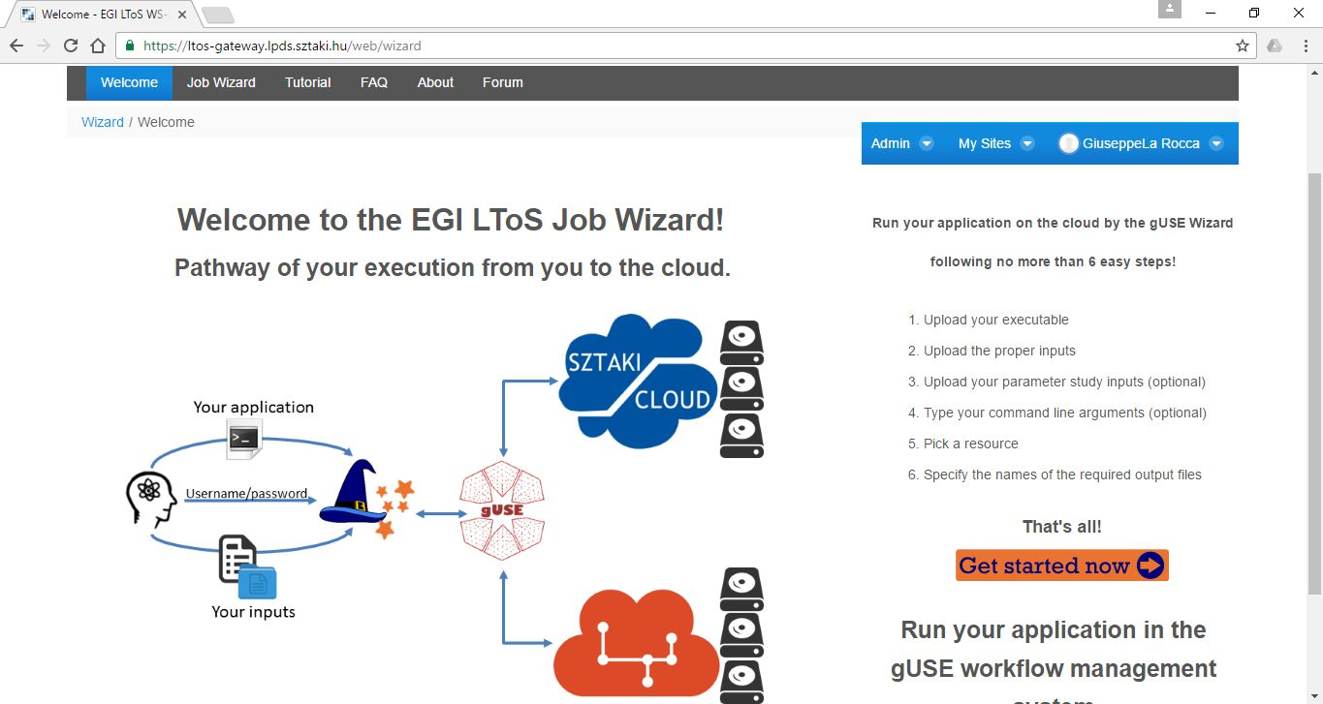
Science Gateways and portals for serving the long tail
The WS-PGRADE/gUSE Science Gateway offers a workflow-oriented Science Gateway framework with different customization methodologies.
- Developed by MTA SZTAKI and released under the Apache 2.0 license.
DI4R Conference – 28th. Sept 2016 - Krakow

Slide 20
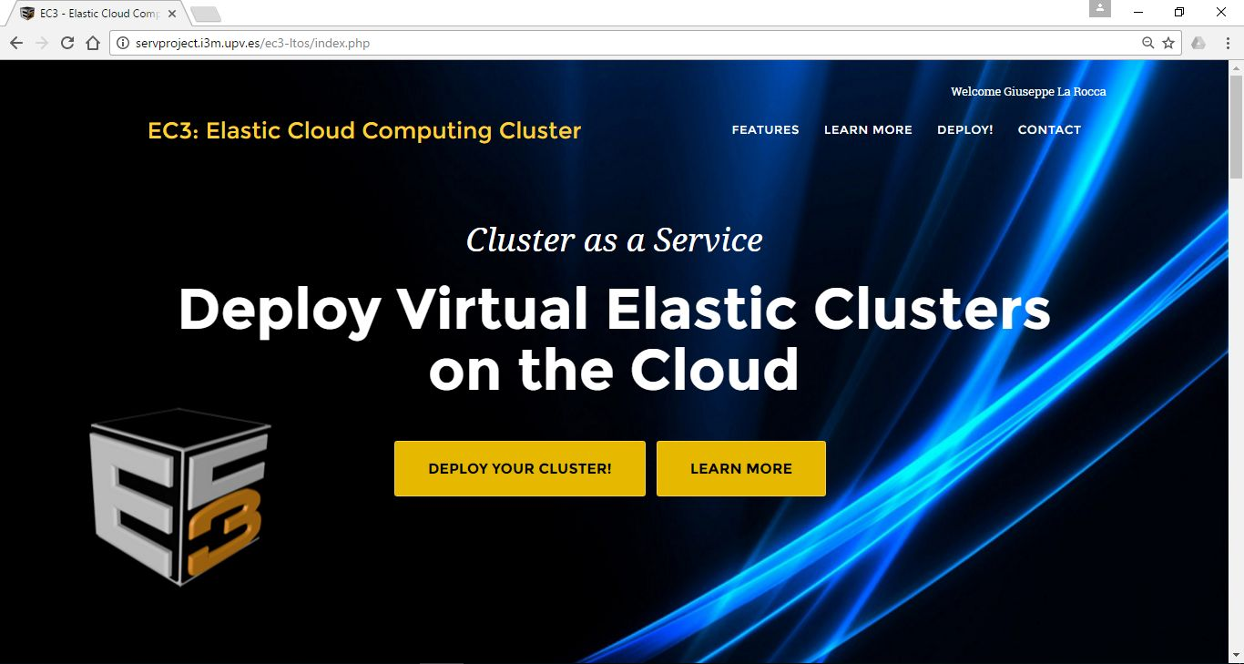
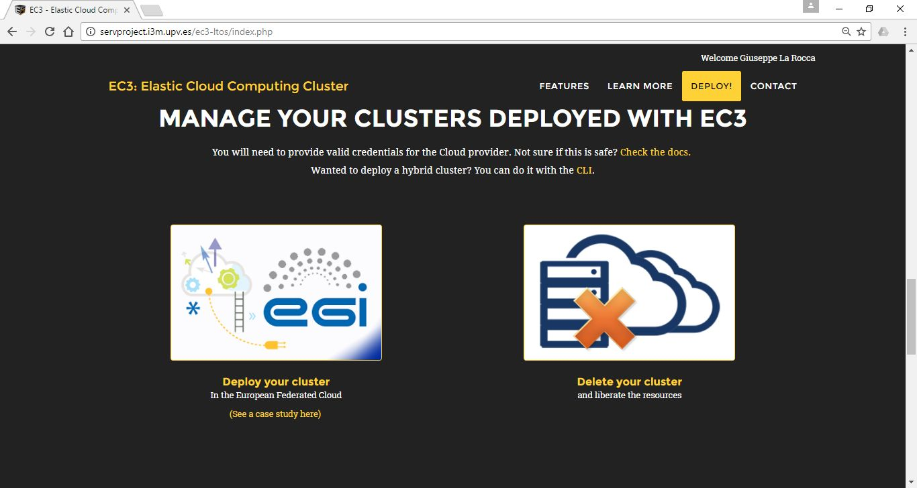
Science Gateways and portals for serving the long tail
The Elastic Cloud Computing Cluster (EC3) is an open-source software platform to dynamically deploy complex scientific virtual computing infrastructures on top of Infrastructure as a Service Clouds
- Developed by the Polytechnic University of Valencia (UPV)
DI4R Conference – 28th. Sept 2016 - Krakow

Slide 21
OLAs with service providers
OLA agreements with service providers
Service component | GOCDB registration | OLA Status | Monitor in ARGO | GGUS Support Unit
User Registration Portal (URP) | Registered | Signed | Active | Created
CSG (Catania Science Gateway) | Registered | Signed | Active | Created
WS-PGRADE/gUSE | Registered | In progress | Active | Created
EC3 | Under setup | Under setup | Under setup | Under setup
QCG-Portal | Expressed interest – working in progress
DI4R Conference – 28th. Sept 2016 - Krakow

Slide 22
X.509 Credential Management system
A X.509 Credentials Management system is directly contacted by the SGs to generate a per-user-sub-proxy (PUSP) from a robot certificate.
Permission to request robot certificate proxies is granted only to the Science Gateways and portals integrated in the LToS platform and only when the user accessing the SG is authorized.
Per-User Sub-Proxy (PUSP) allows identification of the individual users that operate using a common robot certificate.
This is achieved by creating a proxy credential from the robot credential containing user-identifying information in its additional proxy CN field.
Per User Sub Proxy
For the LToS platform, the UID is provided by the URP. The user will have the same UID using different SGs.
The Robot DN is the same for every user of the Science Gateway
Robot Certificate info
User UID
DI4R Conference – 28th. Sept 2016 - Krakow

Slide 23
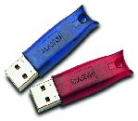
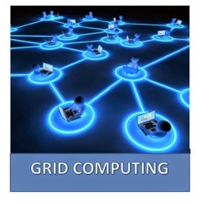
The Long Tail of Science platform: the big picture
User
URP AUP
User Registration Portal (URP) access.egi.eu
Support team
Local robot (OR hosted by INFN eToken server)
UserID (String)
Science Gateway
Science Gateway
PUSP
X.509 Credential Management System
Able to track back usage to the person
Science Gateway AUP
PUSP = Per-User Sub-Proxy
catch-all VO
vo.access.egi.eu
RobotID
UserID
EGI Accounting Database
VO Security Policy
DI4R Conference – 28th. Sept 2016 - Krakow

Slide 24
Scientific applications in the platform
Computer Science and Mathematics
The R Project for Statistical Computing: a free software environment for statistical computing and graphics
Available in the Catania Science Gateway
GNU Octave: a free high-level interpreted language primarily intended for numerical computations
Available in the EC3 portal
gnuplot: a command-line program to generate 2D and 3D plots of functions
Available in the EC3 portal
Cultural Heritage
The Parallel Semantic Search Engine (SSE): a service to demonstrate the potential of information coupled with semantic web technologies to address the issues of data discovery and correlation
Available in the Catania Science Gateway
Application Server
Apache Tomcat: an open-source web server developed by the Apache Software Foundation (ASF)
Available in the EC3 portal
DI4R Conference – 28th. Sept 2016 - Krakow

Slide 25
Scientific applications in the platform
Life Sciences
ClustalW2: a multiple sequence alignment tool for the alignment of DNA or protein sequences.
Chipster server accessed through the Catania Science Gateway
AutoDock Vina: an open-source program for doing molecular docking and virtual screening.
Available in the WS-PGRADE/gUSE Science Gateway
Galaxy: an open, web-based platform for data intensive biomedical research
Available in the EC3 portal
Others
Docker Containers: an open-source project that automates the deployment of Linux applications inside software containers
Available in the EC3 portal
DI4R Conference – 28th. Sept 2016 - Krakow

Slide 26
Status of the platform and roadmap for the next months
Final tests ongoing in EGI.eu
Next step: Invite national EGI member representatives into the test (Oct. 2016)
Open for public as beta service (Nov. 2016)
Developments in parallel:
Integrate EGI CheckIn service in the platform
Expand the list of scientific applications/tools in the platform
EGI dashboard
Alces Flight
DI4R Conference – 28th. Sept 2016 - Krakow

