Slide 1
SME Engagement in PRACE
G. Erbacci, (CINECA and PRACE)
SME Dynamics Workshop: SME engagement across e-Infrastructures
DI4R, Krakow 28-30 September 2016

Slide 2
Partnership for Advanced Computing in Europe
PRACE is an international not-for-profit association under Belgian
law, with its seat in Brussels
PRACE is funded by its members as well as through a series of
implementation projects supported by the European Commission
435 scientific projects enabled
11.4 thousand million core hours awarded since 2010 via peer review, main criterion is scientific excellence
Open R&D access for industrial users with >50 companies supported
>7 350 people trained by 6 PRACE Advanced Training Centers and others
events
21 Pflop/s of peak performance on 6 world-class systems
530 M€ of funding for 2010-2015, access free at the point of usage
25 members, including 4 Hosting Members (France, Germany, Italy, Spain)

Slide 3
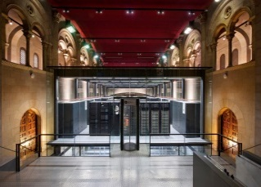
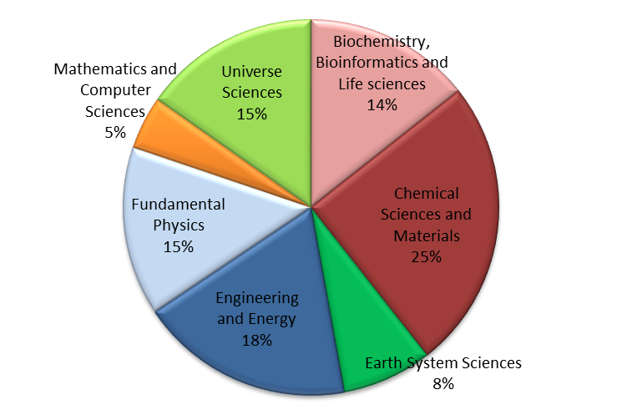
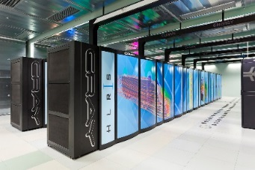
4 Hosting Members offering core hours on 6 world-class machines
JUQUEEN: IBM BlueGene/Q
GAUSS/FZJ
Jülich, Germany
SuperMUC: IBM
GAUSS/LRZ Garching, Germany
MareNostrum: IBM BSC, Barcelona, Spain
Hazel Hen: Cray
GAUSS/HLRS,
Stuttgart, Germany
CURIE: Bull Bullx GENCI/CEA
Bruyères-le-Châtel, France
MARCONI: Lenovo Intel KNL CINECA , Bologna, Italy

Slide 4
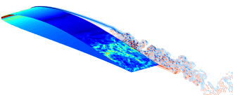
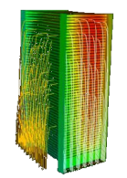
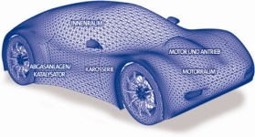
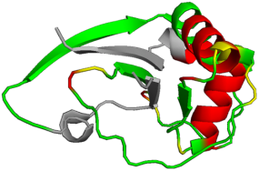
PRACE offers services to the Industry
Access to leading edge resources
To assess the scalability on a wide number of HPC architectures
To give access to HPC resources based on scientific excellence, free of charge, alone or in collaboration with labs
To foster technology transfer between academia and industry
To access to the competences enabling to build new methodologies (multiscale, multi physics, disruptive, uncertainties…)
Access to high value services
Training (PRACE Advanced Training Centers, opened to industrial users)
Code enabling (Open Source codes for industry, etc)
PRACE-1IP Kick-off meeting in
4

Slide 5
Strenghtening the links with industrial users
PRACE Industrial Advisory Committee (IAV
13 high-level representatives of big industrial users, appointed for 2 years
A member representing SME
Anders Rhod Gregersen, PRACE IAC Chairman
Objective :
Gather strategic expectations of industries
Advise PRACE Council on the directions that best suit industrial needs
Help lobby to stimulate the use of HPC and numerical simulation by industry

Slide 6
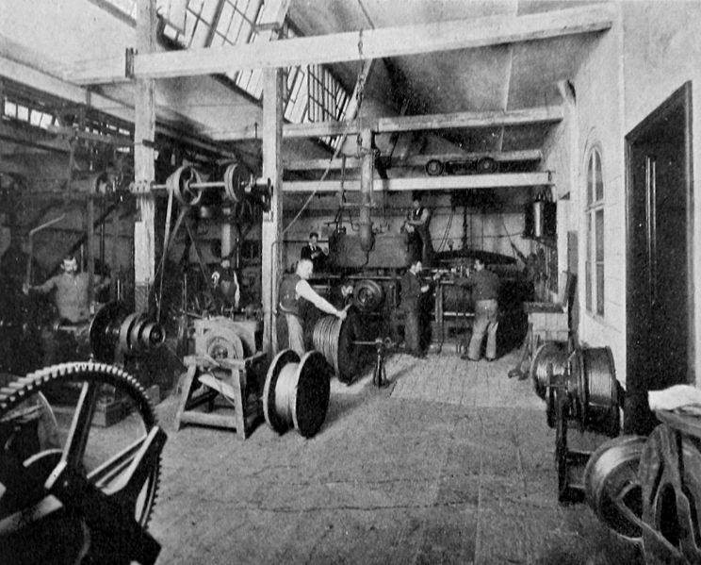
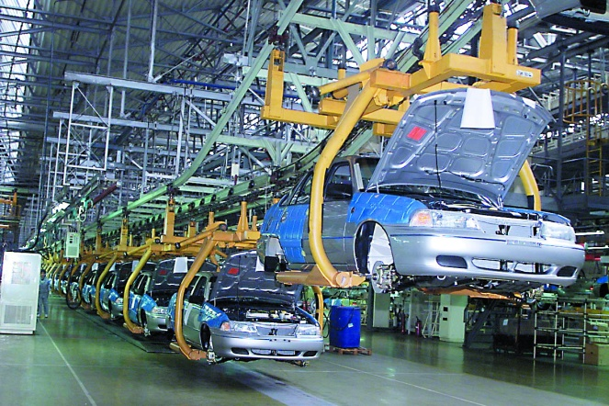
HPC & SMEs
HPC is a powerful technology
enable the development of new products or services,
reduce time-to-market
reduce cost of R&D or increase the product quality
create new business opportunities
HPC can change the Europe’s Industrial Landscape
…. but there are still barriers to use HPC
cost of operation
lack of knowledge
lack of resources

Slide 7
Pan-European, PRACE-based, programme supporting HPC adoption by SMEs.
Raise awareness and equip European SMEs with the expertise necessary to take advantage of the innovation possibilities opened up by HPC thus increasing their competitiveness.
Overcome the barriers to HPC adoption:
Lack of expertise in knowledge of the possibilities of HPC and advanced numerical simulation;
Lack of resources to facilitate the HPC adoption process;
The entry costs of implementing new technologies.
SHAPE facilitates the process of defining a workable solution based on HPC
SHAPE helps to define an appropriate business model.

Slide 8
The main focus is to work on a one-to-one basis with SMEs willing to adopt a new HPC-supported solution
Based on an integrated set of services:
networking,
training in PRACE Centres
expertise provided by HPC and domain-specific experts,
access to PRACE HPC systems (R&D model)
support for identifying funding sources
Support SMEs up to a proof-of-concept
The objective is to equip the participating SMEs with knowledge that will allow them to make an informed decision on the selected solution
After the SHAPE demonstration, companies will have a clear view about
potential of HPC
investments to perform,
skills to hire
software or methodologies to develop,
next HPC Services:
PRACE services for Open R&D services
buying their own HPC facilities
access remote HPC services on commercial Cloud platforms.

Slide 9
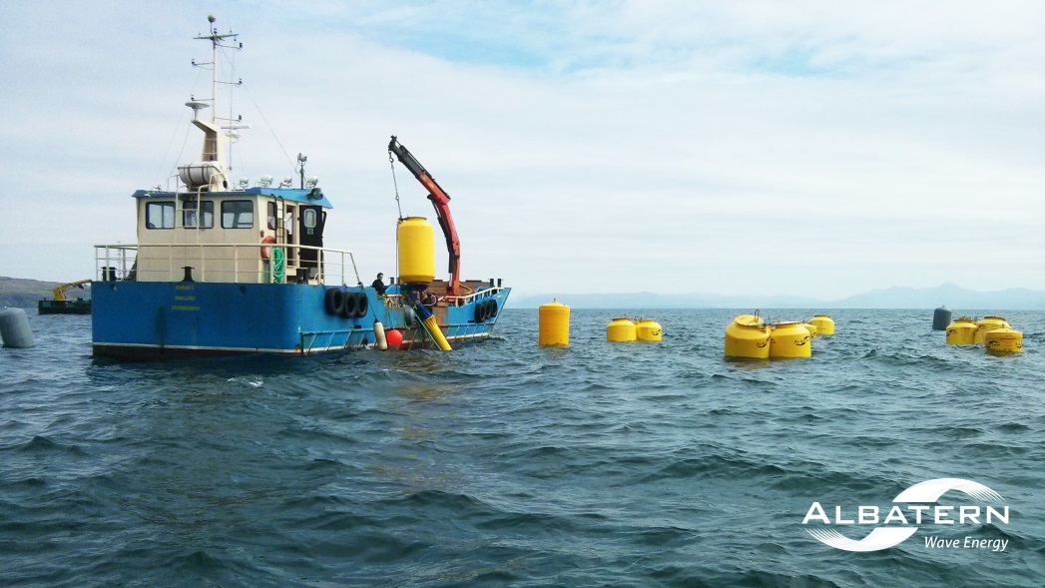
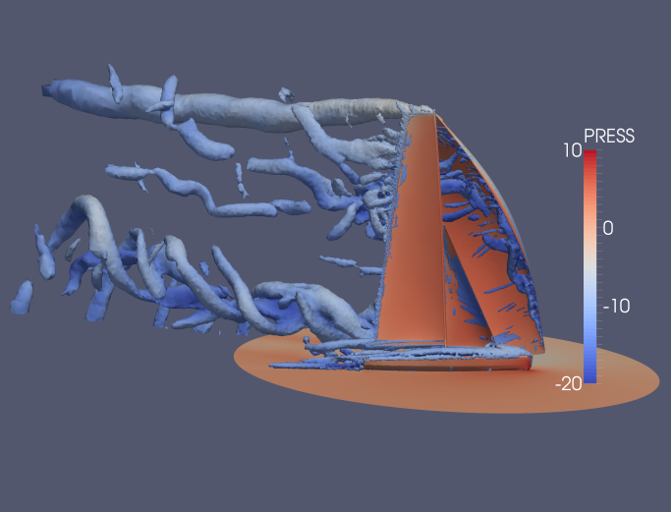
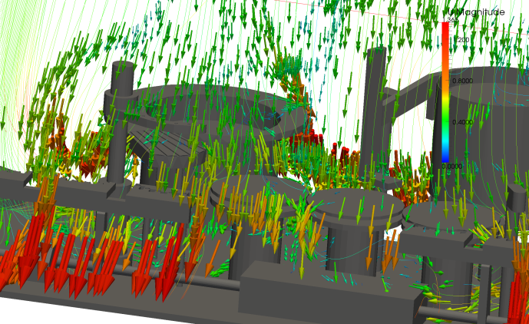
Some SHAPE results
3 calls: 28 projects funded from 9 different countries
4th call closed on September 9th 2016
Different computational fields: hydraulic turbine design, life science, audio technologies, LES turbulence models in race boat sail, airflow simulations, electromagnetic behavior of products, virtual test bench for centrifugal pumps, CFD simulation of innovative hull, etc
Participation in the Programme has been monitored to evaluate
possible benefits, ROI and business impact obtained by the SMEs:
SHAPE is of real value to the SMEs
Many positive outcomes for the businesses involved in the activity
Tangible measures of the ROI in many of the projects:
- new staff people hired
- contracts have been won
costs have been reduced
HPC Access
- in house HPC systems installed
Optimism that the improvement in the service will lead to an increase in customer numbers
Adopting HPC: Companies R&D will be accelerated along with reduced costs
Commitment to continue working with HPC: in-house or via access to PRACE resources
For any information:
www.prace-ri.eu/shape
shape@prace-ri.eu

Slide 11
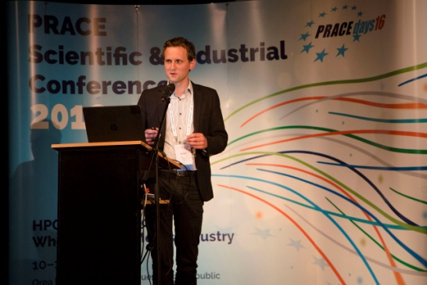
Success story testimonial from Cybeletech SME
Denis Wouters (Cybeletech, SHAPE user) https://www.youtube.com/watch?v=Ba6WVQE7aYw&list=PLfDqbLv1vSqjg2r9S9DY9nMPfdH5nSoFm&index=16

