Slide 1
SME Engagement in EGI
Sy Holsinger
Senior Strategy and Policy Officer
EGI Foundation

Slide 2
Outline
Brief overview of EGI (1-slide)
Why engage with SMEs
Strategy deployed
Services offered / value
Successes to date

Slide 3
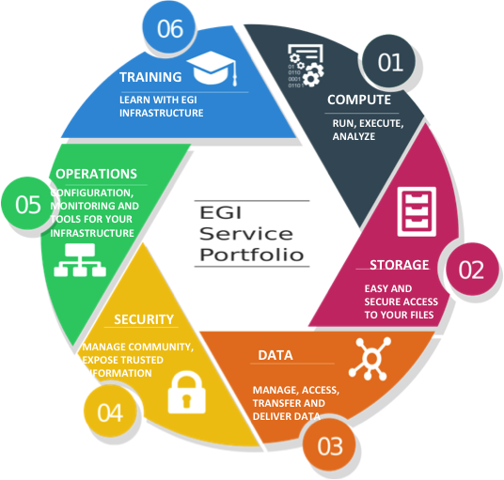
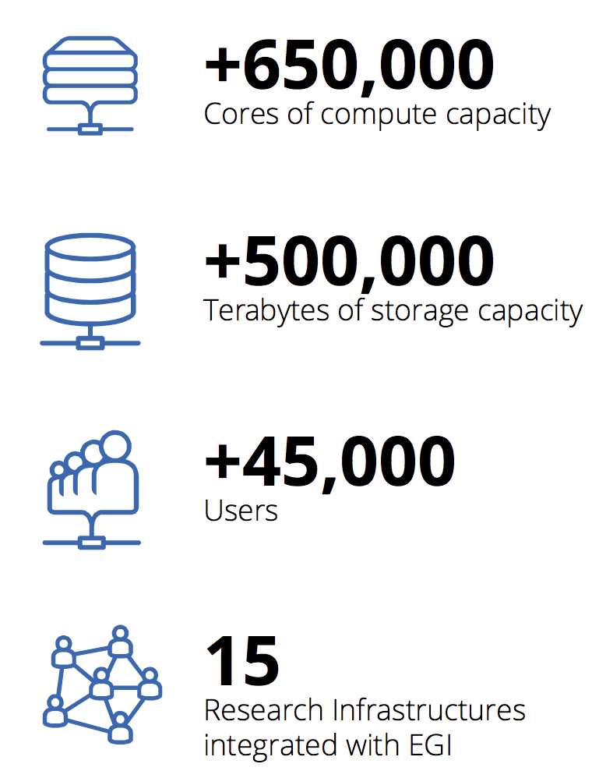
EGI: Advanced Computing for Research
+50 countries
826,000
560,000
48,000

Slide 4



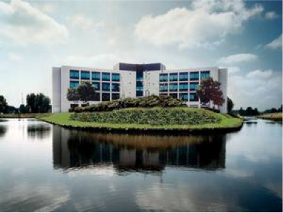
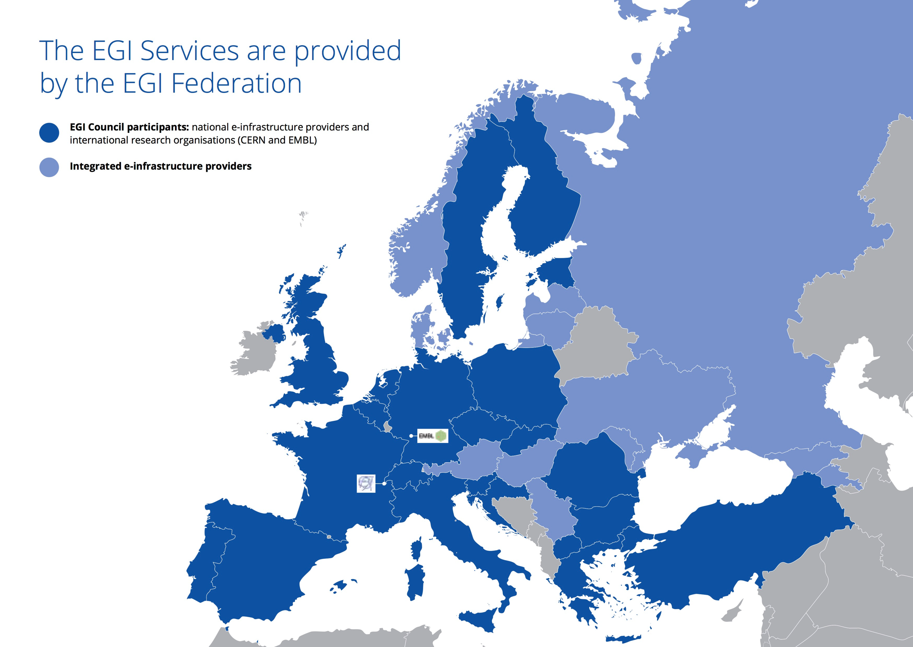














































Why Engage SMEs/Industry
Greater Good
Egotistic

Slide 5
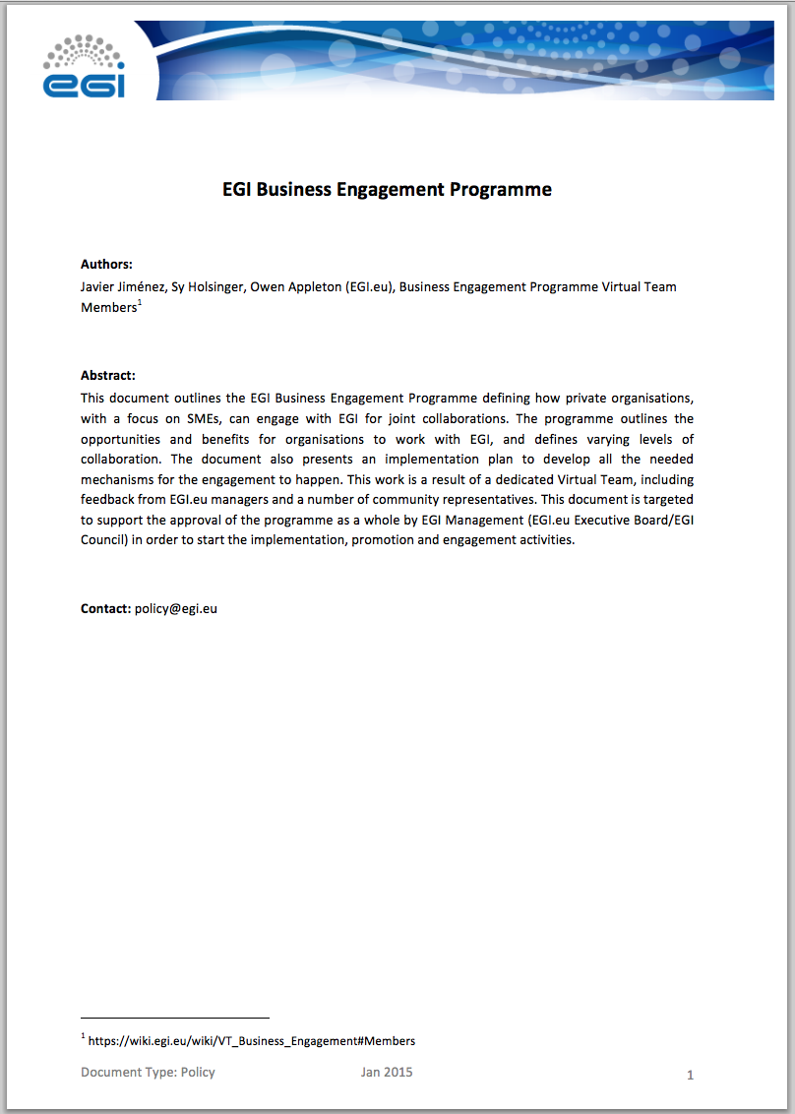
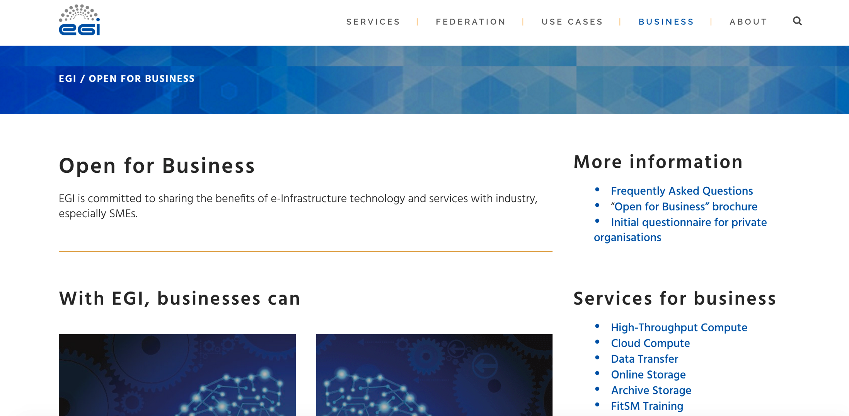
Strategy Deployed
Formal business programme
  SMEs are diverse = value options diverse
  Dedicated resources and services
Geographical focus
  European/global = EGI Foundation
  National/regional = NGIs
Demonstrate value through pilots/collaborations
Establish potential long-term business relations

Slide 6




Services Offered

Slide 7

















Established collaborations
Platform Integration
IaaS Consumers/Pilots
Business Development
Public/Private Partnerships
FitSM Training
EGI FedCloud Provider

Slide 8
Established collaborations
Andreas Ocklenburg, CEO of CloudSME:
“Our software vendor, value added re-seller and manufacturing SME customers will be able to get access to a large resource pool as well as to the vast technical expertise that EGI represents. Collaborating with EGI will further strengthen CloudSME’s position towards the academic and research community and our customers will receive even higher level of computing resources, expertise and support than before”.
Platform Integration
IaaS Consumers/Pilots
Business Development
Hervé Caumont, head of Terradue Platform Operations: “Teaming up with a major European Cloud Computing provider such as EGI through our Partner Programme is reinforcing the strategic evolutions of Terradue Cloud Platform as this new capacity will support our Cloud Platform users to run near real-time processing of satellite data acquisitions”.
Public/Private Partnerships
FitSM Training
EGI FedCloud Provider
Wolfgang Gentzsch, President of UberCloud: “Through our online marketplace EGI can directly address its services to our industry community, while we can reach out to EGI’s scientific community through the EGI FedCloud, which can benefit from UberCloud’s packaged computing and application software services, known as containers.”

Slide 9
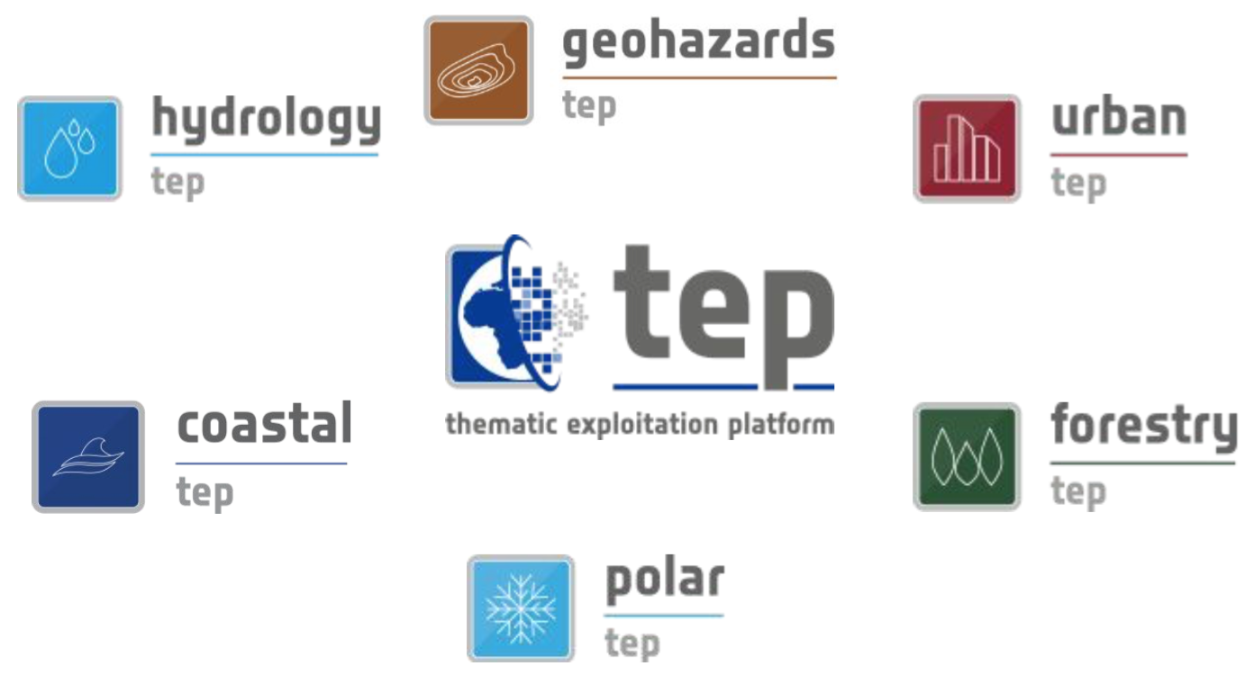
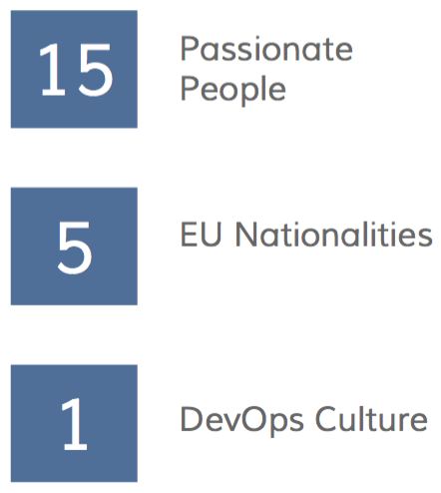
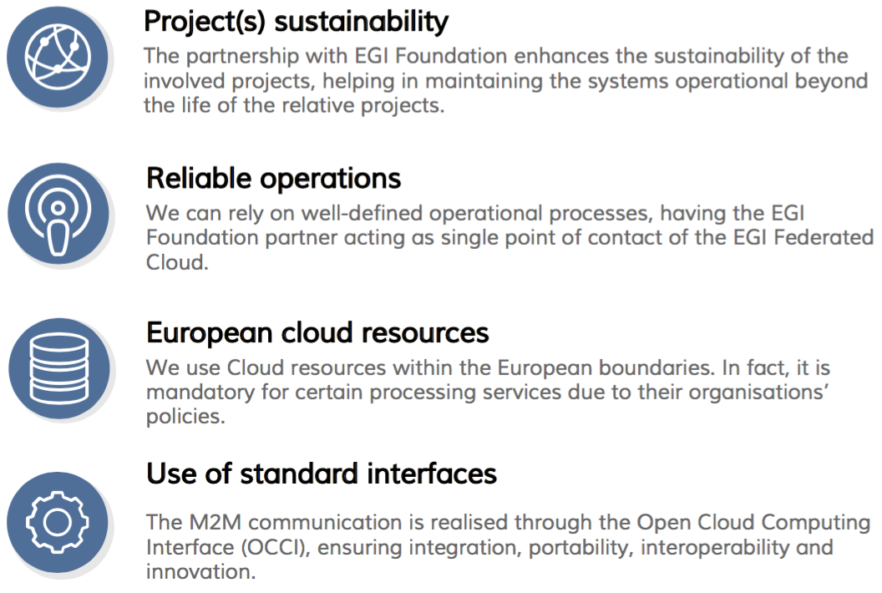
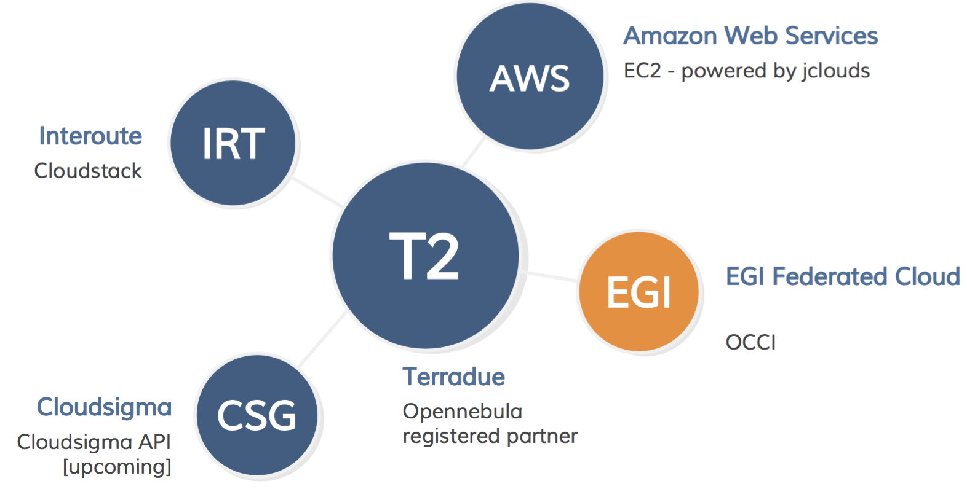
Success Story: Terradue
Demo in Thurs’ COPERNICUS session

Slide 10

@EGI_eInfra
@syholsinger
#DI4R2016
sy.holsinger@egi.eu

