Slide 1
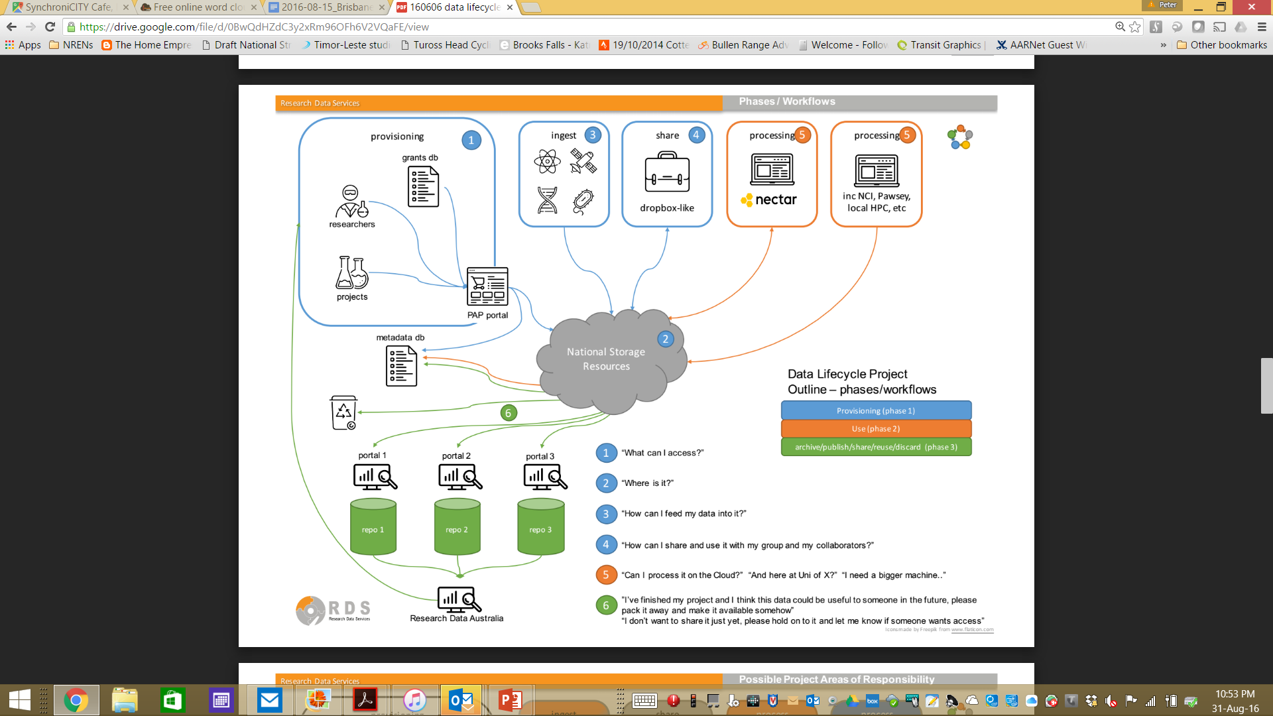
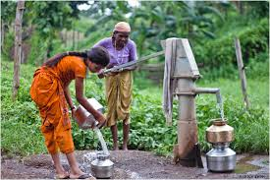
Research Data Workflow Concept

Slide 2
That pump
INTERFACE:
  Needs to act as a commons, as a water cooler, as a go-to resource
  must be user friendly, familiar, viral, extensible (sciency plugins)
  must comply with Metcalfe’s law – be a people magnet
MIDDLEWARE:
  needs to connect to everything.
  Standards-based, lax (in the sense of Postel)
  yet flexible, REST, SOAP, VOOT, CERIF, DataCite, ORCID
  the onus is on the spider in the web
BACKEND:
  scale, scale scale; perform, perform, perform
  Has to be best of breed even though the best components of the moment pop up at will in remote corners and won’t send a sales/account team

Slide 3
THE INTERFACE ease of access
/ word of mouth

Slide 4
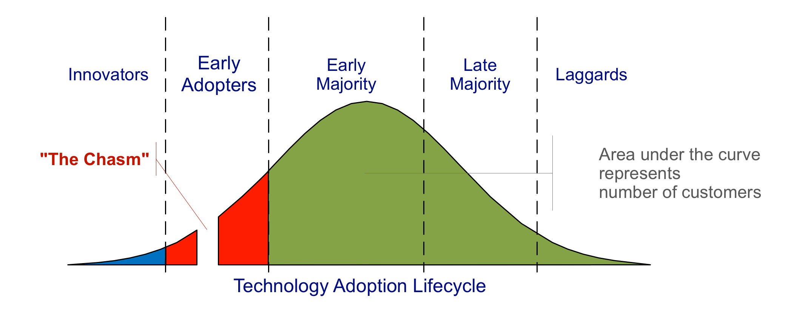
e-Research
Interface. Have we succeeded?
Vocal power users are here – big, but few.
Keywords: metadata, ontologies, grids, HPC, levels-of-assurance.
This area is relatively well funded
“Regular” researchers are here; more modest requirements, but lots more of them. What keeps them up at night? Hard to find out, but a “hit” immediately translates into thousands of happy users.
Users often anonymous to
“the eResearch community”
past this point
Notes:
- the importance of "zero barrier" to entry
- the opportunity you realise by capturing a large user-base is that any changes you make to the service are then available to a lot of users
- the importance of librarians as a stakeholder group is crucial given their roles as digital data custodians
- defining the edges of the problem is hard - eg. The work that's going on in the DLCF to fold in DMP's. I guess this relates to the definition of the "MVP"

Slide 5
Interface. Have we succeeded?
23,000+
~10,000/week
April 2014 – March 2016
April 2014 – March 2016
Zero-barrier to entry
  Free (and on-net)
  Pre-approved 100GB
  Familiar
Fast
Australian
Cross-institution collaboration
Local “real” support
AARNet brand
CloudStor (send) usage – Number of Users (Left); Number of files sent per week Right)
25,000 @ End August
April 2015 – May 2016
April 2015 – May 2016
X
21,000 … 240%
Strong institutional interest …
CloudStor (share) usage – Number of Users (Left); Volume of storage (Right, Terabytes (TBs)

Slide 6
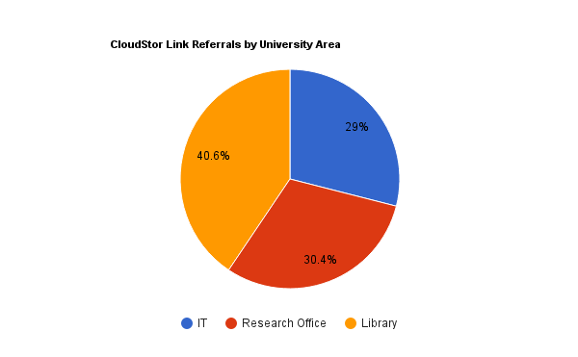
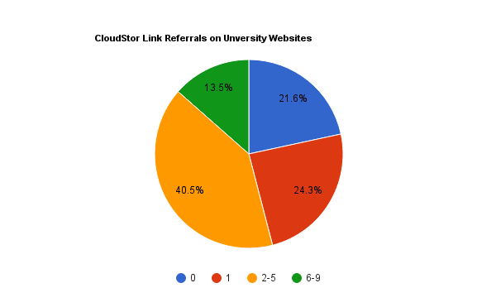
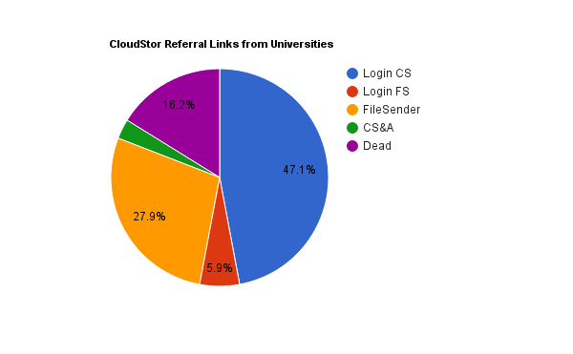
Notes:
https://aplwiki.aarnet.edu.au/display/~ingrid.mason@aarnet.edu.au/CloudStor+Referral
Links Piechart (at bottom) based on data from VIC, ACT & part of NSW (roughly representative)

Slide 7
THE INTERFACE
“sciency” extensibility case #1: analysis

Slide 8












Jupyter notebooks as a plugin:
SWAN Integration Architecture
Clients
SWAN
REST API
namespace
view
Server
namespace
view
Storage
8

Slide 9

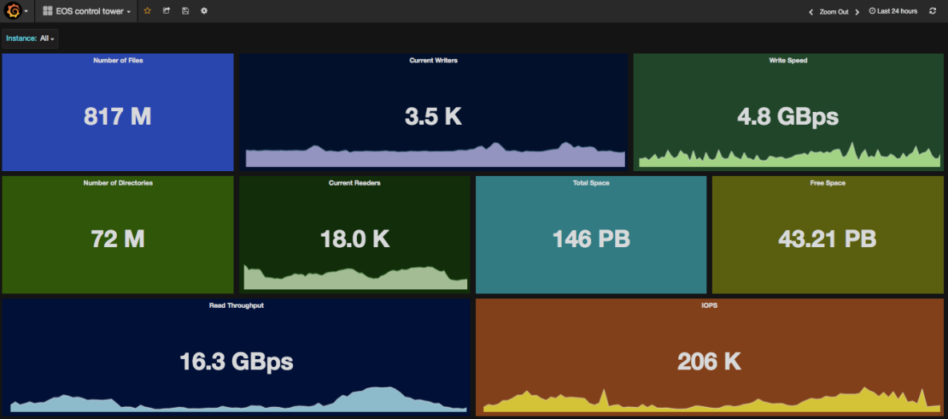
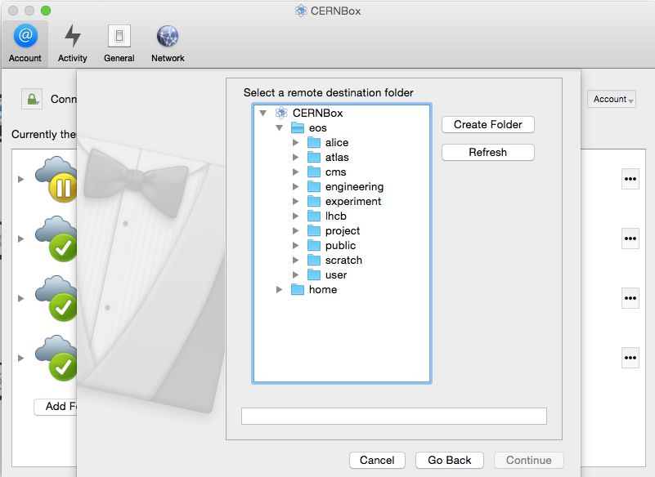

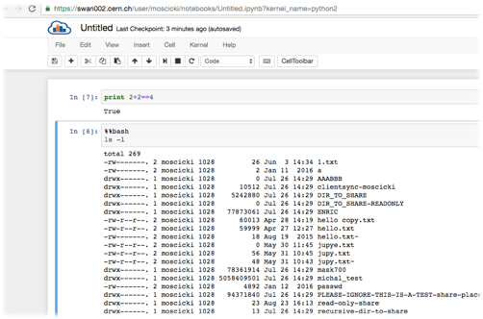
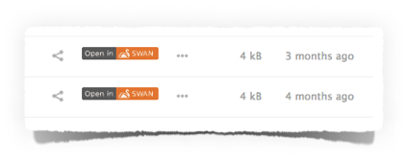
Shared file namespace and sync/share integration with existing repositories
9

Slide 10
THE INTERFACE
“sciency” extensibility case #2: publishing

Slide 11
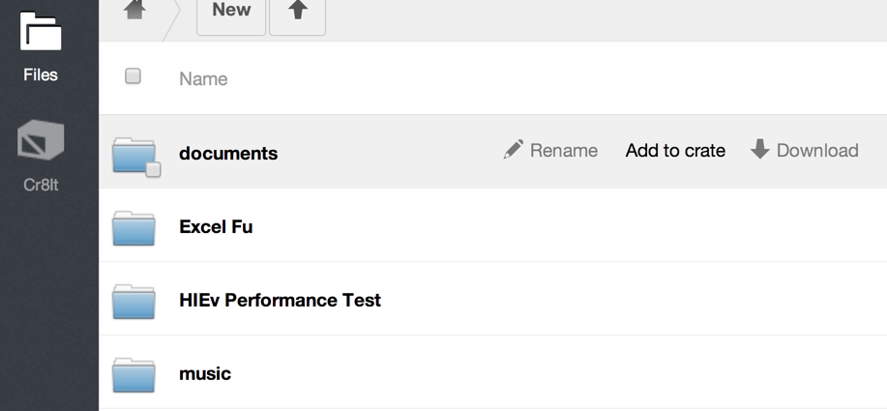
end-of-grant data linking as a plugin: CR8IT

Slide 12
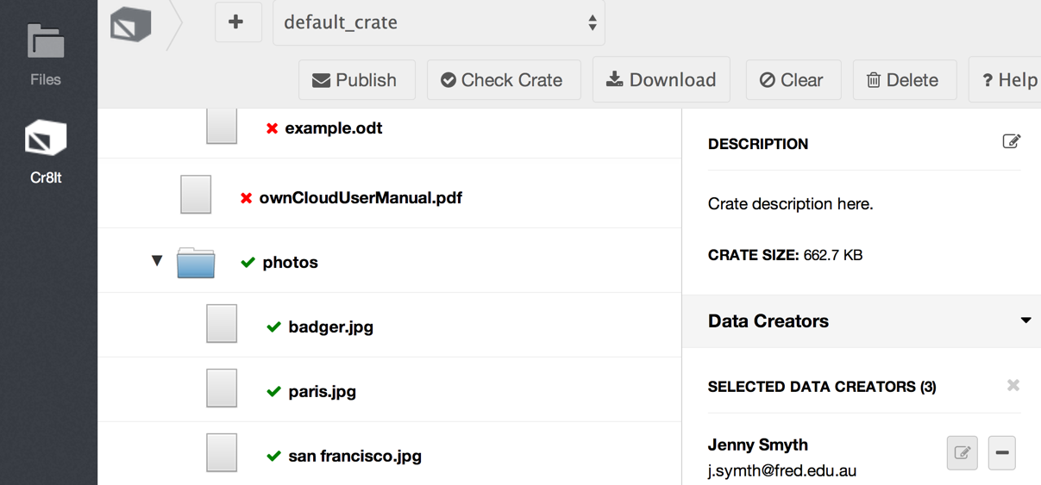
Publish

Slide 13
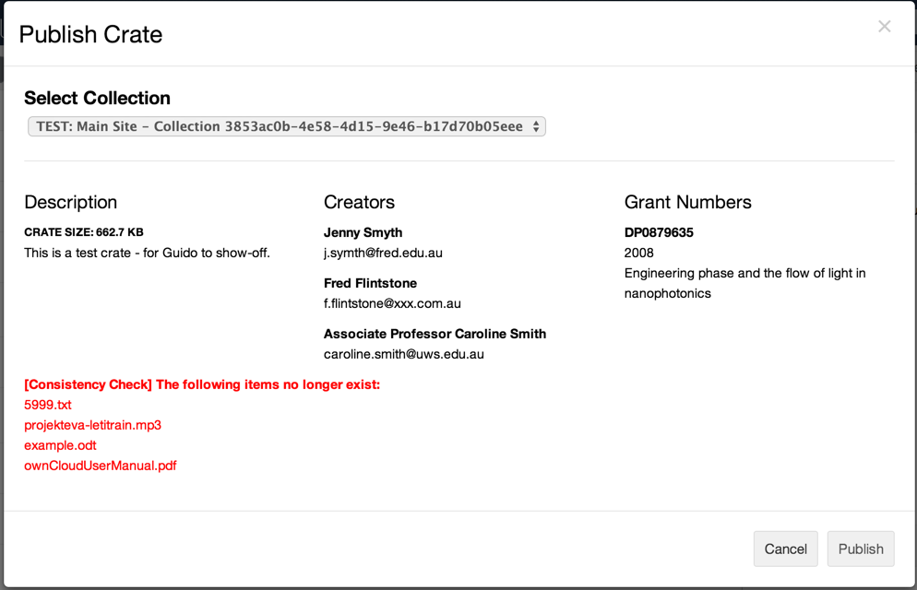

Slide 14
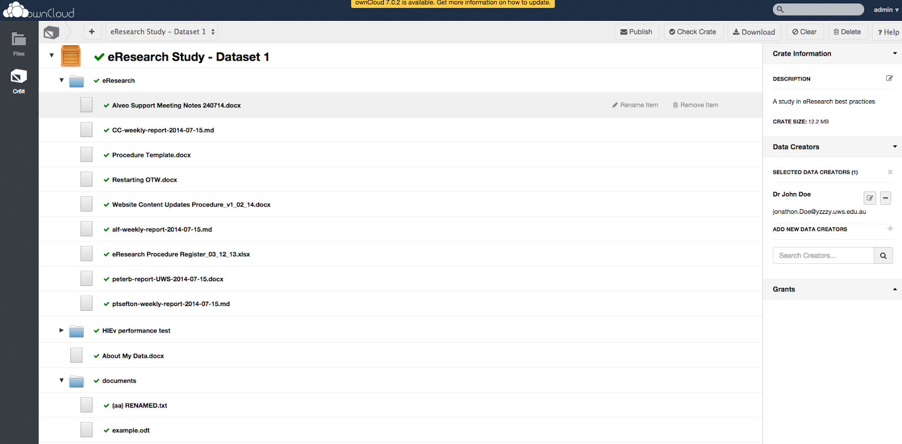
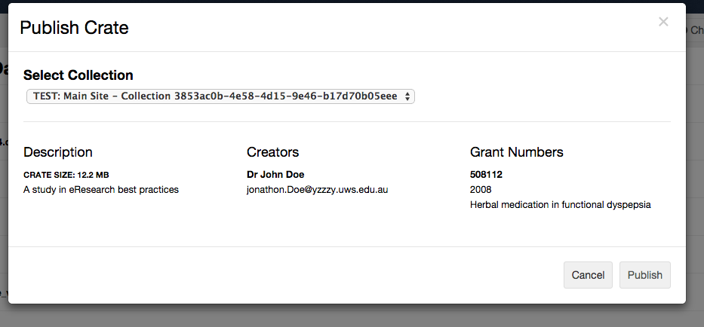

Slide 15
THE MIDDLEWARE standardised glue

Slide 16
What do we need to glue?

Slide 17
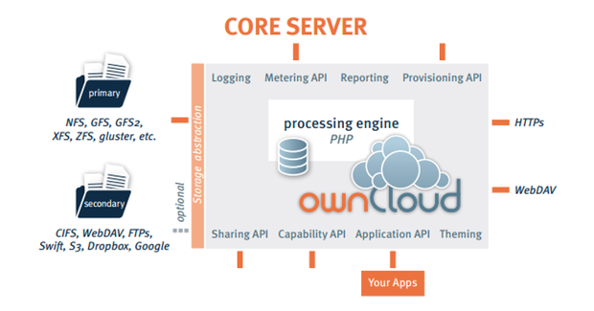
Lots of storage interop out of the box
Notes:
Provisioning API already talks SAML, we are now hacking automation into our implementation of group support (VOOT/CERIF/OAI?)

Slide 18
Metadata Interoperability: WIP
Full CRUD metadata engine,
    including schema support* (DeIC)
Mounting ownCloud volumes on OpenStack VMs
    using Manila (NeCTAR/UNIMELB)
Use of ORCID as a login augmentation source (DeIC)
AuthN through SAML or social login (native)
Group awareness present; Group API/protocol next (VOOT? CERIF? – your opinion counts. RDS/AARNet)
*simple tagging available out of the box

Slide 19
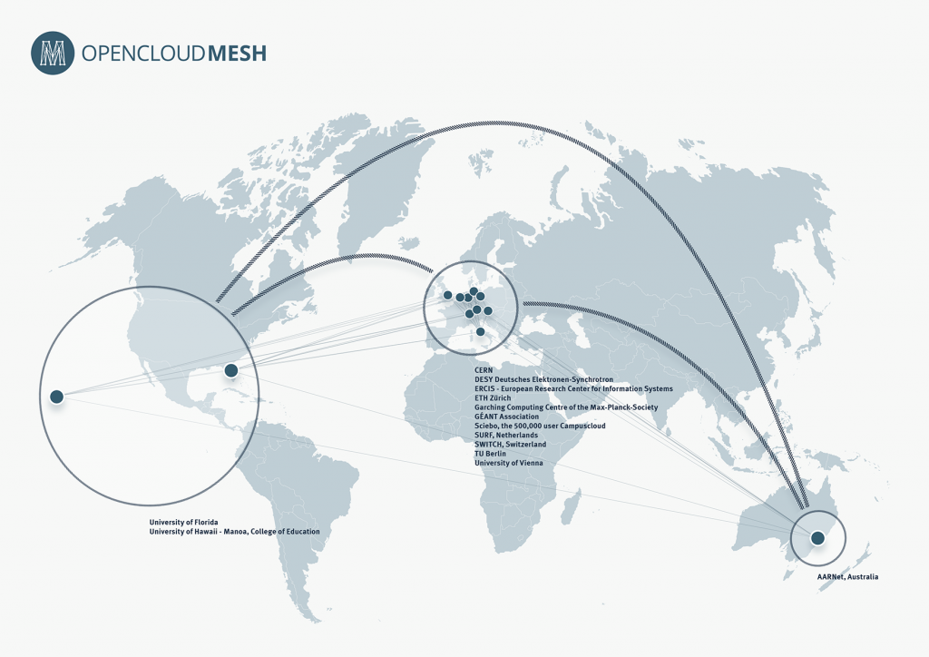
Notes:
Proudest achievement: opencloudmesh; doesn’t just technically implement open-ness but also shows willingness of vendors to live the open dream. ownCloud, pydio, nextcloud, possibly powerfolder. Talking to seafile.

Slide 20
THE BACKEND link speed

Slide 21
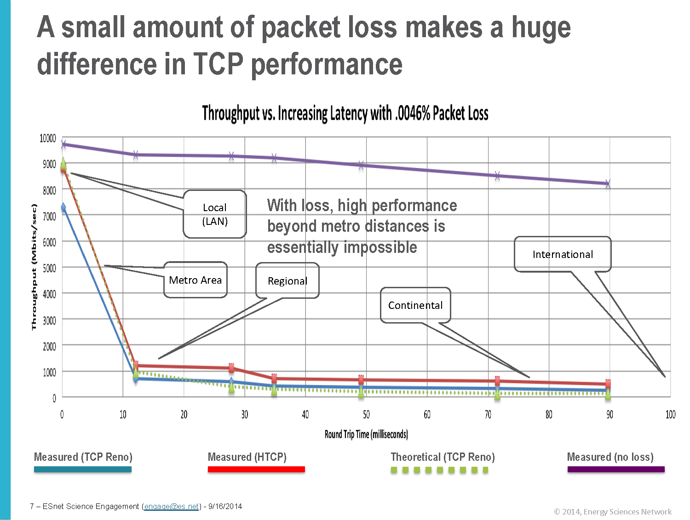
What’s so hard about performance?
21

Slide 22
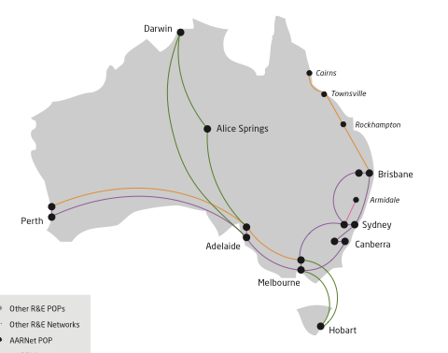
…so nodes must go where the science is
(Slide courtesy of Dr. Rhys Francis)
Extended AREN
$40M
ANDS $69M
Offices
Activities
NBN Blackspots
Tools $12M
ARCS/ANDS
Tools $12M
eRCI
Pawsey
150 Tf/s
>1000Tf/s
Digital Labs
$12M eRCI
VLSCI $100M
NCI
200 Tf/s
>1000Tf/s
Cloud systems $23M eRCI
HPC $130M
Petascale
Specialised
10-15 projects
Data Stores
$50M RDSI
5-10 projects
Data Net

Slide 23
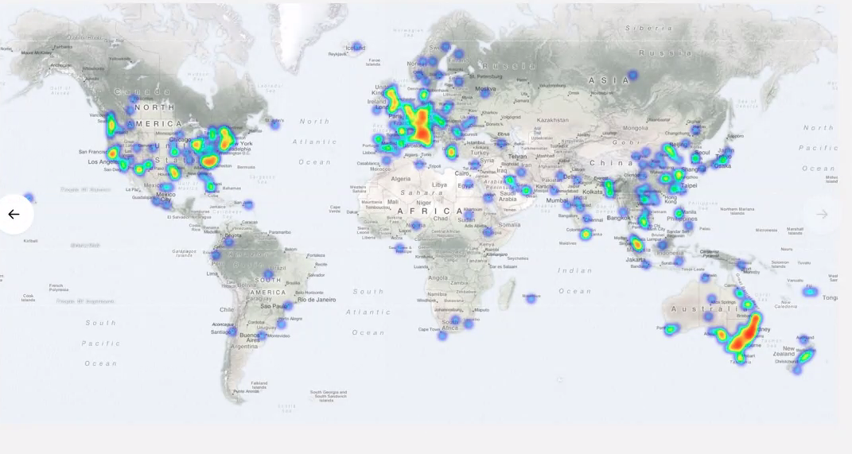
…and we’d like to scale further…
…that really is a bison genetics researcher in Mongolia
Notes:
If we could put nodes all over the world, and potentially do so in a shared fashion, that would be even more excellent. We’ll happily vend in ours.

Slide 24
THE BACKEND scaling
/ best-of-breed lego

Slide 25









Bird / BGP Anycast
/ Galera / MaxScale
/ H-TCP
Notes:
CloudStor is now containerised with Docker
728 cores, 4.3 TB of RAM, and 3 PB of storage
Managed via Ansible, Shipyard, and Swarm
Testing Kubernetes for full orchestration
Can do live non-disruptive updates
Disable new connections to old container, let old connections finish with new connections going to new containers
No new servers or downtimes needed
We should have done this 18 months ago

Slide 26
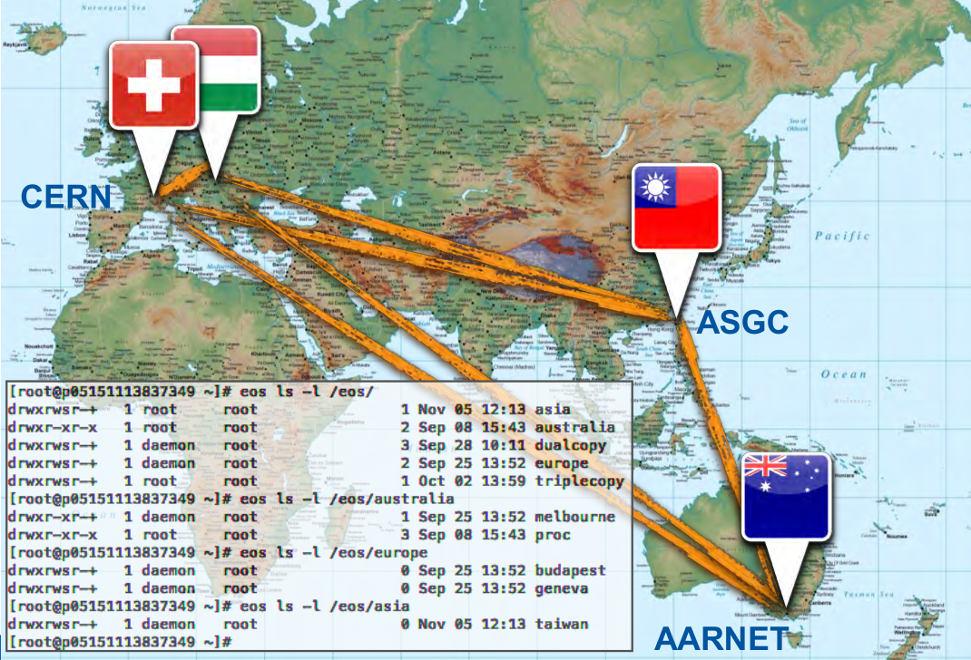
EOS: distributed flat namespace, Gbit/s ingest
…even if we stretched the setup to a geography spanning CERN, ASGC Taipei and AARNet (>300ms)

Slide 27
CERN Eos For Storage
Proven to scale to near the Exabyte range
Understands tape
Allows us to present CloudStor data via other tools
  Authenticated rsync
  FTP/SFTP
  Aspera? GridFTP? OPeNDAP?
  …mould the tool around existing disciple workflow

Slide 28
Other Things We’re Doing Now
MariaDB MaxScale for database load balancing
      Waiting with bated breath for key/hash based sharding
Replace memcache with redis
On-demand / load-responsive Docker containers
VXLAN into a MPLS national network for security
Notes:
The setup right now: mariadb with galera and maxscale is the db, haproxy is the http proxy front end, H-TCP (LFN optimised) between proxies and apache; apache with the “event” mpm is still the web server. php-fpm of course for the php apps (ownCloud)
Redis will act as the new memcache – it’s an improvement because it's replicated, meaning session and other cached elements are visible across the entire cluster. So it's not only state persistence within a data centre, but across the whole country. If a user were to have network issues, and be redirected to another anycast host somewhere else in the country, their session stays alive across any ownCloud server/container.
We're also using it for the cdn soon, caching objects as large as 50MB
We haven't broken up the apps into their own containers yet; that’s on the todo and depends on vxlan being fully functional

Slide 29
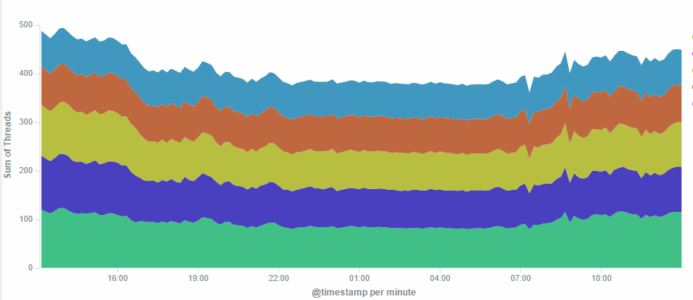
Galera at work
Load spreads evenly
Least contention for locks

Slide 30
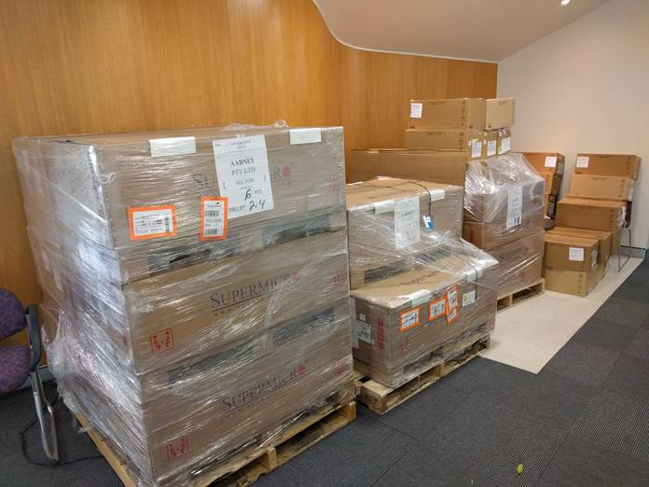
Learn to stop worrying and love the PB
“is that all 2PB is today?”
The boxes at the back of the photo at the disks packed safely for travel.
480Gbps of potential network bandwidth
roughly a million IO operations per second as designed
…and surprisingly cheap…

Slide 31
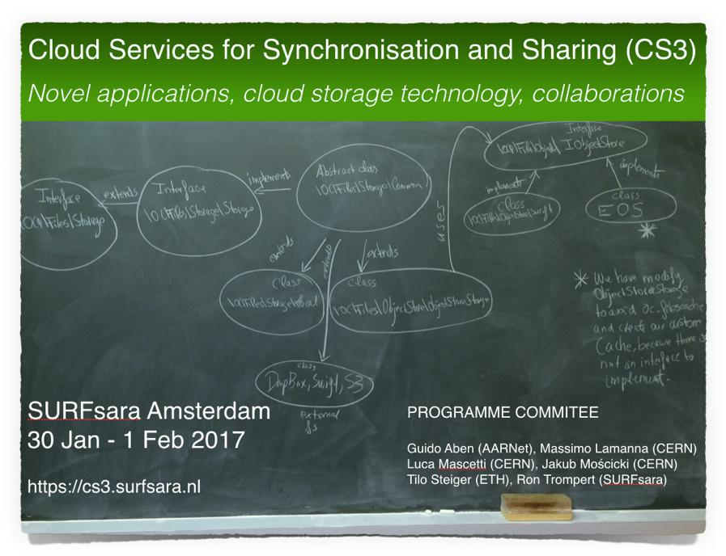




CS3
Workshop
Series

